Slide 1




ASDW COUNCIL OF STUDENT LEADERS PRESENTS
AI IN ASDW SCHOOLS
OUR RESEARCH, RECOMMENDATIONS, AND REPORT
Notes:
violet
introduction

Slide 2
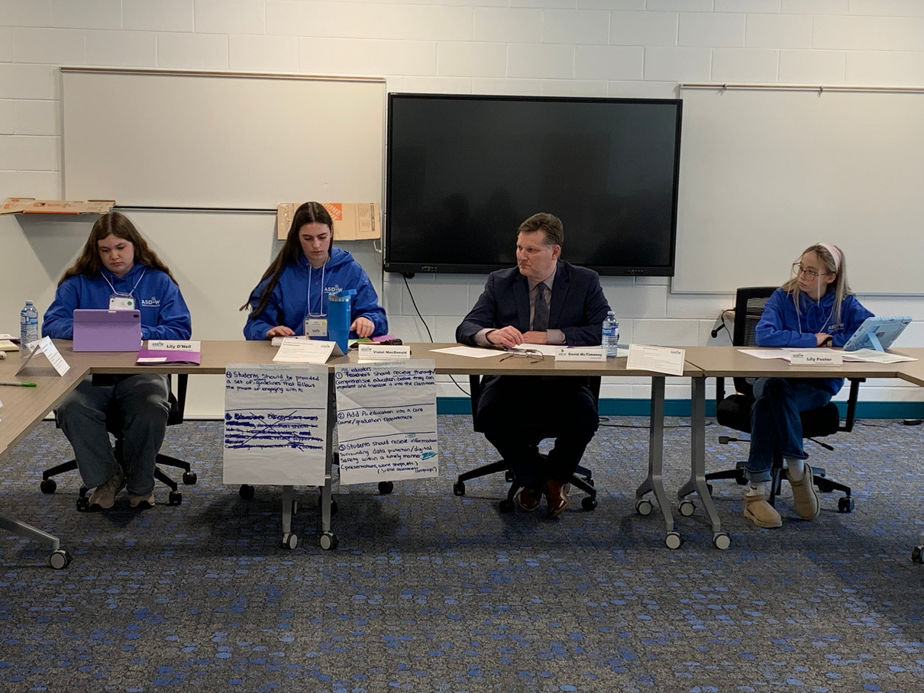
WHO WE ARE
THE COUNCIL OF STUDENT LEADERS
THE COUNCIL OF STUDENT LEADERS IS A STUDENT-LED INITIATIVE IN WHICH STUDENTS COLLABORATE THROUGHOUT THE SCHOOL YEAR TO IMPROVE SOME ASPECT OF SCHOOL LIFE FOR THEIR FELLOW STUDENTS.
Notes:
addie

Slide 3

OPENING ACTIVITY
AI DETECTION AT A GLANCE.
Notes:
lily
-quick activity to compare a couple of AI vs not (small writing excerpt, a picture, and an email).
-Have them raise hands to indicate a vs b.
-It ties in because this highlights our reasoning behind choosing this research methodology: that there is a lack of understanding, and we wanted to get research to support this claim.

Slide 4


OPTION A
OPTION B
Notes:
À is AI, B is human

Slide 5
“I REMEMBER VISITING THE GRAND CANYON AS A CHILD. THE SHEER SIZE OF IT WAS OVERWHELMING, AND I FELT A MIX OF AWE AND FEAR STANDING ON THE EDGE. MY DAD HELD MY HAND TIGHTLY—REMINDING ME OF THE SAFETY RULES AS WE TOOK IN THE BREATHTAKING VIEW.”
“THE GRAND CANYON IS A VERY LARGE AND IMPRESSIVE GEOLOGICAL FORMATION. IT ATTRACTS MANY TOURISTS EVERY YEAR. PEOPLE WHO VISIT THE GRAND CANYON OFTEN FEEL AMAZED BY ITS SIZE AND BEAUTY. SAFETY IS IMPORTANT WHEN VISITING, AND IT IS ADVISED TO FOLLOW ALL SAFETY RULES.”
Notes:
Red is human, blue is AI

Slide 6
OUR GUIDING QUESTION
WHAT ARE STUDENTS’ EXPERIENCES USING AI, AND HOW IS AI HELPING OR HINDERING STUDENTS’ LEARNING?
Notes:
Addie

Slide 7




QUESTIONS TO GUIDE SPECIFIC RESEARCH
3. How can we evaluate existing resources and then how can we increase awareness and promote the resources that will be most beneficial to high school students?
1. How are students using AI as a part of their education and how do they feel about it?
4. How can we show students the positive and negative effects of AI on students’ digital literacy skills (critical thinking, cyber security/privacy, and analytical thinking)?
2. Do students know how to use AI safely and understand the resources they are using?
Notes:
Lily

Slide 8
DATA COLLECTED
WORLD CAFE, SURVEY, TEACHER INTERVIEWS
Notes:
Addie

Slide 9

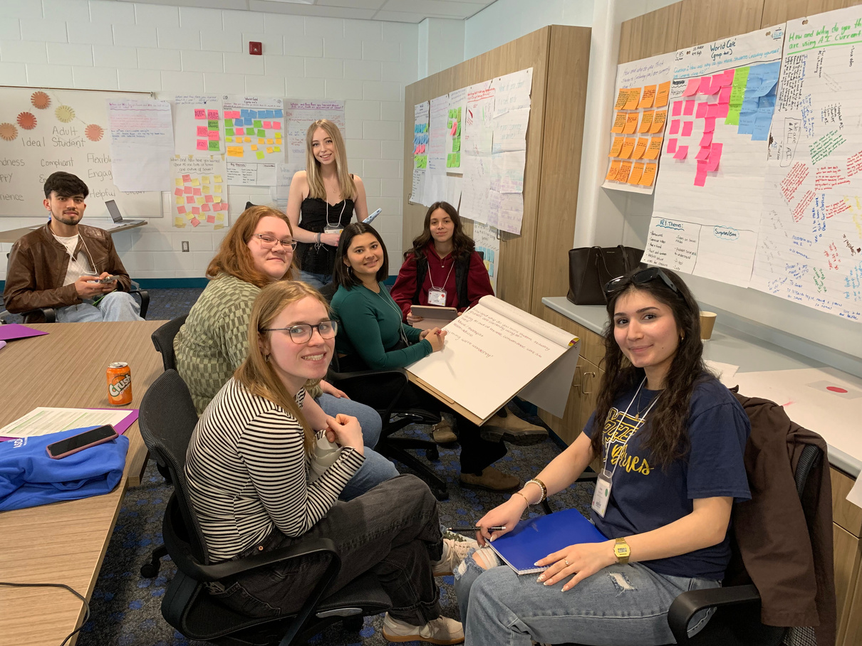
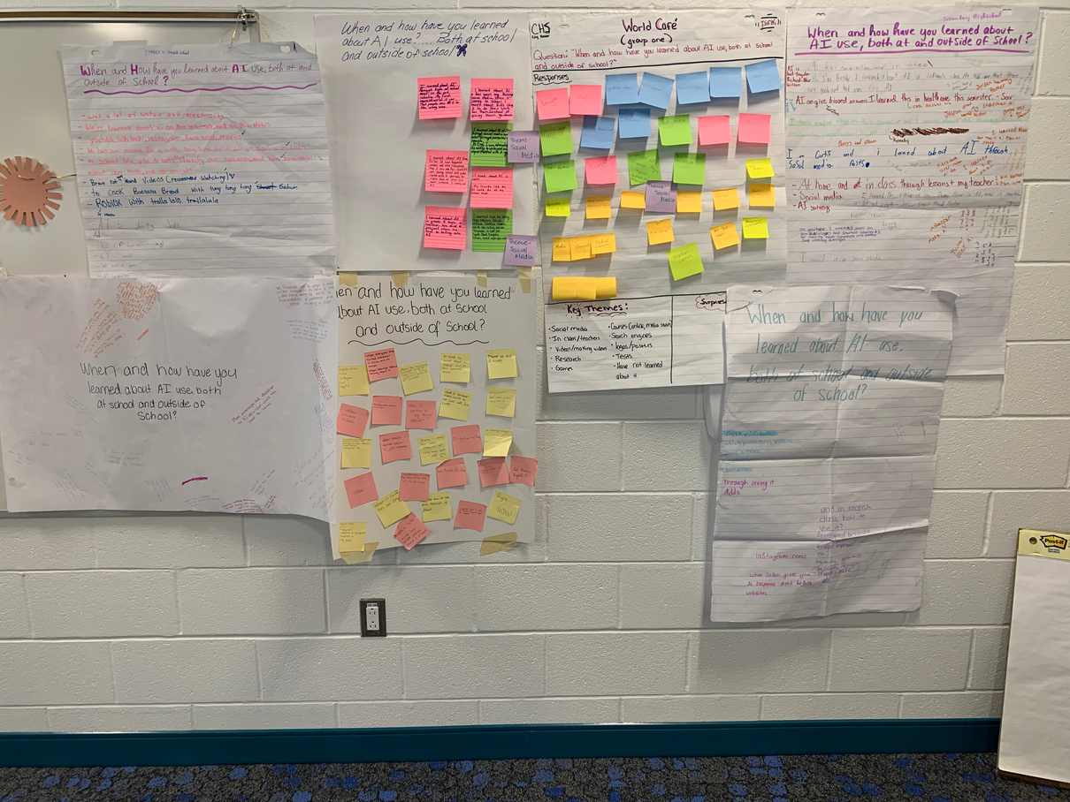
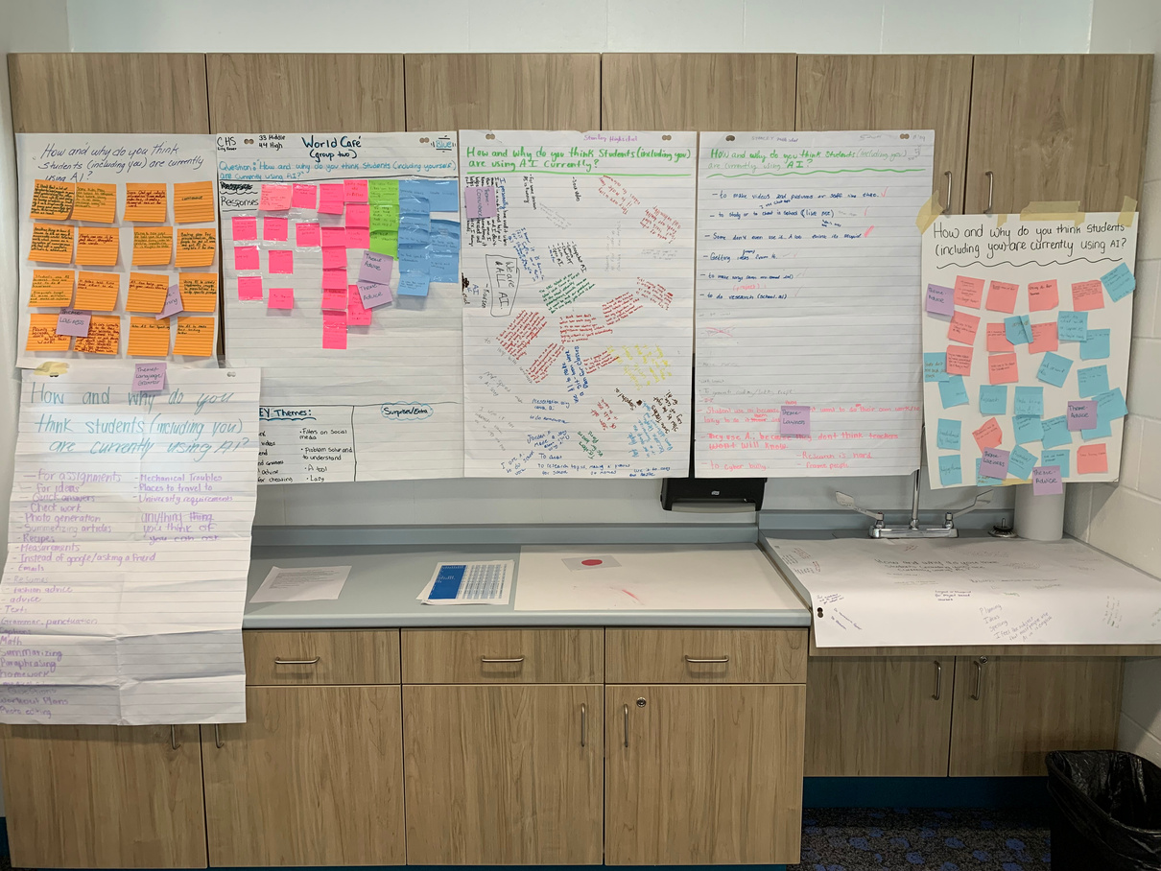
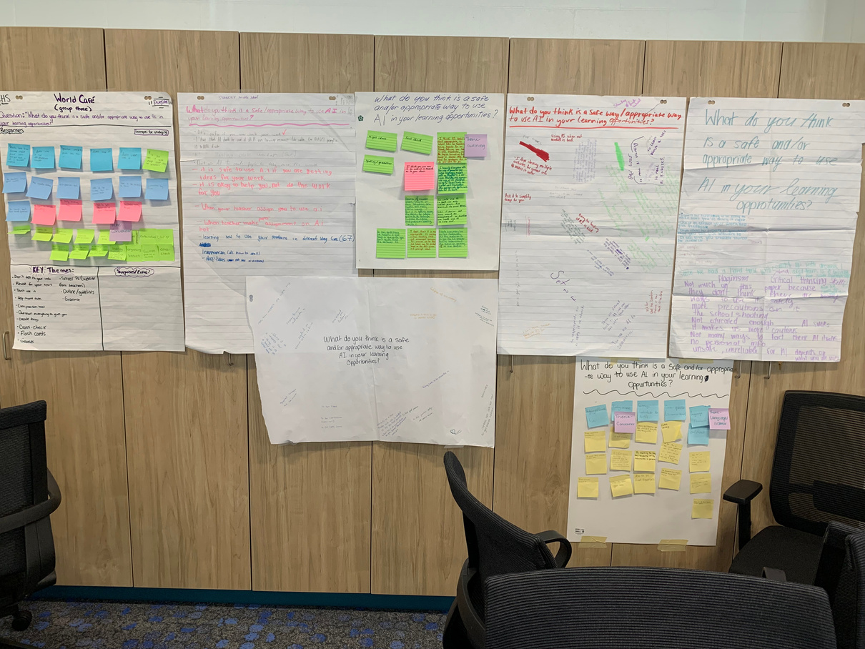
WORLD CAFE
A WORLD CAFE IS A GROUP ACTIVITY WHERE PEOPLE DISCUSS A TOPIC IN SMALL GROUPS AND ROTATE BETWEEN TABLES, BUILDING ON EACHOTHERS IDEAS TO CREATE SHARED UNDERSTANDING.
SAMPLE SIZE: 179 STUDENTS
Notes:
addie

Slide 10
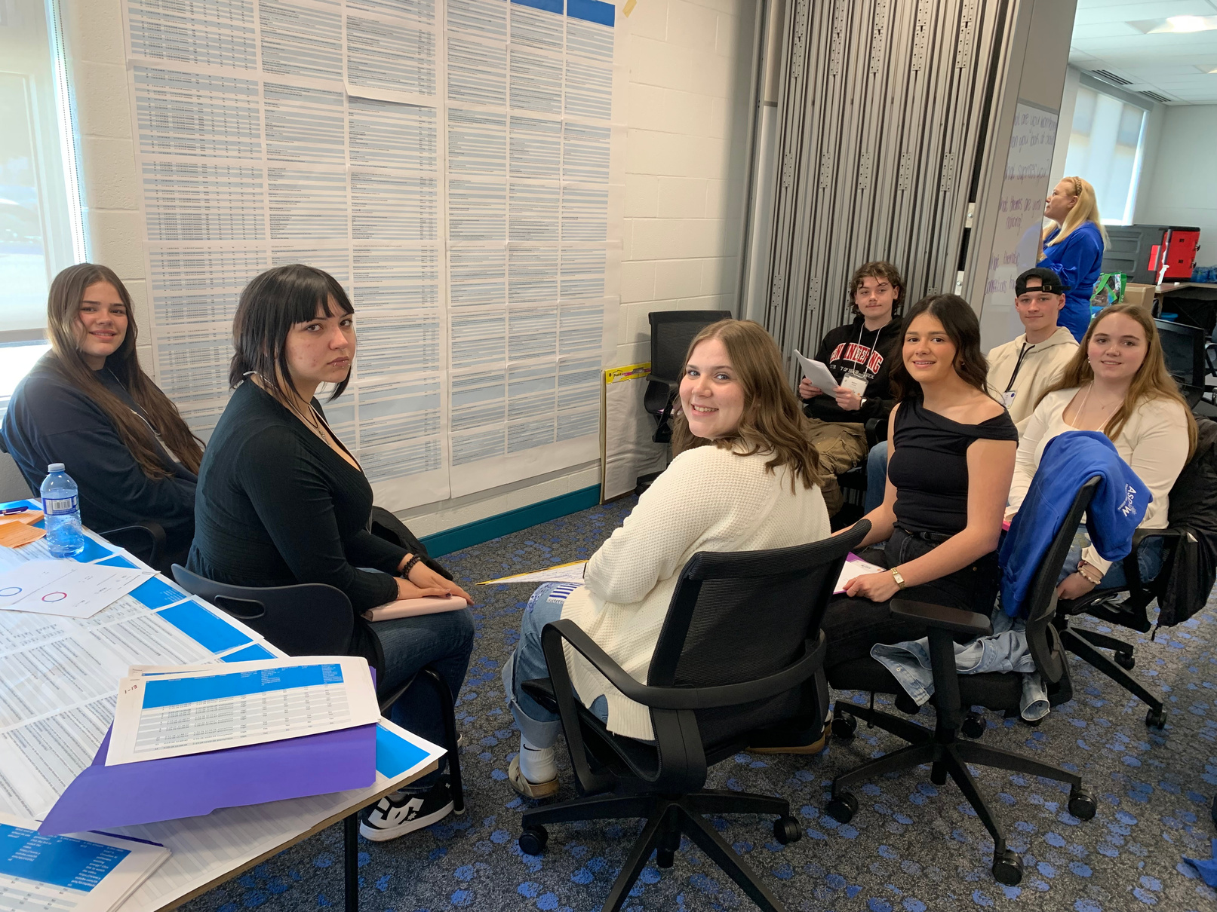
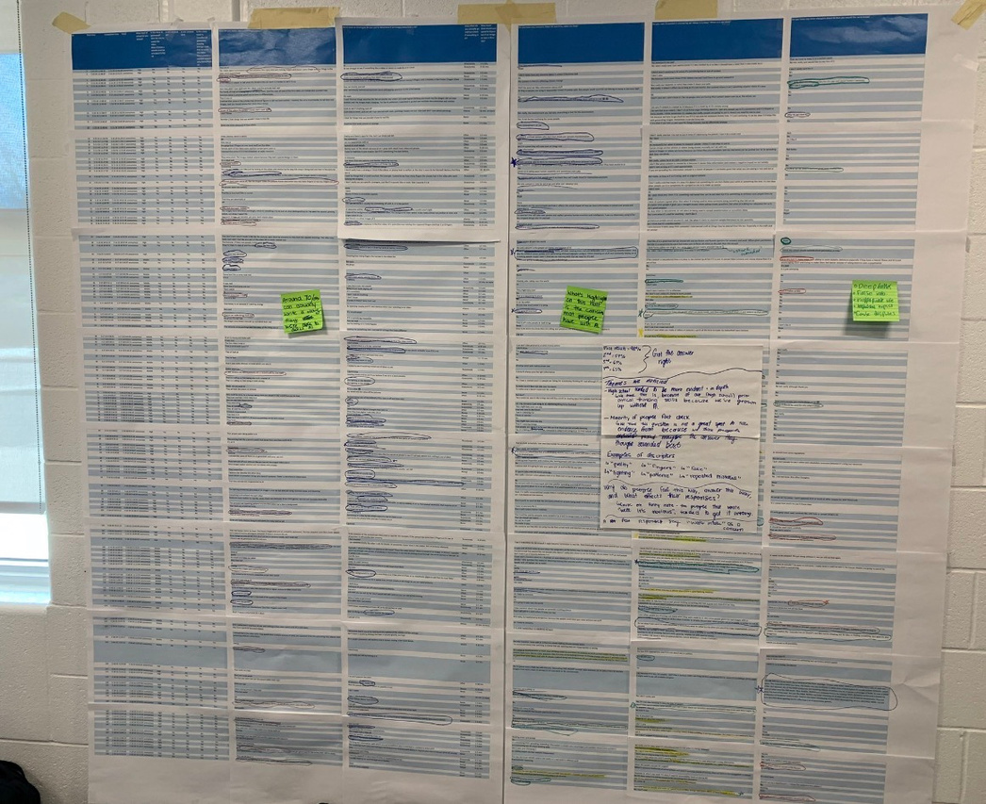
STUDENT SURVEY
SAMPLE SIZE: 153 STUDENTS
Notes:
violet
students completed the survey anonymously at the end of the world cafe session. the survey asked students to detect AI generated materials as well as how students are incorporating it into their lives and their thoughts on AI as a whole.
Students from canterbury High School, Fredericton High school, Chipman forest avenue, stanley consolidated school, woodstock high and leo hayes high school participated
there was a total of 103 high school students and 50 middle school participants. it was important that we included middle school in the data because ai use is not limited to them.

Slide 11
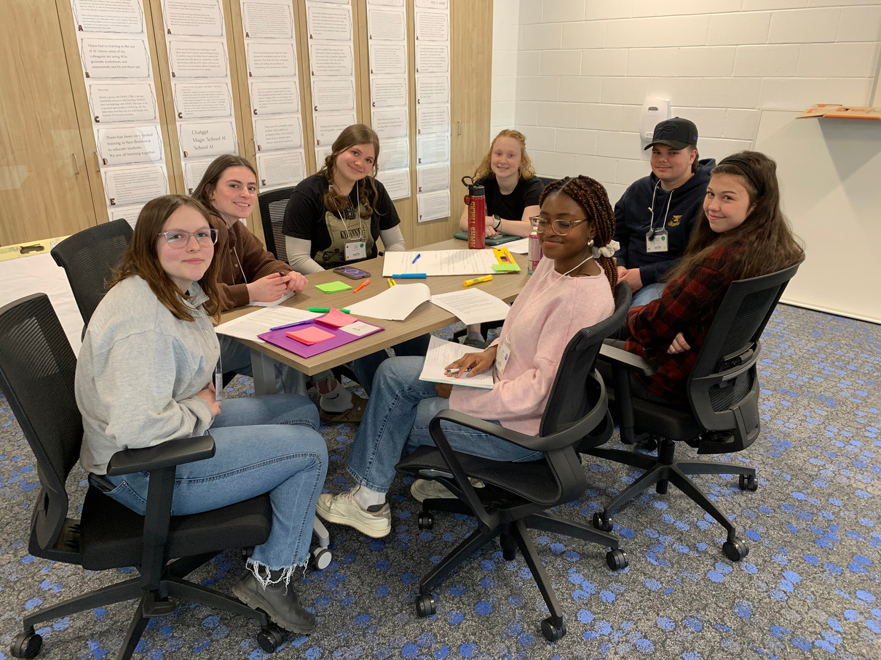
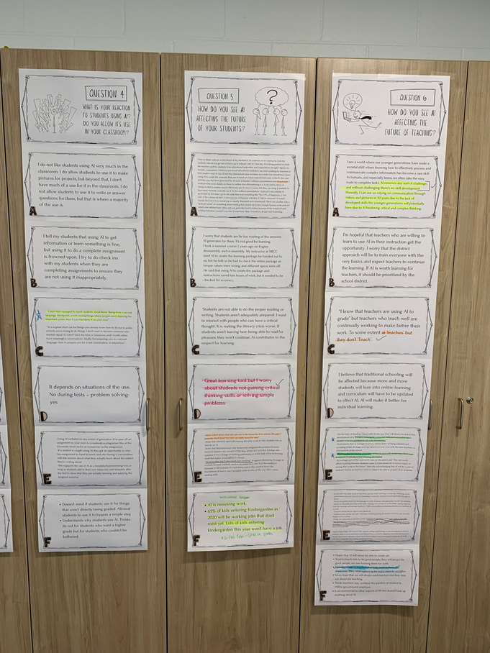
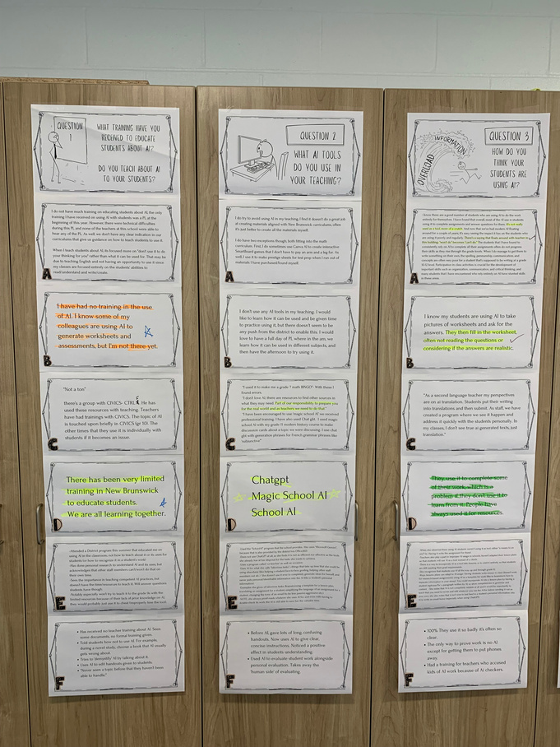
TEACHER INTERVIEWS
SAMPLE: TEACHERS IN DIVERSE SUBJECTS ACROSS DIFFERENT SCHOOLS.
SIZE: 6
ANONYMOUS
CONDUCTED BY COUNCIL MEMBERS
Notes:
lily
-conducted in early/mid March with teachers across various schools, who teach various subjects. Anonymous, and we asked 6 questions. The results we got were by and large supportive of the use of AI, but only when used correctly, and they want more education on how to teach students how to use this tool correctly as well.

Slide 12
PRELIMINARY THEMES PULLED FROM DATA
1. Students are primarily being exposed to AI through social media, which raises concerns of being able to distinguish between AI used for ‘fun’ or ‘serious/influential‘ topics
3. Although teachers agree that AI should be taught (in some capactiy) to prepare students for adulthood, they feel unequipped to teach, use, nor incorperate into the classroom.
2. Students lack media literacy when detecting AI, and teachers identify that it is negatively impacting students‘ academic progress (due to improper use of the tool)
4. AI is being used out of convenience fo students to complete a myriad of tasks like outlining, finding sources, medical advice, or emotional support, without understanding the implications.
Notes:
Lily

Slide 13



RECOMMENDATIONS
BASED OFF OF THEMES FOUND IN DATA.
PART OF OUR FINAL REPORT THAT WE PRESENT TO THE DISTRICT EDUCATION COUNCIL.
Notes:
violet

Slide 14
1
ALL EDUCATORS SHOULD RECEIVE COMPREHENSIVE EDUCATION FROM TRAINED FACILITATORS BEFORE THEY CAN IMPLEMENT AND TRANSLATE IT INTO THE CLASSROOM.
Notes:
violet

Slide 15
2
ADD AI EDUCATION INTO A CORE COURSE/GRADUATION REQUIREMENT.
Notes:
violet

Slide 16
3
STUDENTS SHOULD RECEIVE EVIDENCE-BASED INFORMATION SURROUNDING DATA PROTECTION/DIGITAL SAFETY WITHIN A TIMELY MANNER (PRESENTATIONS, WORKSHOPS, AWARENESS CAMPAIGN. ETC)
Notes:
violet

Slide 17
4
STUDENTS SHOULD BE PROVIDED A SET OF ACADEMIC GUIDELINES AND TOOLS THAT FOLLOWS THE PROCESS OF ENGAGING WITH AI.
Notes:
violet

Slide 18
CONCLUSION
OUR REPORT HAS BEEN FINALIZED AND WILL BE SHARED WITH EDUCATION STAKEHOLDERS SOON.
THIS IS A VITAL STUDENT VOICE INITIATIVE THAT MAKES A DIFFERENCE FOR STUDENTS AND THE EDUCATION SYSTEM.
THANK YOU TO THE SUPERINTENDENT, THE DEC, AND DISTRICT STAFF FOR YOUR ONGOING SUPPORT OF THE COUNCIL OF STUDENT LEADERS.
Notes:
violet

Slide 19
PRESENTATIONS
QUESTIONS?
Notes:
All

Slide 20
PRESENTATIONS
THANKS FOR
LISTENING
Notes:
All

