Slide 1

27/28 Multi-Year
Infrastructure Plan

Slide 2
Projects Underway
Carleton North K-8 - Land Acquisition Complete and Initial Design for Tender
Liverpool Elementary and Forest Hill Elementary Replacement - Land Acquisition complete and Initial Design for Tender
George Street Middle School Replacement - Land Acquisition
Saint Mary’s Academy (K-12, Edmundston) – Addition to School; Design Completed and Ready for Tender
Fredericton South-East K-8 School – Land Acquisition
3 Oromocto K-8 Schools – Land Acquisition

Slide 3
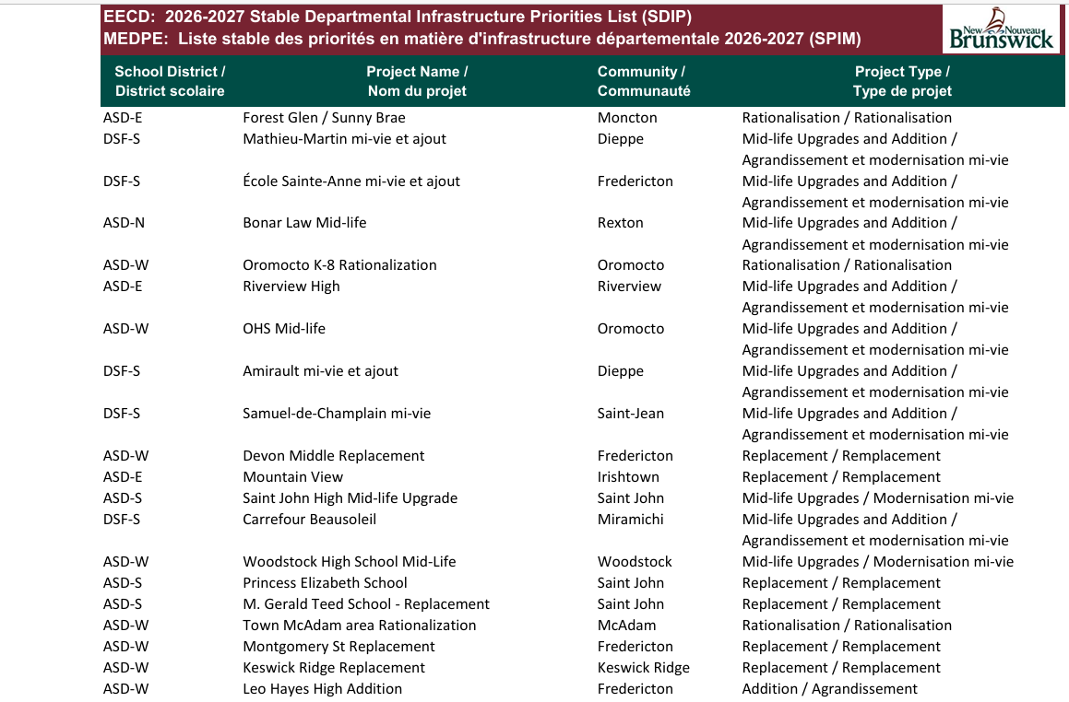

Slide 4
Current Projects on the SDIP
#5 Oromocto K-8 Rationalization: 3 New K-8 Schools (already announced)
#7 Oromocto High School Midlife Project
#10 Devon Middle School Replacement
#14 Woodstock High School Midlife Project
#17 Town of McAdam area Rationalization
#18 Montgomery Street Elementary School Replacement
#19 Keswick Ridge School Replacement
#20 Leo Hayes High School Addition
These projects do not have to be resubmitted to the Minister of Education and Early Childhood Development.

Slide 5
Change to SDIP Submission
Propose changing the Keswick Ridge School Replacement to include Keswick Valley Memorial School and re-establish as a K-8 Rationalization project as recommended in the Ernst and Young report of March 31, 2026.
Action: Motion from Council to revise the SDIP submission if agreed

Slide 6
Major Capital Projects for Consideration
With the recent Ernst and Young Report on Garden Creek Elementary School now complete and recommendations within, ASD-W staff recommends Council to include a K-5 replacement school for Garden Creek Elementary School and Kingsclear Community School as #1 on the SDIP submission this year.
Knowing that EECD welcomes 5 submissions in total and annually, ASD-W staff recommends the following 6 projects be considered.
    John Caldwell School Replacement
    Gagetown School Replacement
    Plaster Rock School Review K-12 Rationalization
    Minto/Chipman Schools Building Assessment to assess a K-12 school in each community.
    New City of Fredericton High School Project
    Barker’s Point Elementary School Replacement
Action: Motion from Council on the order for submission letter of our requests to be scored and prioritized for the SDIP.

