Slide 1

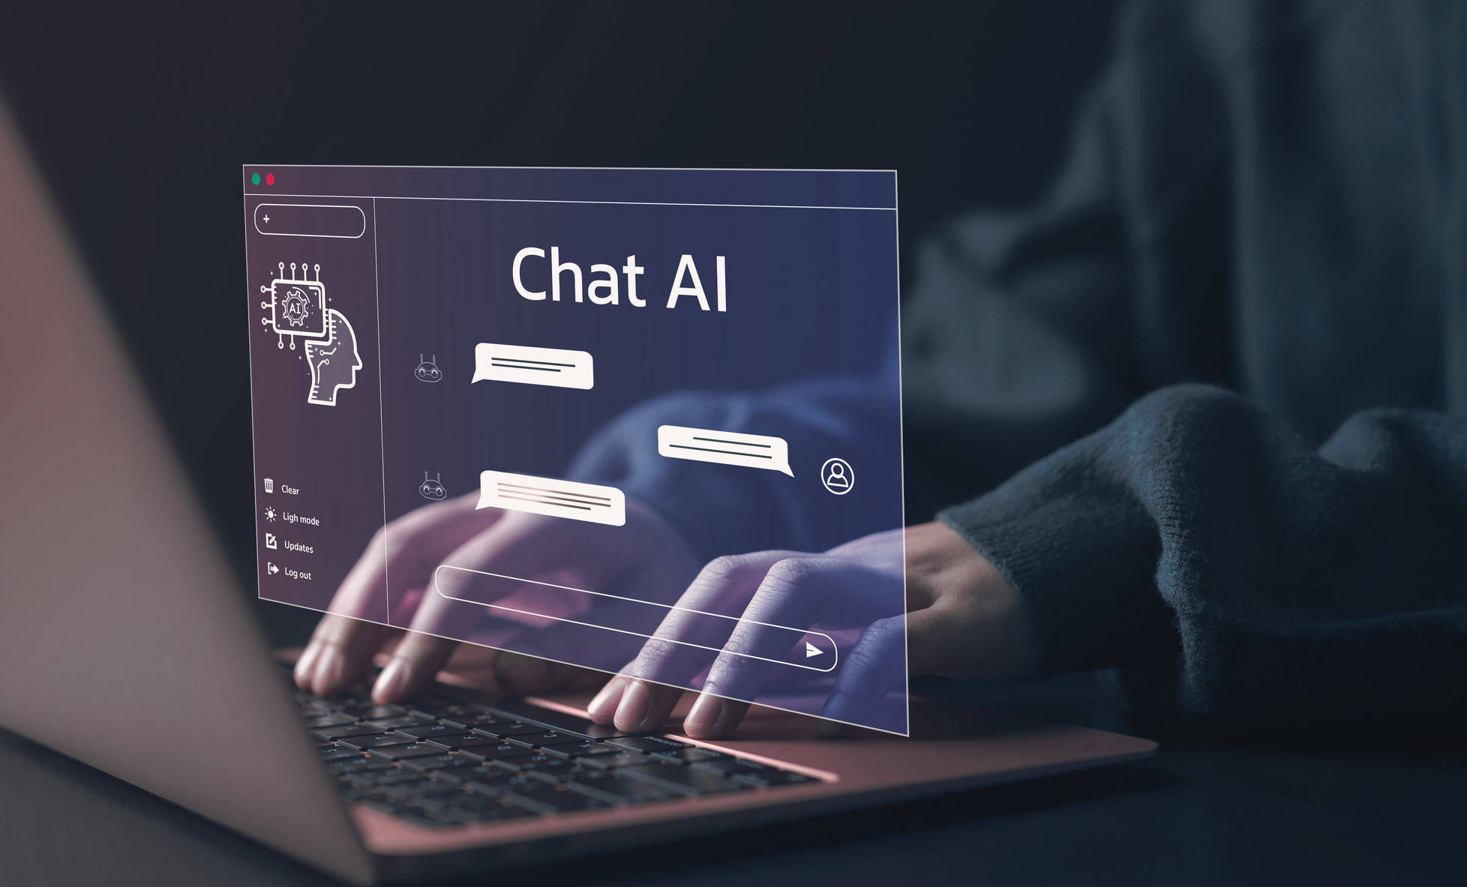
AI USE IN
ASD-W
APRIL 2026

Slide 2



Our Approach to AI
Awareness & Understanding
Collaboration & Capacity Building
Integration

Slide 3
Engaging with AI: With, Through, About, Without
With AI - Students use AI as a thinking partner: generating ideas, getting feedback, exploring options. The student directs the work and makes the final calls.
Through AI – Students learn in environments where AI shapes the experience – adaptive platforms, recommendation systems, interactive tools. Understanding how these shape learning is part of the work.
About AI – Students examine how AI systems are built, what data they draw on, where they can mislead, and what their broader effects are – on society, on fairness, and on the environment.
Without AI – Students build independent skills and original thinking. Some learning goals are best reached without automated support. This is not a rejection of AI – it is a recognition that strong independent thinking makes better AI use possible.

Slide 4



AI in Education Journey
2023
EECD reviews Policy 311, begins research around AI in Education, ASD-W consulted.
January 2024
EECD publishes updated Policy 311. ASD-W updates sign-off forms, etc. (effective 2024-25 school year).
July 2024
EECD publishes their Recommended Approaches to Generative AI
August 2024
ASD-W drafts Guidelines for AI Use.
September 2024
EECD releases amendments to Policy 311.

Slide 5
November 2024
AI in Education Journey
ASD-W updates Guidelines for AI Use to include a list of approved platforms. Shared internally.
January 2025
ASD-W updates guidelines based on internal feedback. The ASD-W Guidelines for AI Use and Approved AI Platforms is shared with the system.
July 2025
Policy 311: Apprendix D - Annual Consent for Use of Approved Artificial Intelligence Tools is created.
August 2025
ASD-W AI Working Commitee established.
Ongoing
Development of resources and supports for educators as they navigate AI use in education.
Upcoming
EECD is beginning work to specifically address AI use in Policy 311; edits to curricular outcomes to include AI use.

Slide 6



ASD-W AI Committee
A district-level Subject Coordinator AI Committee collaborates to explore and align approaches for integrating artificial intelligence across curricular areas.
ASD-W Technology PLC
Supports & Resources
The ASD-W Tech PLC is a network of teachers who test and implement new technologies, including AI. They share effective practices and provide feedback to guide district decisions.
Other Professional Learning
Ongoing formal and informal professional learning
being provided to educators

Slide 7

Upcoming Learning and Events
Advancing AI Leadership
Deepening implementation; Strengthening Governance and ethics
April 22
New Brunswick Digital Learning Summit
Collaboration event: Aligning educational strategies with the demands of the modern workforce
April 23
Atlantic Innovative Education Explore Summit
Designed to advance STEM, AI, and purposeful technology integration
May 7-8
AI in Education (ASD-W)
Exploring the role of AI in education and how it can support teaching and learning.
June 5 (tentative)

Slide 8


