Slide 1



ASD-W
EDI Efforts and Next Steps
April 9th, 2026

Slide 2

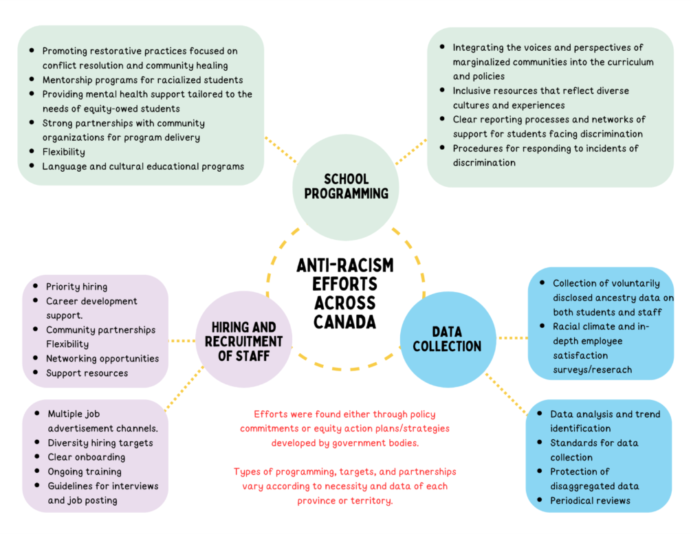
Identifying gaps
Jurisdictional scan on anti-racism and equity-focused efforts in education across Canada
  Onboarding process
  Data collection (qualitative and quantitative)
  Review of hiring procedures
  Building staff capacity through resources and training
  Strengthen partnerships
  Reporting

Slide 3




  Phase 1
Foundation and environmental scan
Why policy?
  Phase 2
  Structure
  Funding
  Commitment
  Alignment with other provinces and Districts
  #1 thing brought up by partners...
  Policy + additional appendices (Flowchart)
Stakeholder engagement and policy development
  Phase 3
Policy rollout and capacity building
We are/were here!
Phase 4
Sustainability and continuous improvement

Slide 4

CURRENT EDI WORLD
  Ongoing efforts and things we’ve accomplished so far
Resource development and sharing
Foundational training
Tailored PLs and consultation
Sharepoint hub
MLL Minutes
Resource development and feedback on a request basis
EECD and BodySwaps initiative
Customizable scenarios
Available for teachers and school staff
Cultural competency and bias training
Anti-racism bystander training
Virtual and in person
Ongoing support with clubs and initiatives
Connecting schools with community partners
Grants
Awareness on data and hiring

Slide 5




Where we are headed
  GNB Anti-Racism Office and interdepartmental commitee - resource sharing, policy and support
  EECD Equity Action Plan and foundational training rollout
  Flowchart resources to be distributed to schools. Pilot schools and training to be discussed.
  Powerschool category change - ongoing
  More discussions needed on self identification data of staff and recruitment - AIP
  Ongoing capacity building and resource sharing to continue + strengthening of internal partnerships

Slide 6

THANK YOU!
Reach out to us if you have any questions.
gabriela.guimaraesfigueiredo@nbed.nb.ca
tegan.taylor@nbed.nb.ca

