Slide 1




Everyone at Their Best
FRENCH LANGUAGE LEARNING IN NEW BRUNSWICK
Notes:
Welcome to this presentation on the French Second Language pathways offered by New Brunswick’s Department of Education and Early Childhood Development.
No matter where you are in the province, your student will learn French within the anglophone sector.
Thank you for taking the time to review this short information session.

Slide 2


Why Learn French?
CLICK TO WATCH VIDEO
Notes:
Please watch this video on the benefits of learning French!

Slide 3

Benefits of Learning French
Fosters stronger literacy skills in both French and English
Develops listening and learning skills
Enhances problem solving abilities
Increases cognitive abilities such as flexible and creative thinking
Exposes learners to literature, art, music and theatre in another language
Improves self-esteem and awareness towards French and other cultures
Explore a variety of themes of interest (e.g., me, my family, food, clothing, leisure, and activities: sports, music, etc.).
Notes:
Learning French has many benefits – much more than just learning another language.
Learning French fosters stronger literacy skills in both French and English, develops listening and learning skills, enhances problem solving abilities, increases cognitive abilities such as flexible and creative thinking, exposes learners to literature, art, music and theatre in another language, and improves self-esteem and awareness of other cultures by exploring a variety of themes.

Slide 4
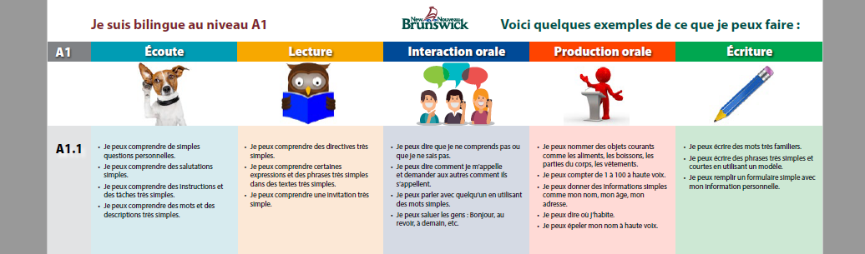
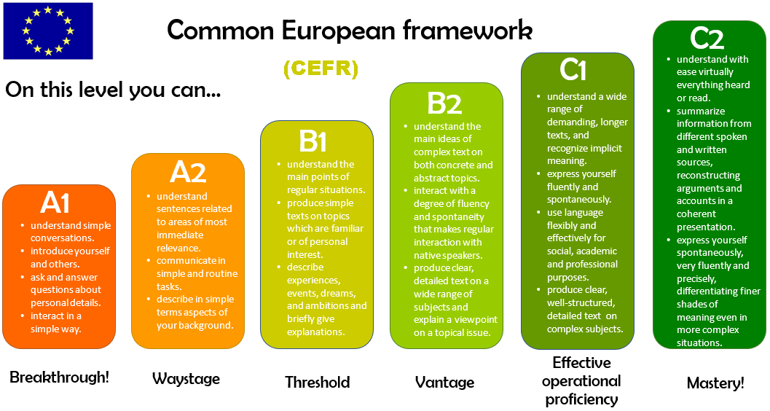



How do we measure French proficiency?
All New Brunswick French pathways are aligned with the CEFR, or the Common European Framework of Reference
It is an internationally recognized tool to describe language learning in any language.
The CEFR shows how language skills develop over time. It describes a learner’s progress, from beginner to more advanced levels.
Learning French is a lifelong journey
English poster may be found at https://bit.ly/3kHLeMs
Notes:
All New Brunswick French pathways are aligned with the CEFR, or the Common European Framework of Reference
The CEFR shows how language skills develop over time, including speaking, reading, and writing. It uses a six-level scale to describe a learner’s progress, from beginner to more advanced levels.
These levels help show a student’s growing ability to use French with confidence.
This scale can support students, teachers and families in identifying what the learner can do in their second or additional language, and also to identify next steps in attaining higher levels of proficiency.
New Brunswick has introduced CEFR-based posters to help learners understand their progress in French.
The proficiency levels are based on the levels described in the CEFR. They are available in English and French.

Slide 5


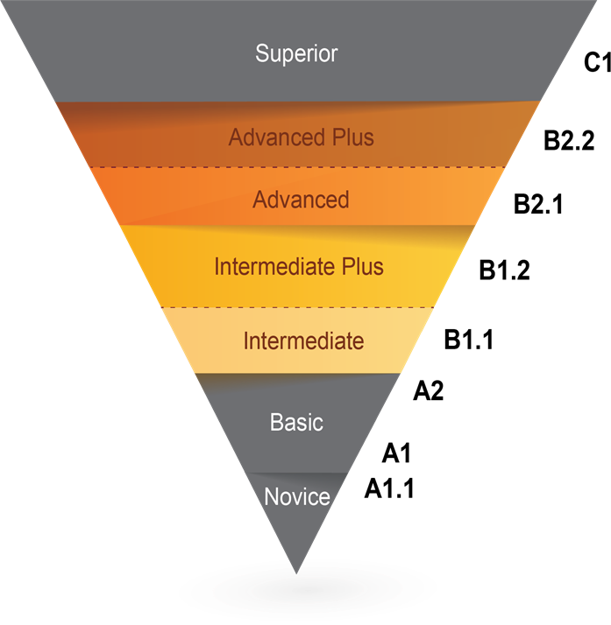


Levels of Proficiency
The level of French that learners attain will vary from one student to another,
in the same way as progress varies in other subject areas
Proficiency grows with more time, more frequent interactions, strong motivation, and consistent exposure to French.
Notes:
This is what some common levels of proficiency sound like. Hover the mouse over each audio icon to reveal the audio control bar. Then, click on the play icon to hear examples of what to expect at various levels.
Keep in mind that the level of French that learners attain will vary from one student to another, in the same way as progress varies in other subject areas.
Proficiency grows when learners have more time, more frequent interactions, strong motivation and consistent exposure to French.

Slide 6

French Second Language Pathways for 2026-27
There are multiple pathways to achieve French proficiency in New Brunswick:
ENGLISH PRIME
Available in all schools
K to Grade 4: Introduction to French through FLORA resources and Pre-Intensive French
Grade 5:
Intensive French
Grades 6 to 12:
Post-Intensive French
FRENCH IMMERSION
Offered in communities where there is sufficient interest and where it is deemed to be sustainable over time as per Policy 309
  Grade 1 Entry Point Early French Immersion
  Grade 6 Entry Point Late French Immersion
Notes:
There are multiple pathways to learning French:
In the English Prime pathway, Pre-intensive, Intensive and Post-Intensive French are offered. This pathway is offered in all schools. Students in the primary and elementary grades learn French through FLORA resources, which establish a foundation in the French language. FLORA stands for French Learning Opportunities Reaching All.
Next, where offered, students may enter the French Immersion pathway in Grade 1 or in Grade 6, based on the guidelines outlined in Provincial Policy 309.
For all programs, French is compulsory until the end of Grade 10. In Grades 11 and 12, there are additional opportunities to build French Language skills.
Each French Second Language program is guided by achievement indicators that describe the desired levels for speaking, reading and writing in French. Students are provided with opportunities to use French in various authentic contexts while building their language skills.

Slide 7

ENGLISH PRIME PATHWAY
Notes:
The next part of this presentation will provide more details on the various French learning pathways.
As stated previously, English Prime and French Immersion are two pathways for learning French in New Brunswick.
We will begin with the English Prime pathway.

Slide 8

English Prime Pathway Overview
K to Grade 4: introduction to French primarily through French Learning Opportunities Reaching All (FLORA) resources and Pre-Intensive French
Grade 5: Intensive 5-month block (occasionally 10-months) typically offered in Grade 5 (occasionally occurs in combined 4/5 classes).
At the end of Grade 5, there are two potential program options depending on the school: French as part of the Post-Intensive program or Late French Immersion (as per provincial Policy 309).
Grades 4-10: Mandatory FSL courses
Grades 11-12: Elective FSL courses in all schools
Notes:
English Prime Pathway:
In grades K-4, instruction starts with a foundation in learning French using FLORA resources, which stands for French Learning Opportunities Reaching All.
In Grade 4, learners will be introduced to more explicit French language learning.
In Grade 5, EP students learn French in an intensive 5-month block.
In Grade 6, students may enroll in late immersion in schools where the program is available or will continue with a required Post Intensive French course in their schedule until the end of Grade 10. They can choose to continue French courses in Grades 11-12 – including French Immersion language arts and other French Second Language subjects offered in their school.

Slide 9


Grades K-4: French Learning Opportunities Reaching All (FLORA)
  FLORA is a made-in-New Brunswick French resource for early language acquisition that includes educational songs, animated characters, readings and activities
  Accessible from home to support in-class learning and for fun
  Uses the same approach as Intensive French with a focus on listening and speaking.
https://flora.nbed.nb.ca
Notes:
FLORA (French Learning Opportunities Reaching All):
FLORA is a made-in-New Brunswick French resource for early language acquisition. It includes educational songs, animated characters, readings and activities
The resources are flexible and online materials can be accessed from home.
It is used in schools during the primary and elementary years to prepare for Grade 5 Intensive French.
Please note that the full release of this resource for K-2 will occur in 2026-27, and 2027-28 for grades 3 and 4.

Slide 10
Grade 5: Intensive French - 2 blocks
First Term (5 Months) Intensive French Block | Second Term (5 Months) Non-Intensive French Block
September – January ←→ February – June
French Language Arts Development of literacy skills in French | English Language Arts Science (English) Social Studies (English) Well-Being (English)
 | French Language Arts
Mathematics (English)
Physical Education, Music, Art (English)
Intensive Block | Non-Intensive Block
Warm-up (French) | English Language Arts
Message of the day: word work and sound work (French)
Oral (French) | Science (English)
RECESS | RECESS
Oral (French) | Social Studies (English)
Reading (French) | Well-Being (English)
LUNCH | LUNCH
Writing (French) | French
Math (English) | Math (English)
Physical Education, Music, Art (English) | Physical Education, Music, Art (English)
TYPICAL YEAR
TYPICAL DAY
Notes:
In Grade 5, instruction is organized into two blocks. For five months, students spend 60% of the school day learning in French. During the remaining five months, French instruction represents 9% of the day.
The intensive block uses a literacy-based approach designed to develop students’ ability to speak, read, and write in French. To support this model, some subject areas are compacted and taught during the non-intensive block.
The Intensive French Block can be offered in either term, as demonstrated by the arrows in the first table. During this block, there is a heavy emphasis on language arts which is beneficial to learners’ overall language development in both French and in English.
The second table represents a typical day in both the Intensive and the non-Intensive blocks in grade 5.
Please note that some schools may choose to distribute intensive French instruction throughout the school year rather than delivering it in a single block.

Slide 11

Grades 6-12: English Prime with Intensive French
POST-INTENSIVE FRENCH GRADES 6−8
    2−3 blocks/classes per week of French
    Focuses on further development of oral, reading, and writing communication skills
POST-INTENSIVE FRENCH GRADES 9−10
    1 course per year
    Reading texts that include greater complexity
    Writing tasks are more complex
POST-INTENSIVE FRENCH GRADES 11−12
    Available for all students
    Both courses are available online
    Upon approval learners may select additional courses in
    French (e.g., Writing 110, Law 120)
Notes:
Students in the English Prime pathway will continue to learn French from grades 6 to 12. French learning is mandatory from grades 6 to 10. Students may then choose additional French Second Language electives in grades 10 to 12.
In Grades 6 through 8, 12% of the weekly instructional time is in French. Learners will have the opportunity to improve their language skills and aim for higher oral, reading and writing competencies.
More advanced learning will take place in Grades 9 and 10, where there is one mandatory French course at each level.
In grades 10 to 12, French second language courses may be selected as electives.
Motivated English Prime learners who have an appropriate French language level may enroll in any course offered in French, including those in the French Immersion pathway.
In addition, there are online courses offered in French at every high school – including, Coop Education, Intro to Environmental Science, Hospitality and Tourism, Law, Writing, and Techniques de Communication.
Learners enrolled in a French course in grade 12 are eligible for an oral proficiency interview through the province of NB.

Slide 12
FRENCH IMMERSION PATHWAY
Notes:
Now let’s explore the French Immersion pathway

Slide 13

French Immersion Overview
LANGUAGE PROFICIENCY TARGETS
Learners work towards French language achievement indicators in the areas of oral proficiency, reading, and writing.
PROGRAM AVAILABILITY
Registration supports district planning.
Families are encouraged to register within the designated dates.
Program availability is dependent upon student enrollment in accordance with Policy 309 .
FRENCH IMMERSION AND INCLUSION
French Immersion is an inclusive program that is accessible to all learners in accordance with provincial Policy 309 and Policy 322.
Notes:
Learners in French Immersion work towards French proficiency in the areas of speaking, listening, reading and writing.
Language learning is a lifelong pursuit. In this pathway, learners are provided with opportunities to use the language authentically in various contexts.
French Immersion is an inclusive pathway that is accessible to all learners.

Slide 14


Grade 1 Entry to French Immersion (Early FI)
Early Immersion begins in Grade 1 when learners are immersed in French language for most of the day. Content such as Science, Math, and Social Studies is all taught in French.
In the early years, language learning is nurtured through everyday activities such as playing, reading, writing, and storytelling in French.
French language learning is embedded through the exploration of familiar and relevant topics, and cultural experiences.
FRENCH INSTRUCTION
Grades 1 and 2:
Grades 3 to 5:
Grades 6 to 8:
Grade 9:
Grades 10 to 12:
85% or more
80%
70% or equivalent
50%
10 French Courses, or 40 credit hours
Notes:
Early Immersion begins in Grade 1, where students spend most of the school day learning in French. Subject areas such as Science, Mathematics, and Social Studies are taught in French as the language of instruction.
In the primary and elementary years, language learning is supported through meaningful, everyday experiences such as play, reading, writing, and storytelling. French is naturally integrated through the exploration of familiar, relevant topics and through opportunities to engage with Francophone cultures.
Some specialty subjects, including physical education, art, and music, may also be taught in French, depending on the number of instructional hours required to meet program outcomes.
English Language Arts is introduced in Grade 3 within the French Immersion pathway.

Slide 15


Grade 6 Entry to French Immersion (Late FI)
Literacy skills are developed through both French Immersion Language Arts and English Language Arts, as well as through all their core subject areas (e.g., social studies, science, mathematics, etc.)
There is an emphasis on oral language in all subjects, followed by learning to read and write in French from the beginning of the program.
Language is modelled; teachers support students as they gradually learn new concepts in their second language.
70% or equivalent of instruction is in French in Grades 6-8
50% of instruction is in French in Grade 9
10 courses instructed in French required across Grades 10-12(students have choice of 40ch)
Notes:
The Grade 6 Entry to French Immersion, or the Late French Immersion pathway begins in Grade 6 and is dependent upon student enrollment and the guidelines provided in Provincial Policy 309.
Exposure to the French language at the primary and elementary levels enables students to transition smoothly to French Immersion in grade 6.
Teachers will model the language to support student success through French Immersion Language Arts as well as content areas such as Math, Science and Social Studies.
In FI Language Arts, the beginning of the year has a focus on building confidence in oral language. Reading and writing instruction is gradually introduced through vocabulary building and modelling. Teachers will build on previously acquired skills to support literacy instruction.
In content area classrooms, vocabulary is embedded along with skills specific to the topics of study.

Slide 16
Grades 1-8: A Typical Day in French Immersion
Grades 1−2 (Exploration Time) | Grades 3−5 (Cross-Curricular Block) | Late Entry 6-8
 |  | Early Entry 6-8
Warm-up (French) | English Language Arts | English Language Arts
Message of the day: word work and sound work (French)
 | French Language Arts | French Language Arts
Oral (French) |  | Science (French)
RECESS | RECESS | RECESS
Oral (French) | Social Studies (French) | Social Studies (French)
Reading (French) | Health and Well-Being (French) | Health and Well-Being (French)
LUNCH | LUNCH | LUNCH
Writing (French) | Science (French) | Science (French)
Math (French) | Math (French) | Math (French)
Physical Education, Music, Art (English/French) | Physical Education, Music, Art (English/French) | Physical Education, Music, Art (English/French)
Notes:
This table shows what a typical day in French Immersion might look like next year.
In blue, you will see the subjects taught in French. Physical Education, Music, and Art may be taught in English or in French.
*The middle school day in Grades 6 to 8 would be similar for early and late immersion.

Slide 17

French Immersion in High School
GRADE 9: 50% OF INSTRUCTIONAL TIME IS IN FRENCH
In addition to French Immersion Language Arts, courses may include Math, Science, Social Studies, History, and Physical Education.
GRADES 10 TO 12: MINIMUM 10 COURSES (40ch) IN FRENCH
Courses may include Chemistry, Physics, Math, Techniques de communication, French Immersion Language Arts, History, World Issues, Biology, etc. Online courses are available to ensure choice.
Notes:
In Grade 9, learners are expected to complete 50% of their courses in French.
In Grades 10 to 12, learners are expected to complete 40 credit hours - or a minimum of 10 full courses instructed in French.
Learners are encouraged to exceed these minimum requirements where circumstances allow.
Learners enrolled in a French course in grade 12 are eligible for an Oral Proficiency Interview through the province of NB.
To enhance choices for students, the Department of Education and Early Childhood Development continues to expand offerings of French online courses and experiential learning.

Slide 18

Online Courses and Options for Credit
    ONLINE COURSES AVAILABLE IN FRENCH
    Law
    Environmental Science
    Writing
    Hospitality and Tourism
    Techniques de communication 11 & 12
    Co-op and Virtual Co-op Education
    OPTIONS FOR CREDIT
    Université de Moncton Explore Jeunesse and Impact School Programs
    Université Sainte-Anne Explore 16+
    Les Jeunes chanteurs d’Acadie
    YMCA Summer Work Exchange Program
    Personal interest opportunities
Notes:
High School students wishing to pursue additional French language learning opportunities can access various online courses instructed in French.
Students may also use some of their French learning experiences outside the classroom for credits towards their high school diploma.
These opportunities have been pre-approved, so students can receive course credits upon proof of completion.
Learners with proof of completion of the opportunities that appear in this list may submit their documents to school administration to receive course credits.

Slide 19
How can families support French language learning?
Support the expectation that French is the primary classroom language for speaking, reading and writing, as well as for interactions with the classroom teacher and peers.
Encourage your child’s attempts to practice
Show interest in what they are learning at school, even if you do not speak French yourself
Participate in special events that promote French language and culture
Encourage time outside of school for French books, games, software, videos, television and radio
Seek additional French opportunities for your child such as library visits, cultural activities, co-ops, internships, experiential learning programs, etc.
Proficiency grows with more time, more frequent interactions, strong motivation, and consistent exposure to French.
Notes:
Families can support students’ learning by increasing time, interactions, motivation, and exposure to French.
This list provides some examples of how you can support these key pillars.

Slide 20

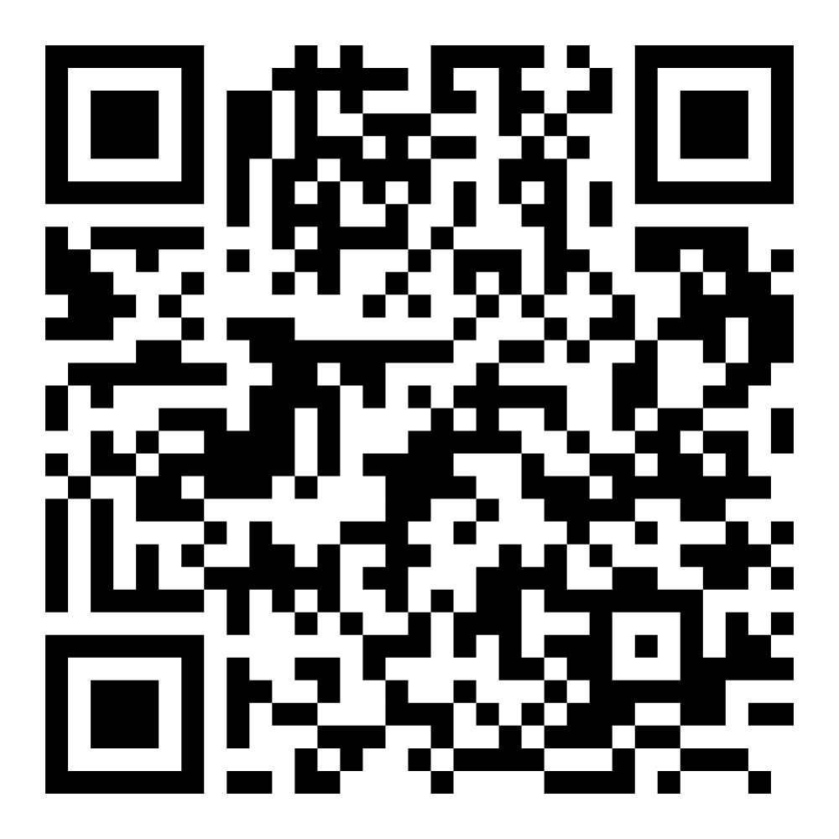
Resources to Support Families
The Centre of Excellence for Language Learning
creates authentic French language experiences, supports families on their child’s FSL journey, and builds partnerships with community groups to promote bilingualism as a life skill in NB.
Click here or scan QR code
Other Helpful Links to support language learning
Electronic Library New Brunswick (ELNB)
SORA Library
Notes:
Resources are available to support families who wish to enhance their students’ French language learning.
Many of these resources are available through the Centre of Excellence for Language Learning, which creates authentic learning experiences, supports families on their child’s language learning journey, and builds partnerships with community groups to promote bilingualism as a life skill
To have access to additional texts and resources in French, you can consult the electronic library of New Brunswick, or the SORA library.

Slide 21

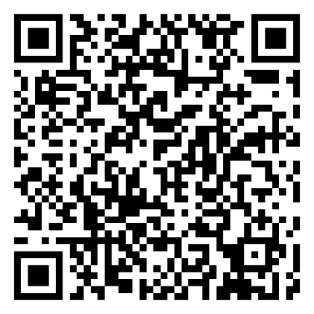
French Cultural Learning Opportunities
Impact (summer French program for students in Grades 9 and 10): 4-week program at Université de Moncton
Explore (ages 16+): 5-week summer French program in locations across Canada
Explore (13−15): 3-week summer French program
Connect (Virtual Summer French Program for Middle School Students - Grades 6, 7 and 8)
For information about French opportunities, visit the GNB French Second Language Education website
Scan here for more information
Notes:
We encourage families to consider the many enriching opportunities available through government programs. These experiences support students in developing their French skills through authentic, real-life situations, while also fostering an appreciation for French language and cultures.
Participation in a bilingual exchange or summer program can significantly strengthen a child’s confidence and ability in French, while offering a safe, engaging environment to build independence and form lasting friendships.
For more information about summer and exchange programs available to students in Grades 6–12, please visit the link provided or scan the QR code.

Slide 22

For more information, visit:
Everyone at their best:
Learning French as a Second Language
Everyone at their best!
Notes:
Thank you for your interest in New Brunswick’s French second language programs.
If you have additional questions about current programs, please contact your local school district.

