Slide 1

Quality in Early Childhood
ASD-W Early Childhood Services Team

Slide 2
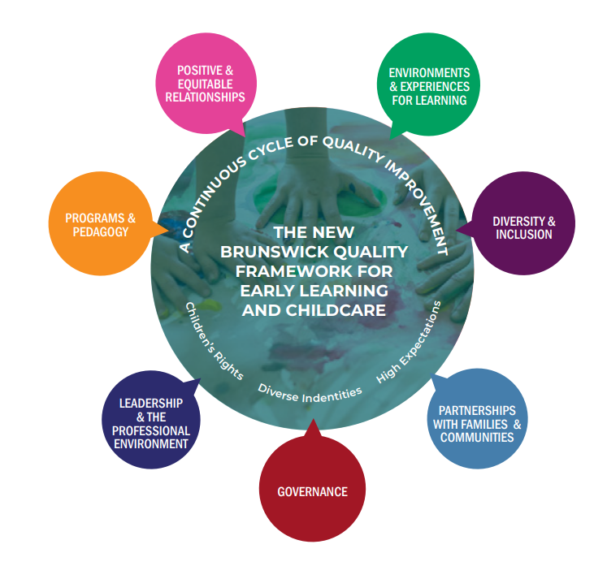
The New Brunswick Quality Framework
Notes:
The New Brunswick Quality Framework (NBQF) is a foundational document that supports and provides context for the New Brunswick Curriculum Framework (NBCF) for early learning. It offers a shared understanding of what quality looks like in Early Learning and Child Care (ELCC) settings across the province and marks an important milestone in New Brunswick’s ongoing commitment to expanding access to high-quality early learning and childcare.
The NBQF is intended for operators, early childhood professionals, administrators, and others involved in delivering or supporting ELCC services for children under six. It helps define quality in early learning centres and homes, supports improved outcomes for children, and fosters a culture of continuous improvement and innovative practice.
At the core of the NBQF are the seven Quality Areas and Indicators, which highlight the key factors that influence quality in early learning and childcare. These areas are interconnected—decisions and actions in one area impact the others—and together they support the development of high-quality ELCC. This interconnectedness is reflected in the circular design of the framework.
We will now share how the work we do connects to the NBQF and how it supports quality across the early learning and childcare sector

Slide 3
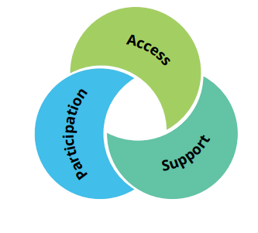
Supporting Inclusion
“How do the tools and programs used to support inclusion in the early learning and childcare sector reflect the NBQF principles of inclusion and contribute to overall quality?”

Slide 4

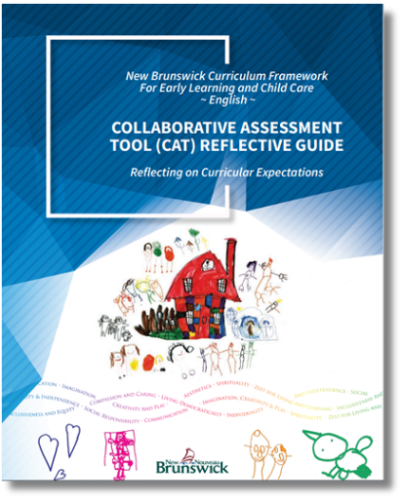

Supporting with the CAT-V and QIPs
“How do quality improvement tools aligned with the NBQF support early childhood professionals and contribute to overall quality in the early learning and childcare sector?”

Slide 5
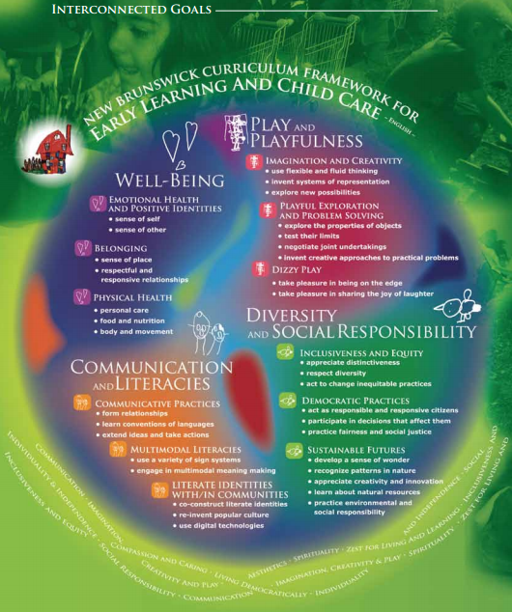
Supporting Professional Learning
“How do the professional learning opportunities we provide align with the NBQF and contribute to quality in the early learning and childcare sector?”
Notes:
Our early learning and childcare Services team provide a wide range of professional learning opportunities to support over 1,000 early childhood educators across ASDW. These opportunities focus on key areas of early learning practice, including literacy, documentation, curriculum, inclusive practice, environments, and pedagogical leadership. Learning is offered in multiple formats—online communities of practice, virtual presentations, and in-person workshops—to ensure accessibility, relevance, and meaningful engagement for educators in different roles and contexts.
This work aligns closely with the New Brunswick Quality Framework, which positions educators as capable, reflective, and continually learning professionals. The NBQF is intended to support ongoing quality improvement rather than compliance, and professional learning provides educators with the shared language, reflection, and research needed to bring the framework to life in daily practice. Our learning opportunities support pedagogical leadership, collaboration, and inclusion, all of which are core values within the NBQF.
Professional development contributes to quality in the early learning and childcare sector by strengthening pedagogical practice and supporting educators to be more intentional, reflective, and responsive. Ongoing learning improves outcomes for children by enhancing educators’ ability to support well-being, inclusion, and meaningful learning experiences. It also builds professional confidence, strengthens team culture, supports retention, and reinforces inclusive and equitable practices. Overall, quality in early learning is built through continuous learning, and professional development is essential to sustaining high-quality programs where children, families, and educators can thrive.

Slide 6
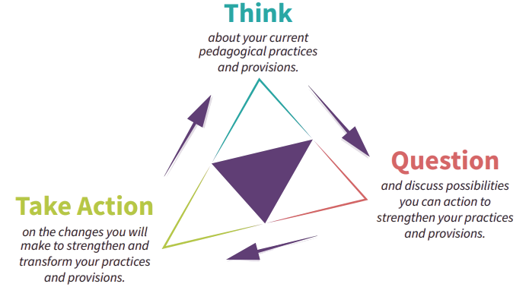
Questions?

