Slide 1
Chronic Absenteeism Long Term Recommendation 1.1
A Briefing for ASD-W District Education Council
October 23, 2025
Notes:
The issue of chronic absenteeism is a problem that has been with us, probably since the very early days of public education. It has however become increasingly evident since the start of Covid and onward.

Slide 2
Setting the Context: 11 Long Term Recommendations
LTR 1.1 Chronic Absenteeism
LTR 1.2 Classroom Composition
LTR 1.3 Technology: E-Sport
LTR 2.1 Middle Level Learners
LTR 2.2 Strengthening French Language Learning
LTR 3.1 Encouraging Movement
LTR 3.2 Community Engagement
LTR 4.1 Recruitment and Retention
LTR 4.2 Educational Assistants
LTR 4.3 Early Readers
LTR 4.4 Equal Access to Professional Learning
Notes:
Use intro notes from Oct. LTR overview.

Slide 3
What is Chronic Absenteeism?
Chronic absenteeism occurs when a student misses 10% or more of instructional time. In a typical school year of 180 student days, this means the student has missed 18 or more days.
Chronic absenteeism has increased in most jurisdictions since the Covid pandemic.
Notes:
Although there are different metrics for measuring attendance, such as the percentage of students in attendance each day, chronic absenteeism is a metric that captures a subset of students with attendance problems. For example, a school may have 95% average daily attendance but still have 30% chronic absenteeism. Ref: Bruner, C., Discher, A., & Chang, H. (2011, November). Chronic elementary absenteeism: A problem hidden in plain sight. Child & Family Policy Center and Attendance Works

Slide 4
How significant is Chronic Absenteeism in New Brunswick?
Chronic Absenteeism in New Brunswick has doubled since the Covid pandemic.
Level | 2018-2019 CA Rate | 2023-2024 CA Rate
K-5 | 15% | 34%
6-8 | 20% | 42%
9-12 | 25% | 42%
Notes:
This increase has been noted across Canada, the United States, and Western Europe.

Slide 5
Why is this a problem?
Chronic Absenteeism is associated with multiple negative outcomes for students. This includes:
Chronic absenteeism in early grades does not usually improve without intervention; in fact, it often gets worse.
Chronic absenteeism is associated with reduced academic outcomes at all levels.
Chronic absenteeism in Kindergarten is associated with reduce executive function in Grade 3. (brain’s ability to manage and control cognitive processes such as organizing, staying on task, controlling emotions, managing time, making decisions, etc.)
Chronic absenteeism is associated with a higher risk of high school dropout.
Notes:
Even two days absence a month will make a student chronically absent.
Kindergarten students who are chronically absent and continue to be chronically absent will have missed an entire year of instruction by high school.
References include: Gottfried, M. A., & Ansari, A. (2021). Detailing new dangers: Linking kindergarten chronic absenteeism to long-term declines in executive functioning. The Elementary School Journal, 121(3), 484–500, and Ansari, A., & Pianta, R. C. (2019). School absenteeism in the first decade of education and outcomes in adolescence. Journal of School Psychology, 76, 48–61

Slide 6
The Ask:
Each school is asked to collaboratively work at reducing chronic absenteeism in their school by 5% over the 2025-2026 school year.

Slide 7
What is New Brunswick doing to address Chronic Absenteeism?
New Brunswick has a four-point plan to address chronic absenteeism, all of which will be implemented in the 2025-2026 school year.
A Standard Protocol to provide a framework for schools to prevent and respond to student attendance problems.
A Multi-Tiered System of Supports which will be a resource for ESSTs preventing and responding to school attendance problems.
Improved data tracking and reporting.
An Awareness Campaign, including social media, to draw wider attention to the importance of school attendance.
Notes:
Provide copies of posters, as well as the standard protocol to DEC members.

Slide 8
What are the key features of the Standard Protocol?
Some of the key features of the Standard Protocol include:
An approach that is primarily supportive and collaborative with families to prevent and respond to school attendance problems.
Proactive communication before attendance problems arise.
5-Day Care and Connect Call: an emphasis on personal communication between teachers and the parents/guardians of their students.
A focus on problematic absenteeism only: under the protocol, efforts are directed to support those students who can and should be in school but are not. It is not for situations in which circumstances exist that prevent regular attendance (e.g., medical concerns).
A School Attendance Support Team to review data and interventions at the school level, and to help determine attendance goals for the school.

Slide 9
How is the Standard Protocol different than our current ASD-W responsive practices?
Current ASD-W Policy
Standard Protocol
5 Days: Personal contact with parents/guardians.
10 Days: Administration sends a letter home, makes an ESST referral, and ensures ongoing communication with the parents/guardians.
5-Day Teacher Care & Connect Call: personal communication with home (e.g., by phone).
10-Day Administrator Care and Connect Contact: Administrator or designate contacts home and makes decisions about 1) is the absenteeism problematic and 2) what steps, if any, are required at this time.
15-Day Administrator Care & Connect Follow Up (problematic absenteeism only): Personal communication (e.g., phone call) by administrator and follow up action by ESST
20-Day Case Management & Monitoring: Ongoing involvement of ESST and potentially ISD partners; intensive individualized interventions are considered.
Notes:
Overall, the Standard Protocol is not so much different than current policy as it outlines more steps and options at each stage of responding to absenteeism. However, the following should be noted:
5-Days: Virtually no change. Teachers are expected to contact home. The difference is the new protocol stresses the importance of making that the personal contact is in fact a personal conversation, such as a phone call, rather than an email.
10-Days: Because of the number of students who hit 10 days, under the Standard Protocol, administrators are asked to use professional judgement to determine which students need intervention at this step. In the current policy, this is mandatory without administrator discretion. Letters are not required at this step.
15-Days: Under the Standard Protocol, steps not taken at 10-days must be taken at this step. This is similar to the requirements of the 10 Day step under the current policy. Any follow up correspondence is supportive in nature, rather than legalistic in tone.
20-Days: This is a new step that outlines more options for the school ESST

Slide 10
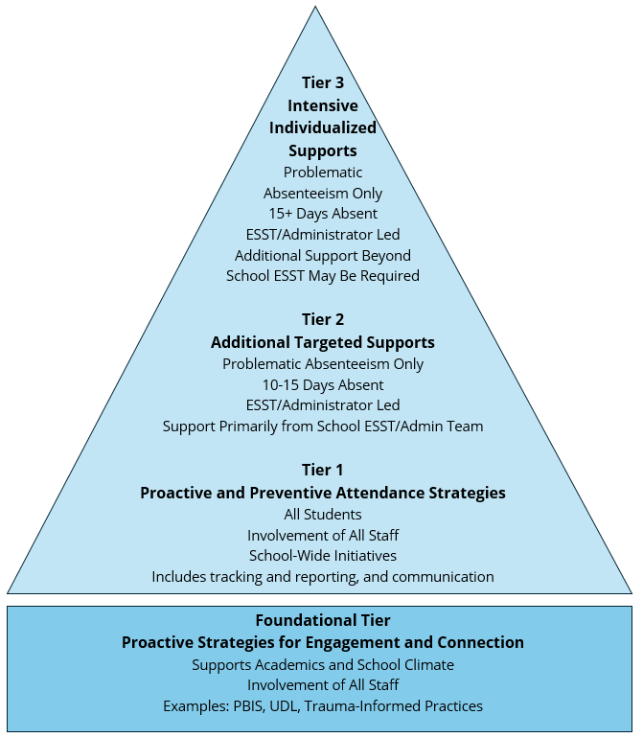
A Summary of the Multi-Tiered System of Supports
Notes:
ESSTs will be provided with the MTSS in September, and accompanying PL on best practices to address school attendance problems will be offered to ESST members in the fall. This slide is just to provide initial awareness of the model. Note: each school is required to have a School Attendance Support Team. This could be the Education Support Services Team, Core Leadership Team, or a team designed for the specific purpose of reducing chronic absenteeism. Meet a minimum of once per month to review tier 1 interventions as well as the progress of students receiving tier 2 and 3 interventions, making changes as needed. The goal is to reduce chronic absenteeism by 5 percentage points
There will also be a District Attendance Support Team.
The responsibilities of the team are as follows:
Ensure chronic absenteeism remains a priority for the district and each school and lead the implementation of the Standard Protocol in the district while monitoring its consistent application.
Ensure each school receives its monthly chronic absenteeism data and review the chronic absenteeism data for the district and for each school on a monthly basis.
Follow up with schools that this data indicates may need additional consultation or support in addressing chronic absenteeism and identify trends which call for additional action or student populations that require additional supports.
Identify barriers occurring at a systems level and respond as appropriate.
Report monthly to the superintendent on the progress of the district on chronic absenteeism, highlighting schools that are leading and lagging in improvement.
The protocol also includes proactive and responsive measures, all with the aim of reducing chronic absenteeism. Promotional materials supporting regular attendance have been developed and will soon be released through the district’s Director of Communications.

Slide 11
“It takes a village to raise a child” is the collective effort that requires the support of many people beyond parents.
Thank you for all that you do to support student attendance.
By continuing to work together, we will be able to reduce chronic absenteeism and increase positive outcomes for students.

