Slide 1
School Food at ASD-W
MAY 22 2025
District education council
Karrie Bedford, RD
ASD-W Community Engagement Coordinator - Operations

Slide 2
Overview
Topic of School Food & Current Events
Current State of School Food at ASD-W
Desired Long-Term Outcomes
Collective Impact on School Food at ASD-W
Food For Thought – Discussion

Slide 3
Disclaimer/Disclosure/ Warning
System Thinker
Passion for prevention, alignment & collaboration
‘New’ to the world of school food
10 years working in Food Security for vulnerable populations
Frequent user of analogies
Welcome to the Carnival of School Food

Slide 4
Topic of School Food & Current Events

Slide 5
Current Events – Government of Canada
January 2022 - What We Heard – Engagement on a National School Food Policy (Gov. Canada)
Feedback from online public questionnaire
Strong agreement that school food programs are beneficial for children
A majority indicating that meals should be both filling and nutritious
Emphasis around the importance of providing healthy, safe, locally-sourced, and culturally appropriate foods
A majority identified ensuring that participants do not experience stigma as the most important component of programming
A large majority indicated child health and well-being and reducing child hunger as the most important objectives
Feedback from Stakeholders
There is no "stereotypical" hungry child, and there are numerous reasons why children go to school hungry
School meal programs extend beyond simply feeding children, and should strive to incorporate educational objectives, opportunities for community building, and linkages with local food systems
A one-size-fits-all approach will not work, and instead local flexibility needs to be baked into the approach
Participants noted that they saw an opportunity to stimulate regional food production and local economic development
Stakeholders also widely reported experiencing significant increases in demand for programming, at a time where they are also facing significant decreases in capacity due to many factors, including the higher cost of food. Organizations shared that they have experienced additional challenges including infrastructure, the need for paid staff, and lack of data and governance
April 1, 2024 – National School Food Program Announced – 1 billion over 5 years
June 20, 2024 – National School Food Policy Released
February 7 2025 – New Brunswick is the fifth province to work with the Government of Canada to increase access to nutritious meals in schools for children across the country.
Notes:
January 2022: What We Heard – Engagement Sessions--- WWHR - Sept 6 – EN
April 1, 2024: A National School Food Program to set kids up for success | Prime Minister of Canada
June 20, 2024 --- National School Food Policy - Canada.ca
February 7 2025: Healthy meals for kids, savings for families in New Brunswick - Canada.ca

Slide 6
Current Events– Government of NB
Food Depot Alimentaire (FDA)
September 2022 – EECD funding to FDA $550,000 ASD-W, ASD-E, Francophone Sud, total 110 schools
Alignment with DAAF- Local Food and Beverage Strategy; GrowNB, BuyNB, FeedNB
Breakfast Clubs of Canada
Still active – not accepting new school applications – 19* ASD-W Schools on the waitlist
Funding partnerships between FDA and BCC
September 2023 – EECD, expansion of funding to FDA $2 million. Expanded to additional 42 schools – across 7 districts
Sept 2024 – Holt Government Election Promise – $27.4 million A free, nutritious breakfast
A new pay-what-you-can lunch offered to all students and families
November 7th, 2024 – Hon. Minister Claire Johnson, EECD
Mandated Portfolio – Platform Theme “Education - Nourishing Kids, Nourishing Minds” – Goal of providing a nutritious universal free breakfast and pay-what-you-can lunches to all New Brunswick students leveraging local, New Brunswick food where possible.
February 7th 2025 – Federal/Provincial Funding Update (11.2 Million)
Notes:
Food Depot Alimentaire
September 2022: https://www2.gnb.ca/content/gnb/en/departments/10/news/news_release.2022.09.0497.html
September 2023: https://www2.gnb.ca/content/gnb/en/news/news_release.2023.09.0493.html
Provincial Government
Election Promise: https://nbliberal.ca/holt-government-to-implement-school-food-program-so-students-can-focus-on-learning/
Mandate: Honourable Claire Johnson https://www2.gnb.ca/content/gnb/en/corporate/government_websites/mandate-letters/mandate-letter-Johnson.html
https://www2.gnb.ca/content/gnb/en/news/news_release.2025.02.0034.html

Slide 7
Current Events - Advocacy
NB School Food Coalition The formation of the "NB School Food Coalition" (NBSFC) was announced in the fall of 2024; developed to work collectively towards the advancement of school food programming in New Brunswick to meet the diverse needs of school communities across the province. While the NBSFC is not an official Coalition chapter, it is closely connected to the Coalition and its work, through Food For All NB (a Coalition for Healthy School Food member organization), the organization leading the NB coalition's development.
Members of the NBSFC will work together to enhance awareness and education surrounding school food programs in NB. The NBSFC commits to working with diverse partners and representatives involved in health, education, and food from all regions, First Nations, and key sectors to support capacity building and policy development for high quality school food programming for all students.
Question that comes forward: What do DISTRICTS and SCHOOLS need for managing school food. “Doing with, not doing for” = strong & sustainable programming
Notes:
NB Action | Coalition for Healthy School Food | Canada https://www.healthyschoolfood.ca/nb-action
Food For All NB https://foodforallnb.ca/focus/schoolfood
Current email list for NB School Food Coalition – standing meeting set for once per month
"aubrey.kirkpatrick@gnb.ca" <aubrey.kirkpatrick@gnb.ca>; "Duplessie, Chadly (HorizonNB)" <Chadly.Duplessie@HorizonNB.ca>; "chiefghginnish@gmail.com" <chiefghginnish@gmail.com>; "Christine Allain" <christine.allain@nbse.ca>; "Christine Roherty" <croherty@hsf.nb.ca>; "Eloi Doucet" <eloi.doucet@gmail.com>; "Stordy, Heather (ASD-E)" <Heather.Stordy@nbed.nb.ca>; "Hébert, Hélène (ESIC/SIES)" <Helene.Hebert22@gnb.ca>; "Theriault, Johanne (DH/MS)" <johanne.theriault@gnb.ca>; "judith.barry@breakfastclubcanada.org" <judith.barry@breakfastclubcanada.org>; "Bedford, Karrie (ASD-W)" <Karrie.Bedford@nbed.nb.ca>; "Thériault, Marc (DSF-NE)" <Marc.Theriault@nbed.nb.ca>; "Mercure-Dumont, Martine (DSF-NO)" <martine.mercure@nbed.nb.ca>; "Mary L McKenna" <mmckenna@unb.ca>; "Ryder, Molly (DH/MS)" <Molly.Ryder@gnb.ca>; "Schofield, Rachel (DSF-S)" <RACHEL.SCHOFIELD@nbed.nb.ca>; "Miller, Shauna (DH/MS)" <shauna.miller@gnb.ca>; "Stephane Sirois" <stephane.sirois@fooddepot.ca>; "Susanne White" <swhite@capitalrsc.ca>; "Lise Morin" <lmorin@capitalrsc.ca>; "Larry, TerriAnne (EelGrd)" <TerriAnne.Larry@nbed.nb.ca>; "chloe.costa@breakfastclubcanada.org" <chloe.costa@breakfastclubcanada.org>; "Awad, Melissa (EECD/EDPE)" <melissa.awad@gnb.ca>; "paz-monica.paz@breakfastclubcanada.org" <paz-monica.paz@breakfastclubcanada.org>; "McGraw, Gina (DH/MS)" <Gina.McGraw@gnb.ca>; "McCluskey, Emily (DH/MS)" <Emily.McCluskey@gnb.ca>; "Johanna McLeod" <jmcleod@hsf.nb.ca>; "mary mckenna" <mlmckenna2020@gmail.com>; "Jill Van Horne" <jill@foodforallnb.ca>
olivia@foodforallnb.ca – dedicated personnel for coordinating standing meetings and minutes. (Food for All NB has received funding from ESIC to cover this position)

Slide 8
Summary
2022
2023
2024
2025
Public interest in school food programs
Breakfast Programs FDA/EECD
Supports from Breakfast Clubs of Canada
National School Food Policy
Provincial Mandate – Nourishing Kids, Nourishing Minds
NB School Food Coalition
Federal and Provincial Funding
2 School Food Program Leads (EECD)
NB School Food Coalition
What We Heard- Engagement on a National School Food Policy – Government of Canada

Slide 9
Current State of School Food at ASD-W

Slide 10
BUSSING / TRANSPORTATION
BREAKFAST PROGRAMS
CAFETERIAS
EARLY LEARNING / AFTERSCHOOL PROGRAMS
STAFF/ALT. LUNCH AREAS
SCHOOL BASED EVENTS/ FUNDRAISING /EXTRA CURRICULARS
NON-PROFIT / BUSINESS/ COMMUNITY-LED PROGRAMS
CURRICULUM LED PROGRAMMING / CULINARY LABS
COMMUNITY USE OF SCHOOLS RENTALS
Notes:
Overview of where we can see ‘food’ in our ‘schools’

Slide 11
Overview of School Food Partners
FDA Breakfast Program | Breakfast Club of Canada | Cafeteria Contracts | Food Security Partners
9 schools not currently accepted to the program. Barkers Point Gagetown George Street Hartland Keswick Valley Nashwaak Valley New Maryland Oromocto High Stanley Consolidated These schools will be added for 2025 school year. Some have already been onboarded. | Andover Elementary School Bath Community School Bliss Carman Middle School Bristol Elementary School Cambridge Narrows Community School Carleton North High School Centerville Community School Chipman Elementary School Florenceville Elementary School Florenceville Middle School Forest Hill Elementary School Gagetown School Geary Elementary Community School Gesner Elementary School Gibson Neill School John Caldwell School Lincoln Elementary Community School Liverpool Street Elementary School Meduxnekeag Consolidated School Park Street Elementary School Perth- Andover Middle School Southern Victoria High School Townsview School 19 other ASD-W Schools on Waitlist Bolded Schools = staffed with Community School Coordinator | Chartwells Andover Elementary Bliss Carmen Middle Carleton North High School Central New Brunswick Academy Devon Middle Florenceville Middle George Street Hanwell Park Academy Harold Peterson Middle Hartland Community School Harvey High School Hubbard Elementary School John Caldwell Keswick Valley Memorial School Leo Hayes High School Meduxnekeag Consolidated Minto Elementary Middle Nackawic Elementary Nackawic Middle Nackawic High Nashwaaksis Middle School New Maryland Elementary Oromocto High School Perth-Andover Middle Ridgeview Middle Southern Victoria High School Stanley Consolidated Woodstock High Townsview Jobs Unlimited Gibson-Neill Park Street Royal Road Connaught Cuffman Street Home and School Associations* Geary Elementary Donald Fraser | Food Banks Home and School Associations Community Non-Profits Business Partners School Champions Funding Partners
Notes:
FDA: 9 schools not currently on program – decided at a department level.
BCC: Various Support Models. Direct to schools, but also to partner such as FDA.

Slide 12
Who holds the responsibility of overseeing school food?
School
Principals / Vice Principals
Resource and/or Teachers
Administrative Assistants
Educational Assistants
Community School Coordinator
Custodian
Students
Volunteers
Home and School Associations
District
Community Engagement Coordinators
Facilities – Cafeteria, Culinary Labs
Budget and Accounting
Transportation
Subject Coordinators
ESS
Healthy Learners in Schools Team / HPPH
Early Learning / Afterschool Programs
DEC – Policy
Funding – Healthy Minds, Nutritional Literacy, etc
Senior Admin - DFA
Department
Policy
Funding
Centers of Excellence
Governance
Notes:
It looks different at each school.
Need to make sure we keep the identity/established partners, but also ensure best practices and policies are followed.

Slide 13
Some areas for improvement
Stigma around food programs: Lunch examples (Bagged Lunch, Cafeteria Lunch, Snacks, etc)
Everyone is a “food expert” – How do we build an environment where food is not perceived as ‘good’ or ‘bad’?
Transportation Impacts
Equipment, aging infrastructure – reactive state (Ex: Fire Marshall & microwaves)
Scheduling – not enough time to eat. Example: flipping outside recess & lunch time
Food Premise License – Food Safety in Schools
People Management – “Not my job”
Limited selection of foods that are culturally safe and/or inclusive to dietary restrictions
Notes:
If focus on alignment – we’re working smarter, not harder
Try to move from constant ‘reaction mode’ to ‘prevention mode’
Our world has become more ‘task focused’ and less ‘people focused’. How do we make sure we are meeting our student needs, building a healthy working environment for our staff and build greater impact?

Slide 14
BUSSING / TRANSPORTATION
BREAKFAST PROGRAMS
CAFETERIAS
EARLY LEARNING / AFTERSCHOOL PROGRAMS
STAFF/ALT. LUNCH AREAS
SCHOOL BASED EVENTS/ FUNDRAISING /EXTRA CURRICULARS
NON-PROFIT / BUSINESS/ COMMUNITY-LED PROGRAMS
CURRICULUM LED PROGRAMMING / CULINARY LABS
COMMUNITY USE OF SCHOOLS RENTALS
Notes:
If there is no coordination, or our ‘system’ doesn’t have mechanism in place for communication/alignment – it quickly becomes a ‘free for all’.

Slide 15
Desired Long-Term Outcomes

Slide 16
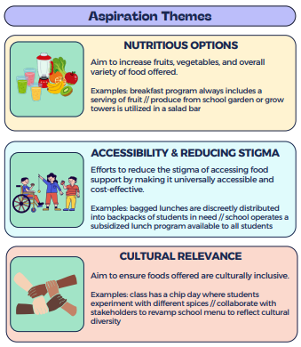
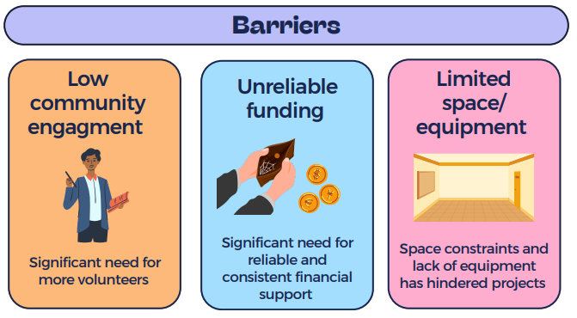
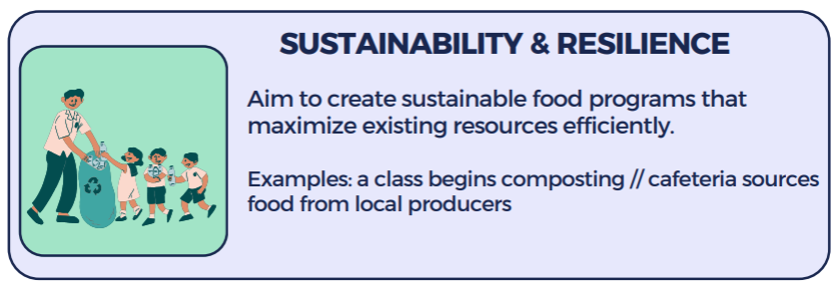
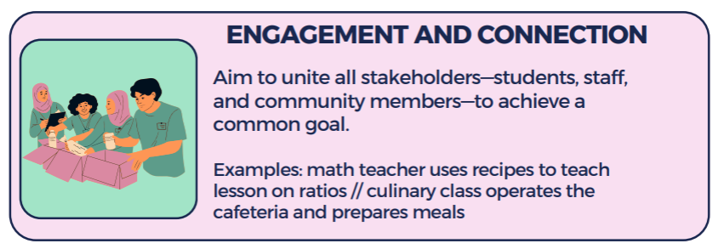
Results of 2023 -2024
Nutritional Literacy Survey
Notes:
Top three barriers from our Nutritional Literacy Survey in 2023 – common trends that align with Gov’nt of Canada Survery in 2022.
Used ABCD to switch narrative of responses from deficit focus to asset-focus.

Slide 17
Collective Impact on School Food at ASD-W

Slide 18
Communication throughout the ‘System’ = best practice/policy adherence, prevention – ‘getting out of reaction mode’
‘Community Capacity Building & Culture’ – Getting Engagement and Participation
Data and Measurement- reporting to funders, feeds into measuring impact and fostering trust/engagement from partners
Defining structure/process – shared responsibility – who holds all the moving pieces?
‘Guiding Star’ – ASD-W Vision for School Food
Notes:
Asset Based Community Development (ABCD): https://www.tamarackcommunity.ca/hubfs/Resources/CDC%20ABCD%20resources/ABCD%20at%20a%20Glance.pdf?hsLang=en-us
Collective Impact Toolkit: https://www.tamarackcommunity.ca/hubfs/CI%20Toolkit%20Ebook/CI%20Toolkit%20Temp.pdf?hsCtaTracking=54eca90a-e53c-45b6-9944-16c3bd7a0e91%7Cc9712a5d-f5c2-411c-9715-c41c37830291

Slide 19
Food for Thought

Slide 20
Where are we today?
Government of Canada will invest approximately $11.2 million over the next three years to expand and enhance access to school food programs in New Brunswick to feed more kids. Enhancements will include:
purchasing new kitchen equipment
hiring regional program coordinators,
developing new program guidelines.
Expansion will also include planning for the creation of a province-wide pay-what-you-can lunch program to be launched in future years.
Community Engagement Coordinator – Operations
Provided a summary of cafeterias and equipment needs to EECD
Working with FDA to onboard remaining 9 schools in our district
EECD has posted for 2 School Food Program Leads
No updates on District resources to manage School Food to date
Continue to find funding and community partnerships that can support our needs (aging equipment, food safety licensing, access to appropriate storage, volunteers)
Active participation at NB School Food Coalition Table
Active participant with the School Food & Allergies Working Group (Atlantic School Food Champions)
Notes:
NB Action | Coalition for Healthy School Food | Canada https://www.healthyschoolfood.ca/nb-action
Food For All NB https://foodforallnb.ca/focus/schoolfood
Current email list for NB School Food Coalition – standing meeting set for once per month
"aubrey.kirkpatrick@gnb.ca" <aubrey.kirkpatrick@gnb.ca>; "Duplessie, Chadly (HorizonNB)" <Chadly.Duplessie@HorizonNB.ca>; "chiefghginnish@gmail.com" <chiefghginnish@gmail.com>; "Christine Allain" <christine.allain@nbse.ca>; "Christine Roherty" <croherty@hsf.nb.ca>; "Eloi Doucet" <eloi.doucet@gmail.com>; "Stordy, Heather (ASD-E)" <Heather.Stordy@nbed.nb.ca>; "Hébert, Hélène (ESIC/SIES)" <Helene.Hebert22@gnb.ca>; "Theriault, Johanne (DH/MS)" <johanne.theriault@gnb.ca>; "judith.barry@breakfastclubcanada.org" <judith.barry@breakfastclubcanada.org>; "Bedford, Karrie (ASD-W)" <Karrie.Bedford@nbed.nb.ca>; "Thériault, Marc (DSF-NE)" <Marc.Theriault@nbed.nb.ca>; "Mercure-Dumont, Martine (DSF-NO)" <martine.mercure@nbed.nb.ca>; "Mary L McKenna" <mmckenna@unb.ca>; "Ryder, Molly (DH/MS)" <Molly.Ryder@gnb.ca>; "Schofield, Rachel (DSF-S)" <RACHEL.SCHOFIELD@nbed.nb.ca>; "Miller, Shauna (DH/MS)" <shauna.miller@gnb.ca>; "Stephane Sirois" <stephane.sirois@fooddepot.ca>; "Susanne White" <swhite@capitalrsc.ca>; "Lise Morin" <lmorin@capitalrsc.ca>; "Larry, TerriAnne (EelGrd)" <TerriAnne.Larry@nbed.nb.ca>; "chloe.costa@breakfastclubcanada.org" <chloe.costa@breakfastclubcanada.org>; "Awad, Melissa (EECD/EDPE)" <melissa.awad@gnb.ca>; "paz-monica.paz@breakfastclubcanada.org" <paz-monica.paz@breakfastclubcanada.org>; "McGraw, Gina (DH/MS)" <Gina.McGraw@gnb.ca>; "McCluskey, Emily (DH/MS)" <Emily.McCluskey@gnb.ca>; "Johanna McLeod" <jmcleod@hsf.nb.ca>; "mary mckenna" <mlmckenna2020@gmail.com>; "Jill Van Horne" <jill@foodforallnb.ca>
olivia@foodforallnb.ca – dedicated personnel for coordinating standing meetings and minutes. (Food for All NB has received funding from ESIC to cover this position)

Slide 21
Leveraging our Assets as a District
How might we best align, support and collaborate with our school food champions so we can build a shared vision on school food at ASD-W?
Ideas discussed to date:
ASD-W School Food Champions Network
→ ASD-W School Food Task Force
→ District Wide Visioning Exercise
Projects on the go related to this work:
→ External funding ($16,666 from ESIC) to help build a network of School Food Champions at ASD-W
→ Capital Region Food Council – part of building a regional voice for food security
Notes:
What is the best way to align, support and collaborate with our school food champions so we can build a shared vision on school food at ASD-W?
Who are the key champions that need to be part of the Task Force?

Slide 22
Food for Thought
Questions?
Reflections?
Ideas?
Thoughts?

Slide 23
THANK YOU - WOLIWON - MERCI
Contact
Karrie Bedford | Karrie.Bedford@nbed.nb.ca | 506.259.5905

