Slide 1
DEC MEETING-
Doak Road School Catchment Ideas
→ Thursday, march 13th, 6:30PM
Woodstock education centre

Slide 2
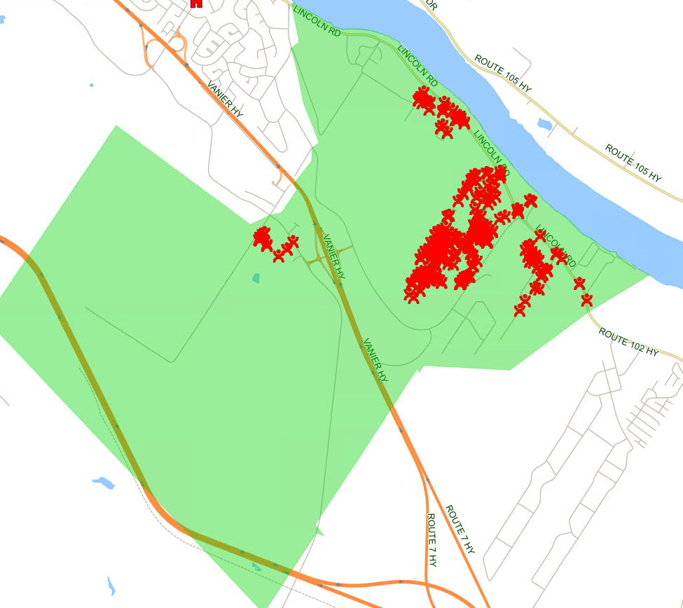
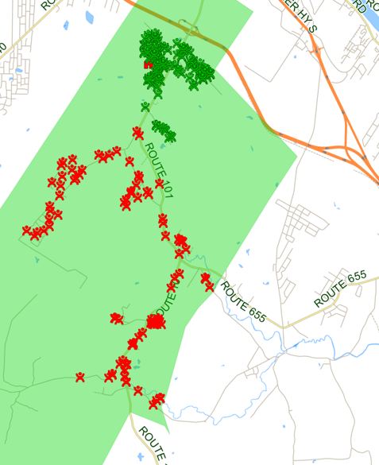
PROPOSED CATCHMENT AREA – DOAK RD AREA
K TO 8
6 TO 8
Proposed Doak Rd Area School Enrolment
Grades | # of Students
K | 25
1 | 36
2 | 36
3 | 35
4 | 28
5 | 37
6 | 69
7 | 59
8 | 64
Total | 389

Slide 3
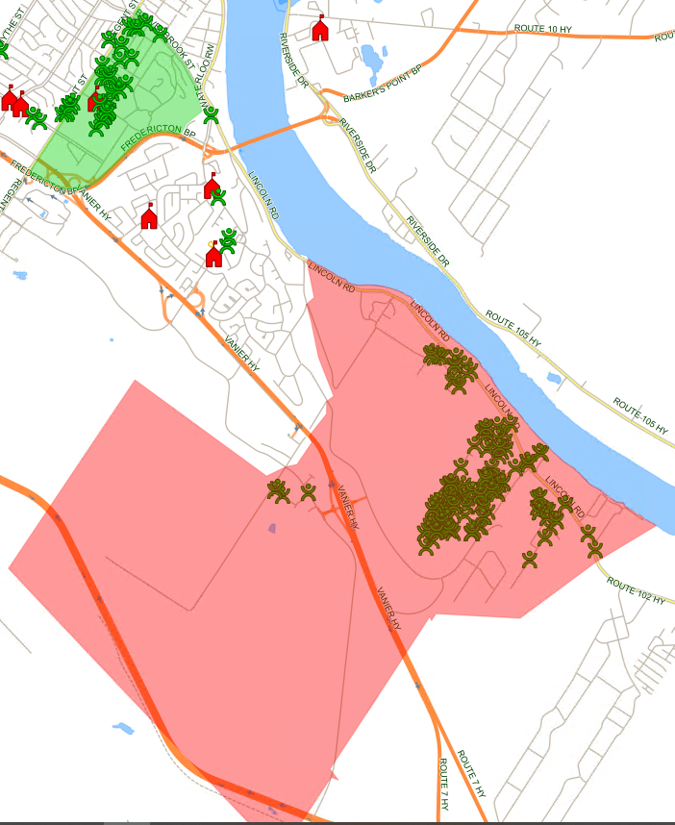
CURRENT CATCHMENT AREA – MONTGOMERY STREET ELEMENTARY
Current Montgomery Street Elementary School Boundary
Grades | # of Students
K | 33
1 | 42
2 | 43
3 | 42
4 | 38
5 | 45
Total | 243

Slide 4
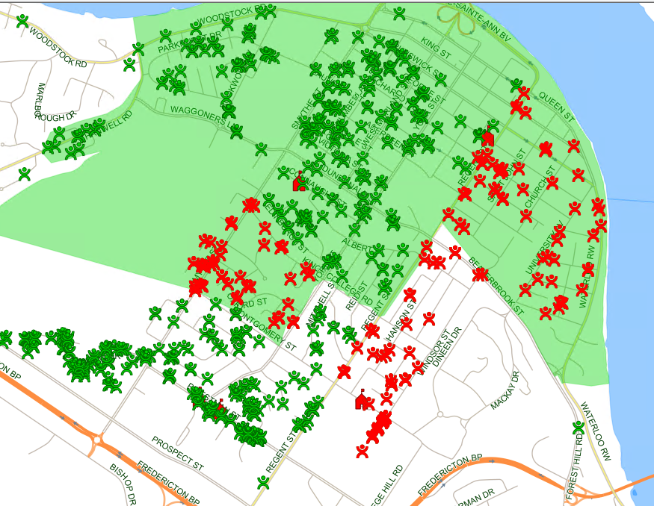
PROPOSED CATCHMENT AREA – MONTGOMERY STREET ELEMENTARY (RED)
Proposed Montgomery Street Elementary School Boundary
Grades | # of Students
K | 22
1 | 21
2 | 25
3 | 28
4 | 26
5 | 31
Total | 153

Slide 5
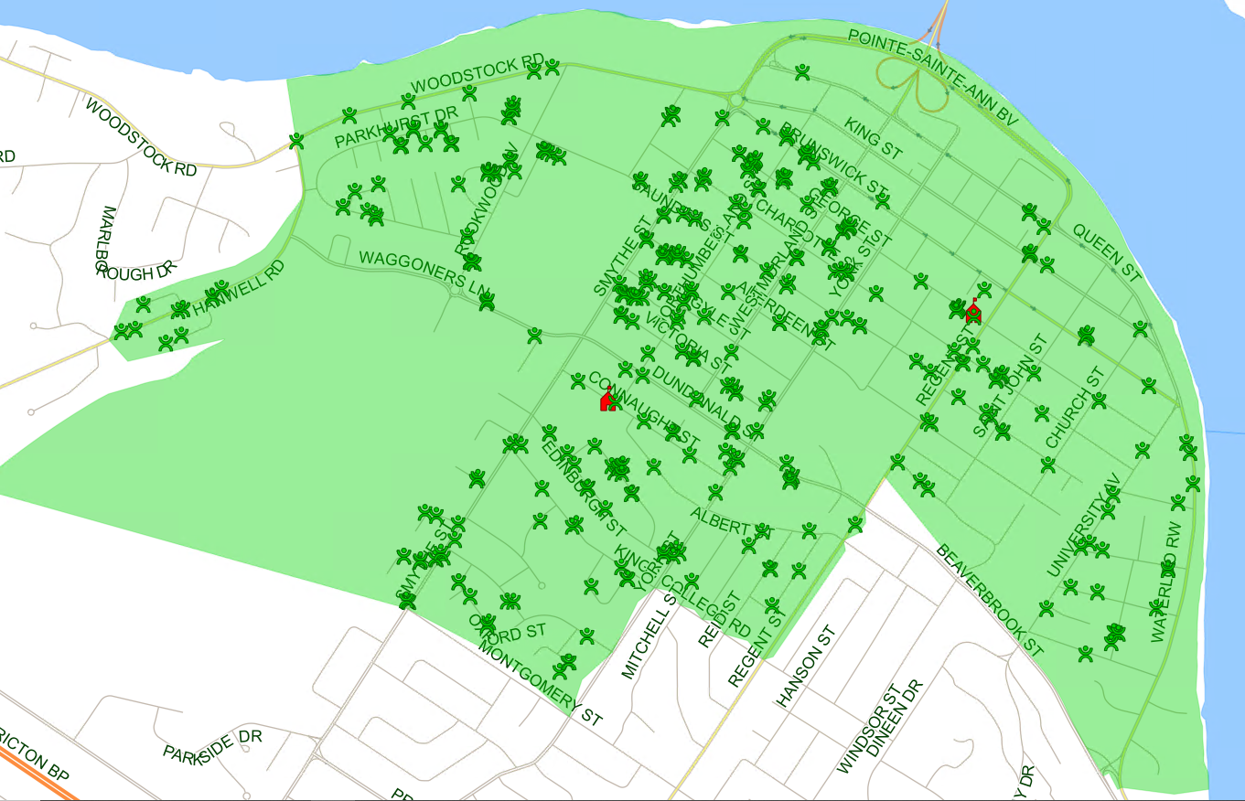
CURRENT CATCHMENT AREA – CONNAUGHT STREET SCHOOL
Current Connaught Street School Boundary
Grades | # of Students
K | 50
1 | 56
2 | 63
3 | 57
4 | 61
5 | 70
Total | 357

Slide 6
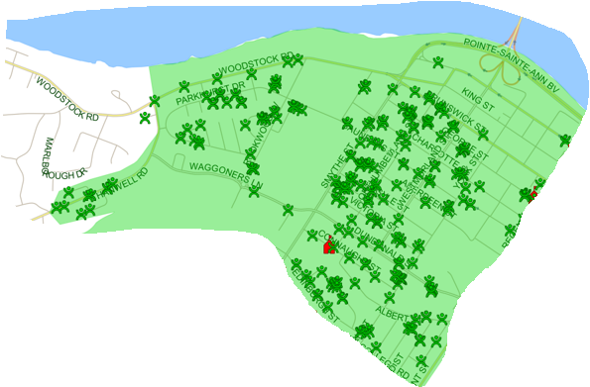
PROPOSED CATCHMENT AREA – CONNAUGHT STREET SCHOOL
Proposed Connaught Street School Boundary
Grades | # of Students
K | 33
1 | 43
2 | 48
3 | 38
4 | 40
5 | 46
Total | 248

Slide 7
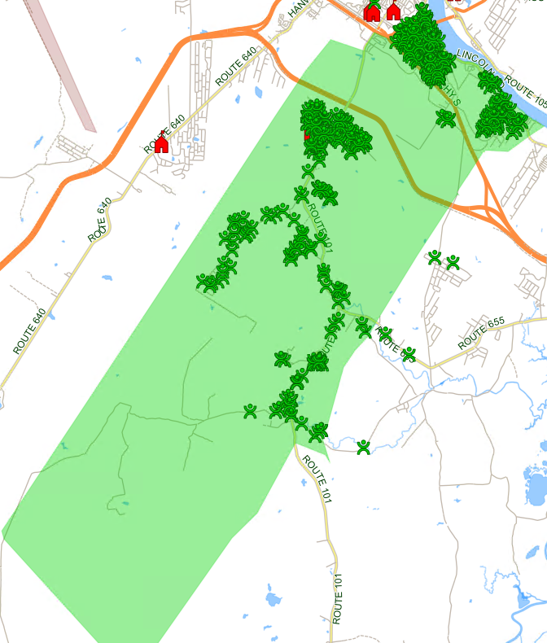
CURRENT CATCHMENT AREA – BLISS CARMAN MIDDLE
Current Bliss Carman Middle School Boundary
Grades | # of Students
6 | 218
7 | 187
8 | 231
Total | 636

Slide 8
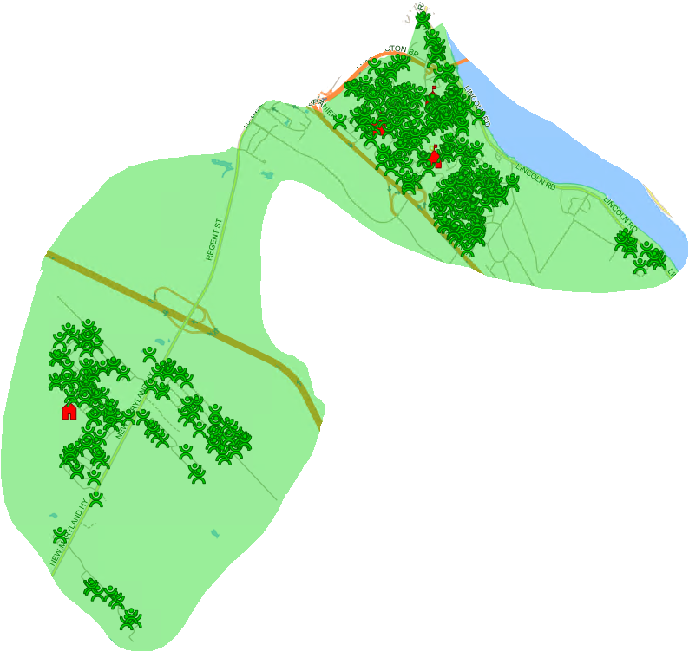
PROPOSED CATCHMENT AREA – BLISS CARMAN MIDDLE
Proposed Bliss Carman Middle School Boundary
Grades | # of Students
6 | 149
7 | 128
8 | 167
Total | 444

