Slide 1



Academic Support Teachers in K-8 Numeracy Classrooms

Slide 2


ASDW Schools
Notes:
In ASDW, we have 39 Academic Support Teachers:
They support various schools across our district , such as:
K-2 (2 ), 2-5 (1) , 3-5 (2), K-5 (18) , K-8 (10), K-12 (3), 6-8 ( 3)

Slide 3



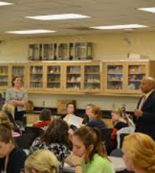
the Role of an AST in the Numeracy Classrooms
Collaborate with educators
Classroom Intervention
Co-teach/Co-plan
Direct small group or individual instruction
Notes:
Tier 1 Tier 2
PLCs – data driven
Build teacher capacity

Slide 4

ASD-W focus - Operations
Grades K,1 – Subitizing up 10 and Counting principles
Grades 2,3 - addition and subtraction fact fluency
Grades 4,5 - multiplication and division fact fluency, decimals
Grades 6 - addition, subtraction, multiplication and division of benchmark decimals
Grade 7 - Focus on addition, subtraction, multiplication and division of decimals and fractions/mixed numbers
Grade 8 - Multiply and divide integers, order of operations with whole numbers, fractions and decimals
Notes:
Provincial assessments indicated low success rate in operation application. With AST support in schools, we directed their work to target "operations" in the Number strand from grades 1-8 .
It is our hope that with target focus, this will increase achievement in operations and skills achievement in the Number Strand.

Slide 5
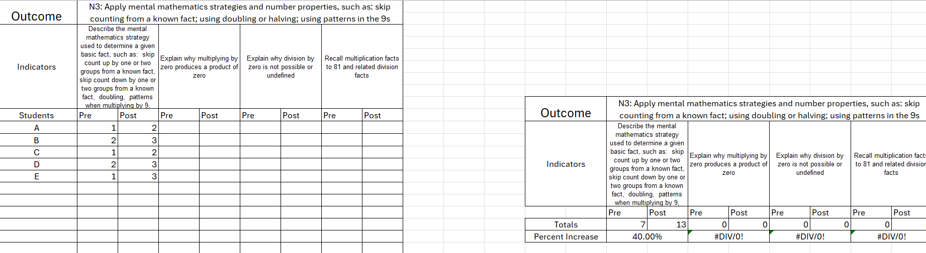

Data Reporting for AST Interventions
Outcome specific
Targeted Indicators
Pre – Post
Growth percentage based on achievement scale 1-3
Notes:
SharePoint is being created for ASTs to upload data

Slide 6


Measuring the Impact & Supporting Academic Support Teachers
Monthly sessions
Survey results from teachers and school leaders
Anecdotal evidence suggests students benefit from AST support
2024-2025 targeted data spreadsheet
Notes:
First Thursday of each month, Numeracy team meets with ASTs to provide professional learning, time for collaboration and problem solving.

Slide 7

QuEstions?
Thank you!
Your Numeracy Coordinator Team: Derrick Grant (6-12 FEC – OEC)
Katrina Paget (K-12 WEC)
Mary Anne Reynolds (K-5 FEC – OEC)

