Slide 1
Culturally-Based Education
By
David Perley
(November 21, 2024)

Slide 2
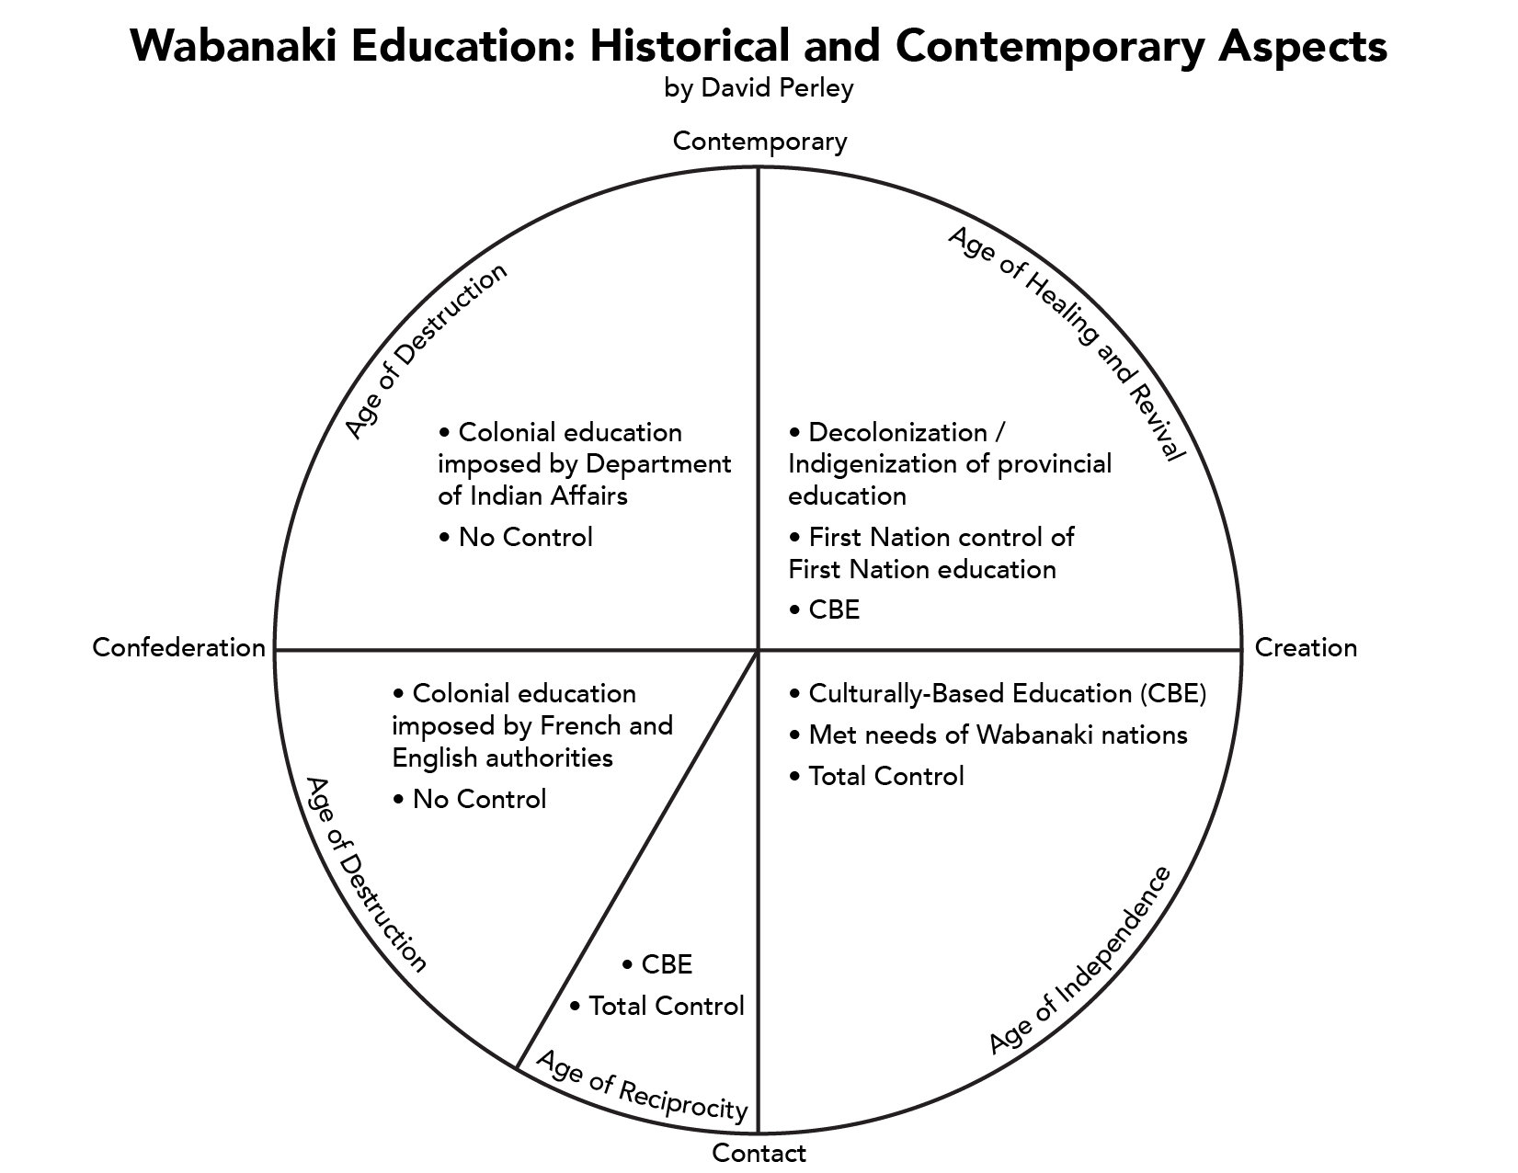

Slide 3
What is Culturally-Based Education?
“Education which reflects, validates and promotes the values, world views, and language(s) of the community’s culture. CBE is intended to honour all forms of knowledge, ways of knowing and world views equally. The goal of CBE is to support all students through affirmation of their culture. It builds a sense of pride and self-esteem, which is the best gift any teacher can give to his/her students.”
(North West Territories Teacher Induction Program)

Slide 4
Impacts of Culturally-Based Education
First, culture-based education (CBE) positively impacts student socio-emotional well-being (e.g., identity, self-efficacy, social relationships). Second, enhanced socio-emotional well-being, in turn, positively affects academic outcomes.
The data support the hypothesis that cultural approaches strongly enhance relevance and relationships at school, while also supporting positive academic outcomes (pp. 17)
Source: “Culture-based Education and Its Relationship to Student Outcomes” by Shawn Kana’iaupuni, Brandon Ledward and “Umi Jensen in Kamehameha Schools Research and Evaluation Division, September, 2010.

Slide 5
Impacts of Culturally-Based Education
Have higher socio-emotional well-being and higher levels of trusting relationships with adults
Experience a deeper sense of belonging at school
Demonstrate enhanced motivation, self-esteem, and ethnic pride
These, in turn, lead to increased achievement as students begin to feel comfortable in their school environment. There is a direct tie between culture-based education and improved student outcomes.
Source: Value of Culture-Based Education for Native American Students (https://cicerogroup.com/blog/2019/07/19/the-value-of-culture-based-education-for-native-american-students/)

Slide 6
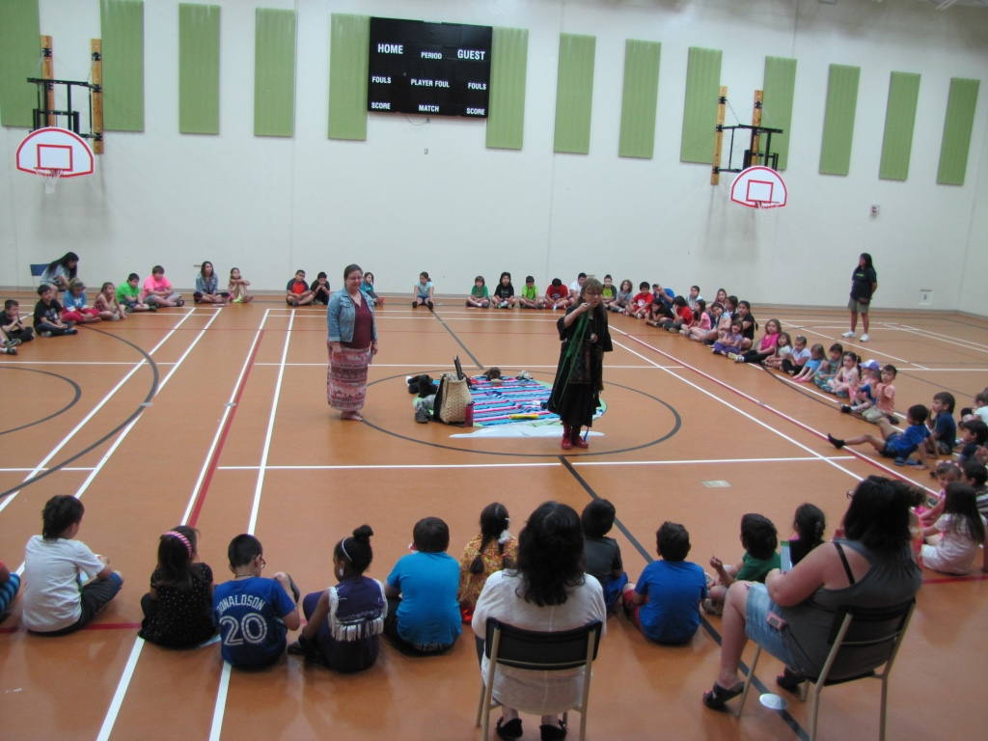
Elements of Culturally-Based Education Program
Incorporates Wolastoqey culture and language
Adopts pedagogical practices that reflect Wolastoqey culture
Adopts teaching strategies that are congruent with Wolastoqey culture and in particular ways of knowing and learning

Slide 7
Elements of Culturally Based Education Program
Implements a curriculum based on Wolastoqey culture
Encourages community participation in general and school activities in particular
Acknowledges and incorporates the knowledge and world views of Wabanaki communities

Slide 8
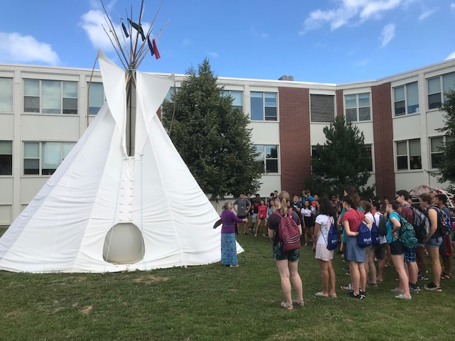
Culturally-Based Education Bachelor of Education Program

Slide 9
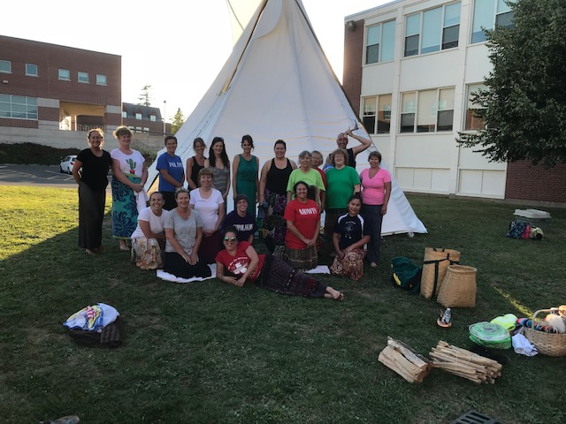
Culturally-Based Education Bachelor of Education Program

Slide 10
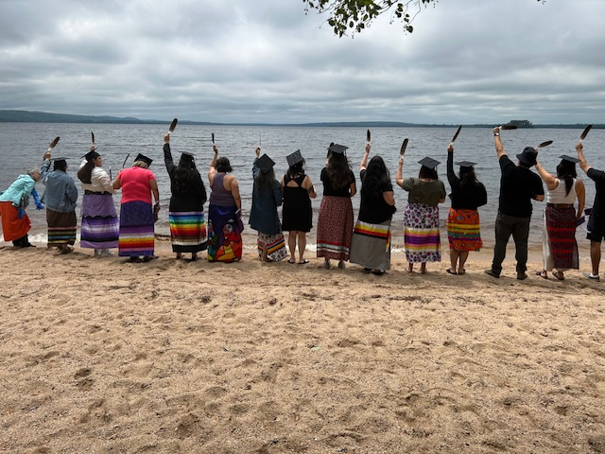
Culturally-Based Education Wabanaki Bachelor of Education

Slide 11
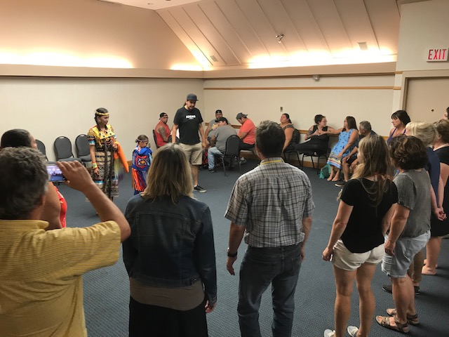
Culturally-Based Education Cultural Immersion for Teachers

Slide 12
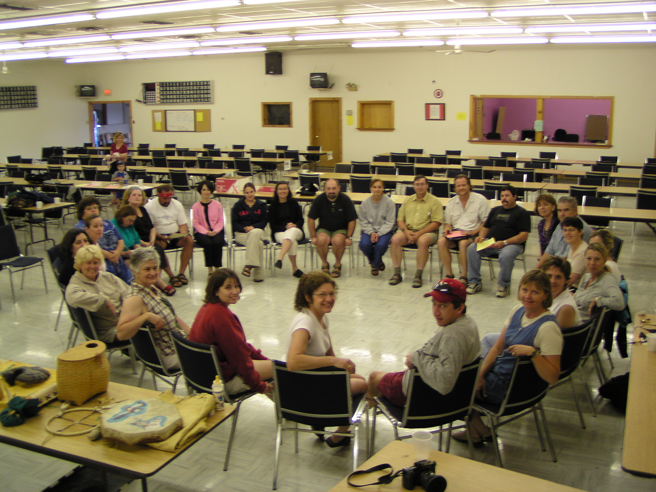
Culturally-Based Education Cultural Immersion for Teachers

Slide 13
Culturally-Based Education
Culturally-responsive teachers and administrators
Culturally-responsive schools
Culturally-knowledgeable students

Slide 14
Culturally-Based Education
“If my children are proud, if my children have identity, if my children know who they are and if they are proud to be who they are, they’ll be able to encounter anything in life. I think this is what education means.”
(Native Mother)

Slide 15
Culturally-Based Education
Woliwon!

