Slide 1
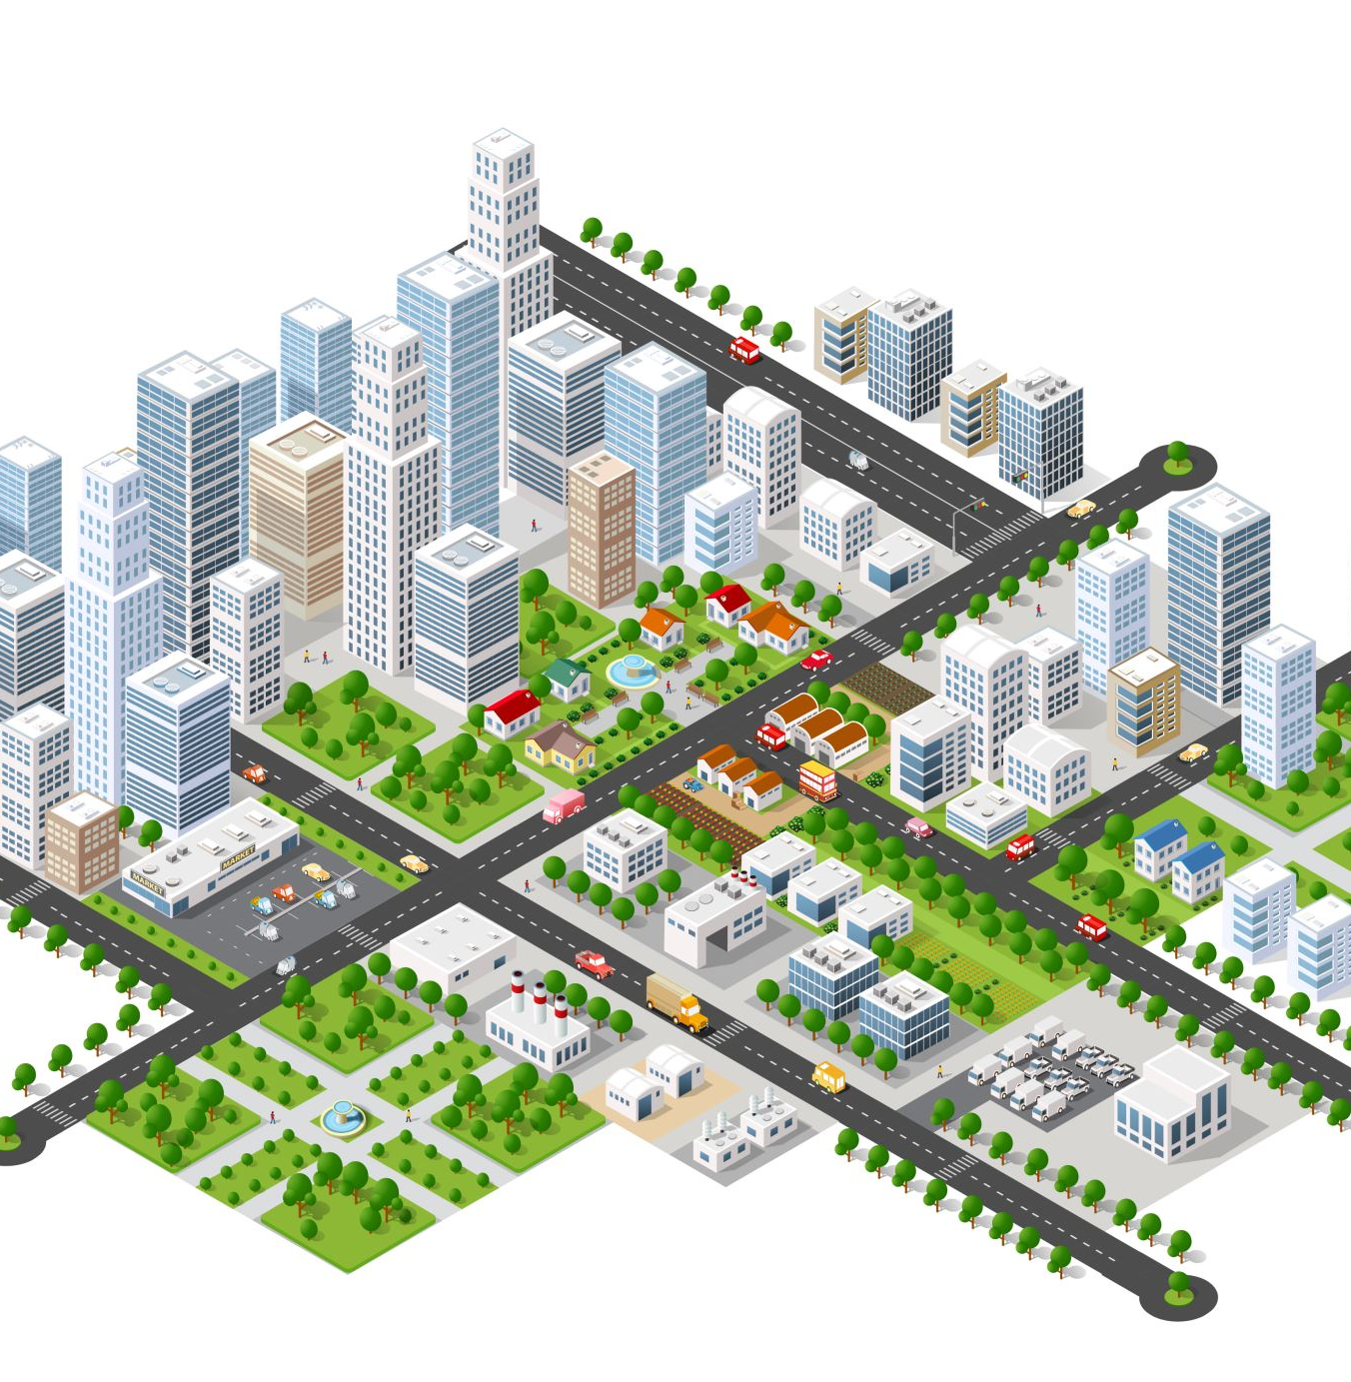
25/26 Multi-Year Infrastructure Plan

Slide 2
Infrastructure Database
The district keeps a database of each school and updates the information on an annual basis as part of the infrastructure plan to support decisions around sustainability and major capital infrastructure.

Slide 3
Projects Underway
Fredericton Northside East K-5 (Cuffman Street) Construction - Estimated to open Sept 2024
Nashwaaksis Memorial / McAdam Avenue K-5 Construction - Estimated to open Sept 2025
Carleton North K-8 - Land Acquisition
Liverpool Elementary and Forest Hill Elementary Replacement - Education Specifications & Land Acquisition
George Street Middle School Replacement - Education Specifications & Land Acquisition

Slide 4
Major Capital Priorities on SDIP (2024-25)
Education and Early Childhood have scored using the Quadruple Bottom Line Matrix (QBL) the following 5 projects and they sit on a five-year plan provincially with District Projects across the Province:
#5 - George St Middle School Replacement School
#17 - OHS Midlife
These projects do not have to be resubmitted for approval by the District Education Council.
#15 - Oromocto K-8 School Rationalizations
#20 - Devon Middle Replacement
#3 - Forest Hill/Liverpool St Elementary School Rationalization Project for a new K-5 school

Slide 5
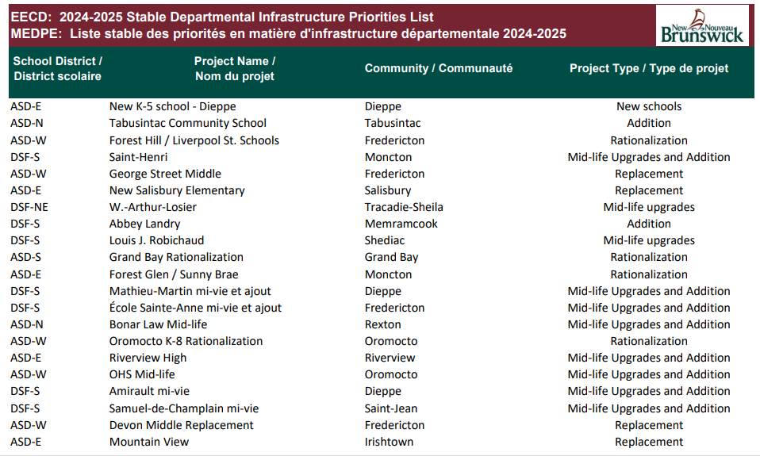

Slide 8
Major Capital Priorities Proposed
Minto/Chipman Building Assessment based on EY study that was conducted that recommended: Combine Minto High with Minto Elem/Middle & Combine Chipman Elementary in with Chipman Forest Avenue
Leo Hayes High School Shop and Skill Trades Addition and Renovation
Montgomery St Replacement School with goal to ease enrolment pressures at Connaught St School
Barkers Point Elementary School Replacement
Garden Creek/KCS Rationalization Study
McAdam Area Rationalization
Woodstock High School Mid-Life Project
Saint Mary’s Academy Building addition to address the increased enrolment
Plaster Rock School Review: K-12 concept at Tobique Valley High School
Future School K-8 in Doak Road Development Area
Fredericton
What is the recommended priority listing?

