Slide 1
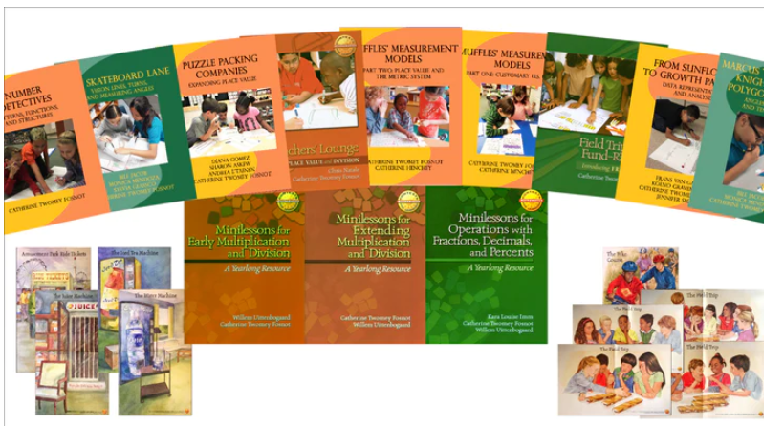
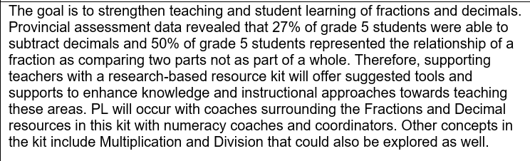
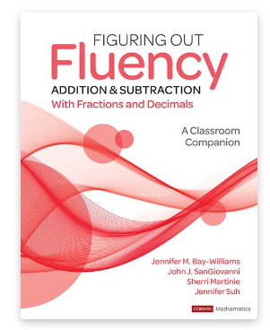

Strategies and Actions to Improve Academic Achievement in ASD-W
Focused in on specific grade level ( 5 and 7) schools ( based on student achievement results)_
Numeracy -
Grade 5 PL
Numeracy -
Grade 7 PL
Notes:
For grade 7 – also created a binder of resources for fractions for teachers to support teaching

Slide 2

Strategies and Actions to Improve Academic Achievement in ASD-W
Numeracy -
Knowledgehook currently in 2 schools; in line for expansion to 8 more schools
Zorbits Program K-3 at 20 schools . ASD-W has 1240 active student accounts and 186 teachers using from K-3 ( both Prime and FI)
Math Running Records - 37 schools K-8, are implementing the framework across ASD-W
Book Studies K-2 ( Fluency and Flexibility - 75 teachers )
3-5 ( Developing Fluency - 55 teachers )
6-8 ( Open Middle - 10 teachers and Guided Math – 13 teachers )
D2L PL Hub Learning Modules ( k-2, 3-5 Numeracy )
Weekly Posts for Teachers on the ASD-W TEAMS site ; i.e. Pedagogical Practices and resources to enhance teaching and learning
Formative Data Collection Spreadsheet being used in schools with an Academic Support Teacher. Currently, 18 of 34 have teachers engaged with the usage of the tool.
ASD-W K-12 Numeracy SharePoint site that offers resources to teachers to enhance planning, instruction, assessing and reporting
Building Thinking Classrooms – Professional Learning ( 136 teachers 2023-24)

Slide 3
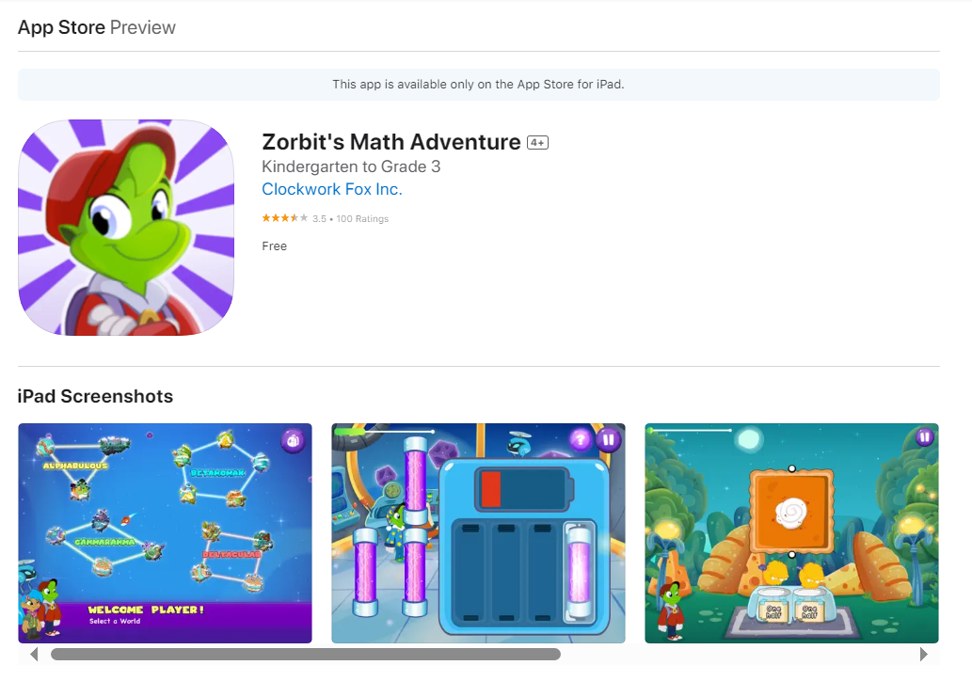
NUMERACY STRATEGIES
Zorbit's Math Adventure
‎Zorbit's Math is a blended learning platform for K-3 math that empowers teachers to elevate lesson plans in class, at home, and anywhere in between. The foundation of the platform is the Zorbit’s Math Adventure game where curriculum standards are integrated into engaging gameplay and fun narrative

Slide 4
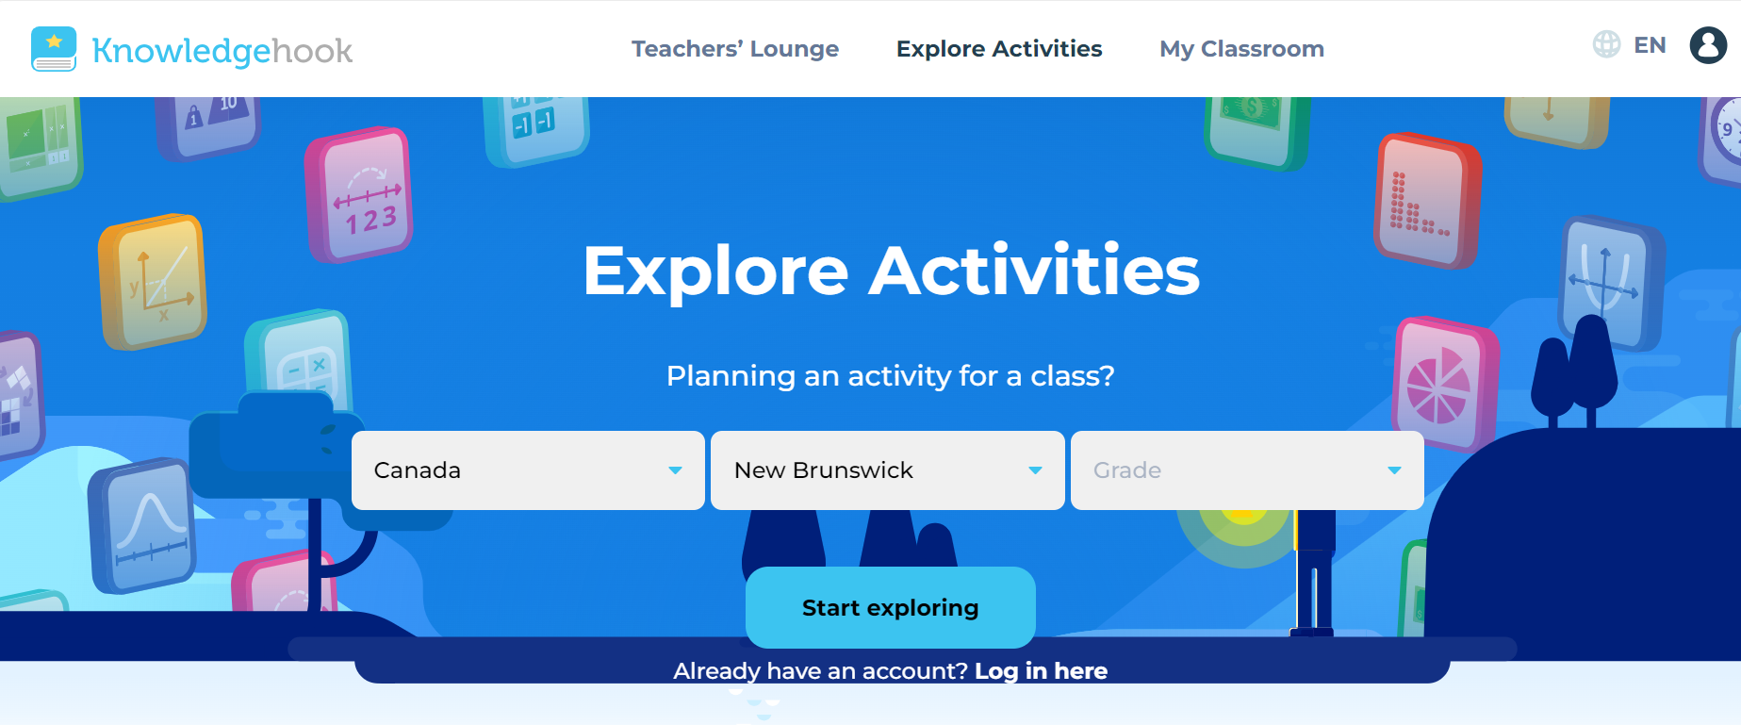
NUMERACY STRATEGIES
Knowledgehook
‎Knowledgehook is a secure, online tool designed to provide useful information to help guide the next steps in instruction during the learning process.
Teachers can send updates and reports on questions covered in class through emails. These will give families a general overview of how their child did during that particular activity, but will not show the exact questions they answered. These emails are chosen by the teacher and may be sent regularly or intermittently at the teacher's discretion.

Slide 5
Strategies and Actions to Improve Academic Achievement in ASD-W
Literacy –
Introduction of tools ( Oral Reading Fluency ; Maze Comprehension ; Spelling Inventory )
20 PLCs on topics related to the Holistic Curriculum
K-2 Foundational Support with the Building Blocks of Reaching ( Year 2)
Grades 3-5 and on request at 6 -8
Literacy SharePoint Site ; Lit Bits Newsletters ; Teacher Resource site
EST-Resource Support and professional learning provided on intervention tools

Slide 6
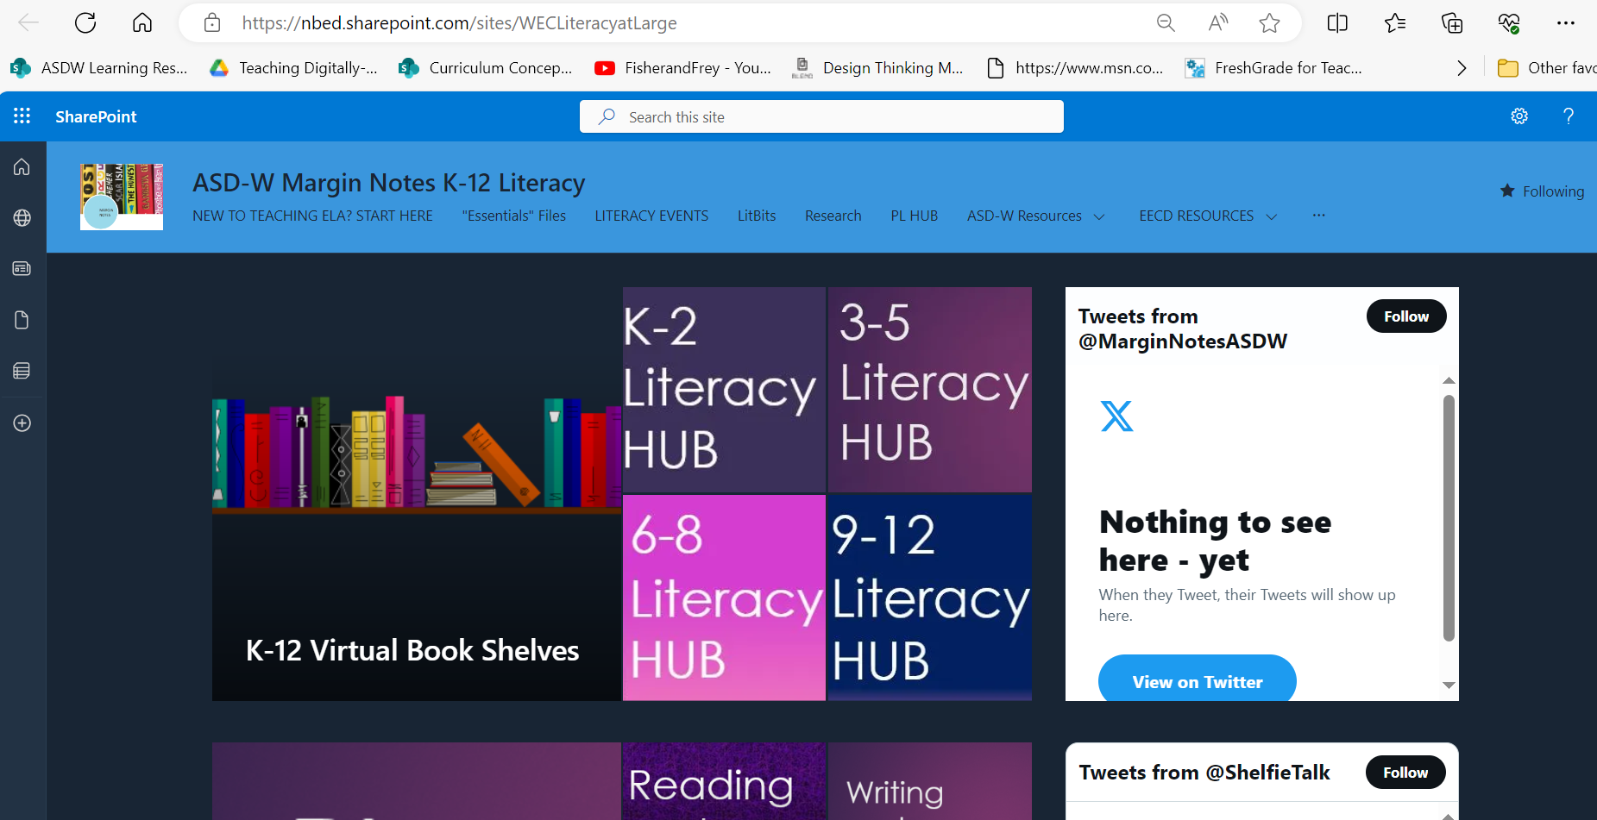
ASD-W Margin Notes K-12 Literacy - Home (sharepoint.com)

Slide 7

EGLA Early Grades Language Assessment
Background
EGLA is a standardized, formative assessment tool. It’s meant to be used regularly in classrooms to target reading skills (one-on-one, small group, or whole class).
EGLA is aligned with the new English and French Language Arts Holistic Curriculum documents and provides greater consistency in how reading skills are assessed across our province.
Early Grades Literacy Assessment (sharepoint.com)

Slide 8
Literacy / Numeracy
Coordinators/Coaches/Leads supporting all teachers/schools across ASD-W ( Teacher PL, capacity building , …)
5 Numeracy and 6 Literacy
Coaches/Leads supporting new teachers/ 55 local permits ( close to 200)
Coordinators /Coaches /Leads supporting the work of the 34 ASTs of ASD-W
Coordinators supporting school administrators ; conversations with the Instructional Leaders
Coordinators/Coaches/Leads supporting the 34 schools Implementing the Holistic Curriculum 2023-24

Slide 9


PL Hub (nbed.ca)

Slide 10

September to December 2023
Survey results Summary
Notes:
Provincial Assessment Hub

Slide 11
The Academic Support Teacher for Literacy and Numeracy position has been established to provide students with direct academic support and to enhance teachers’ ability to collect data, analyze data, and provide targeted small group instruction based on personalized student goals. Improved student achievement in literacy and numeracy is the primary goal of the work of the Academic Support Teacher, and increased teacher capacity is a secondary benefit.
AST Initiative
Vision
Key Performance Indicators (KPIS) 2023-2024
Improved student achievement in literacy and numeracy using report card data
Improved student achievement in numeracy outcomes using the Formative Assessment Tool
Improved student achievement in reading using the Early Grades Literacy Assessment (EGLA)
Improved attendance of students who receive direct academic support though this work
Improved teacher competence collecting and analyzing student data, co-constructing personalized student goals, and providing targeted small group instruction from feedback survey/focus groups

Slide 12
Preliminary Information from Surveys
In place now:
98 ASTs provided to 93 schools provincially (Sept-Dec, 2023)
80% across the province began their role in Aug/Sept 2023
11% did not begin until November or later
District | Number of ASTs | # of AST Survey Responses* | # of Teacher Survey Responses | Number of Schools with ASTs | # of Admin. Survey Responses
ASD-N
ASD-S
ASD-E
ASD-W | 34 | 34 | 169 | 34 | 34
Total | 98 | 95 | 369 | 93 | 92

Slide 13
Support Provided
ASTs report supporting 576 classrooms in total
24% were assigned to Grade 3 classes.
ASD-W ASTs report supporting 220 classrooms in total (169 completed the survey)
Grade Levels supported by AST’s :
  Grade 3 82% 28 classes
  Grade 4 79% 27 classes
  Grade 2 74% 25 classes
  Grade 5 68% 23 classes
  Grade 1 65% 22 classes
  K 56% 19 classes
  Grade 6 9% 6 classes
  Grade 7 15% 5 classes
  Grade 8 6% 2 classes
Classes Supported by Grade | Provincial Data | Percent
K and combined classes with K | 74 | 14%
G1 and combined classes with G1 | 81 | 15%
G2 and combined classes with G2 | 89 | 17%
G3 and combined classes with G3 | 127 | 24%
G4 and combined classes with G4 | 93 | 17%
G5 and combined classes with G5 | 59 | 11%
G6 and combined classes with G6 | 9 | 2%
G7 | 3 | 1%
G8 | 3 | 1%
Each AST supported 2-10 classrooms with an average of 6 per AST

Slide 14
Type of Support Provided
Overall, ASTs have spent a greater percentage of time supporting targeted literacy activities than numeracy activities.
Percentage of ASTs support
Help Provided | Numeracy Support Prov / ASD-W | Literacy Support Prov / ASD-W
Collecting data using a tool or method that was already in place in the classroom. | 48% 53% | 66% 76%
Helped the teacher to use a new tool or method for collecting data. | 56% 56% | 81% 91%
Helped the teacher review/analyze data to inform instruction using a process already in place in the classroom. | 54% 62 % | 72% 79%
Helped the teacher develop a new process for reviewing/analyzing the data. | 26% 18% | 58% 59 %

Slide 15
Type of Support Provided
Overall, ASTs have spent a greater percentage of time supporting targeted literacy activities than numeracy activities.
Percentage of time ASD-W
Planning related to literacy, including assisting with collecting and reviewing data Direct small group or individual learner literacy instruction | 50% 44%
Planning related to numeracy, including assisting with collecting and reviewing data Direct small group or individual learner numeracy instruction | 47% 32%

Slide 16
Type of Support Provided to Classroom Teachers and Most Useful
Help Provided | Province | ASD-W
Helping with collecting Leaner Data | 83% | 85%
Helping to interpret data to inform Instruction | 60% | 62%
Developing Learner Interventions with the classroom Teacher | 48% | 47%
Modelling/ providing learner Interventions | 56% | 57%
Activities Most Useful | Province | ASD-W
Assisting with targeted small group literacy/numeracy instruction | 46% | 48%
Helping with collecting learner data | 18% | 17%
Developing /modelling/ providing Learner Interventions | 14% | 14%

Slide 17
AST Work Context
Number of days ASTs) were needed for supply teaching/ unfilled vacancies:
Provincially ASD-W
41% - no days 47% - no days
Mean = 2.4 days Mean = 1.5 days
In addition, 66% provincially and 71 % for ASD-W of ASTs participated in nearly all relevant PLC meetings.
Some barriers for the AST role:
  New to role and new to school / getting the school to understand the role
  Supply teacher shortage
  Delay in availability of EGLA class report or platform
  Too many teachers/students to support

Slide 18
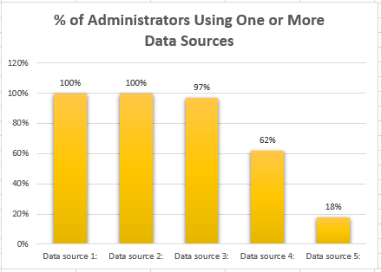
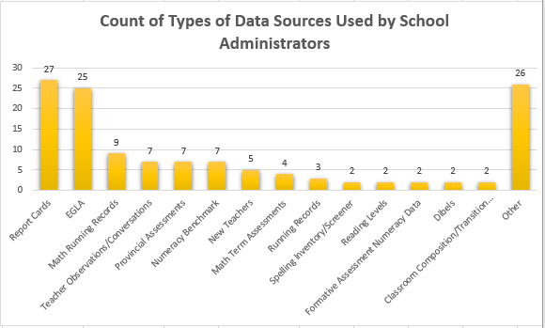
Academic Support Teacher Survey: Main data sources that assisted school administrators in assigning the AST to classrooms for Literacy and Numeracy

Slide 19
Preliminary Impacts
80% Provincially and 82% for ASD-W of classroom teachers with AST support feel it is having positive effect on learning for all or nearly all learners.
97% Provincially and 100% for ASD-W of school administrators agreed that having an AST had a positive impact on their school.
Improvements in Learning Outcomes
Teachers are observing increased outcomes in literacy and numeracy.
Students previously working slightly below grade level have improved.
Students and Teachers Feeling More Supported
Classes with many different academic needs are getting more targeted support.
ASTs allow for much-needed small group instruction.
Support has been particularly valuable for new teachers—less stress, more confidence.
Better Implementation of Initiatives
Teachers are supported in implementing strategies like the Building Blocks of Reading, EGLA, Collecting Data for Formative Math Recording, and incorporating Running Records into daily practice.
Many mentions of ASTs being instrumental in supporting EGLA
Increase in familiarity with the curriculum and formative assessment practices.
School-specific goals that have been discussed for years finally launching successfully.

Slide 20
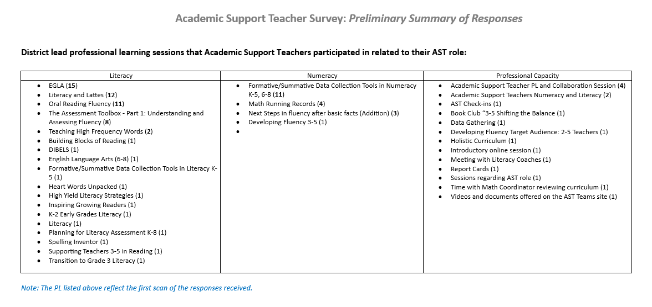

Slide 21
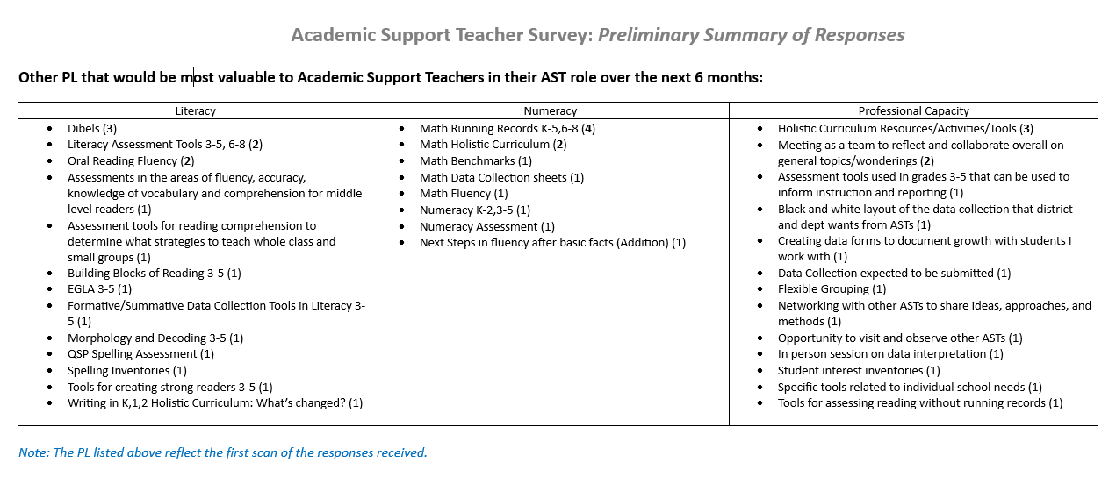
Future PL ….

Slide 22
Next steps..
Key Performance Indicators (KPIS) 2023-2024
Improved student achievement in literacy and numeracy using report card data
Improved student achievement in numeracy outcomes using the Formative Assessment Tool
Improved student achievement in reading using the Early Grades Literacy Assessment (EGLA)
Improved attendance of students who receive direct academic support though this work
Improved teacher competence collecting and analyzing student data, co-constructing personalized student goals, and providing targeted small group instruction from feedback survey/focus groups

Slide 23
