Slide 1
Circle of Understanding
y

Slide 2
Kwolahsihkulpon
Kwolahsihkulpon askomi tpeltomuhtit ‘kitahkomikumuwa Wolastoqewiyik.
We Welcome you to the unceded Territory of the people of the beautiful and bountiful river Wolastoq.

Slide 3
Sankuwi Kisuhs
Thirteenth Moon teaches us the medicine of grandmother teachings. Every night, our grandmother moon watches over us. They teach us to take care of our lives, during our earth walk and when we return to our spirit walk. Before our birth, we hear the echo of our grandmothers who went before us within the wombs of our mothers. At Birth, we hear the echoes of our grandmothers again whenever we sound our sacred drums. All Grandmother Drums are our medicine.

Slide 4
Wetapeksi
I represent my Kiwhos and Qaqsoss clan that gifted me identity, my traditional name is Opolahsomuwehs which means Moon of the Whirling Wind, a name that I am reclaiming from my day school assaults on my cultural pride. Unfortunately, an ongoing intergenerational ordeal that still exists today as our indigenous children strive to learn in a culturally safe space.
A sacred fire is lit to represent our shared council fire of understanding. May our passion that gifts us with purpose be respectfully united as we weave our cultural differences into a braid of friendship.
I have prepared a wooden bowl of water to honor my Wolastoqi ancestors as people of the beautiful and bountiful river and to gift them gratitude for instilling in me the art of respecting all emotions, may all our emotions be medicine of heart
I am sharing earth mother’s medicine to honour gifts of all senses.
Skicin- Earth walker
Waponuhkew- People of the Dawn
Wolastoqew- People of the River
Neqotkukew- TFN
Sitansiskew- SMFN
Metaksonihkew-HBMi
Kiwhusuwakutom-Muskrat Clan
Qaqsossuwakutom-Fox Clan
Monqon Aluhk-Rainbow Clan
Uhkomi Komiwon-Grandmother Rain

Slide 5
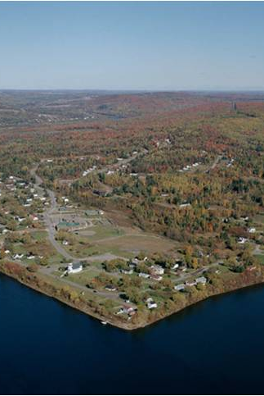
Wolastoq Nil Ntoliwis
Kilhusuwicik
Malisicik
Wolastoq
Wolastoqew
Wolastoqiyik
Wolastoqey
Wolastoqi

Slide 6
Cultural Humility
Cultural Humility is the “ability to maintain an interpersonal stance that is other-oriented in relation to aspects of cultural Identity that involves acknowledging oneself as a learner when it comes to understanding another’s experience”. This extends even to treatments that might not be found in a western doctor’s guide.

Slide 7
Cultural Sensitivity
lived experiences of all people includes aspects similar and different to our own and that our actions affect other people
approaches acknowledge that difference is important and must be respected.
a culturally sensitive person is one who is familiar with the values, beliefs, ideals and worldviews of First Nations.

Slide 8
Cultural Competence
enables service providers to be respectful and effective in their interactions with First Nation people
requires improving knowledge about First Nation issues and de-colonizing the skills and actions that will lead to positive change.

Slide 9
Cultural Safety
Promotes a safe environment for all aspects of cultural identity
Promotes cultural pride and self-esteem
Celebrates unity within diversity

Slide 10
Internalized Dominance
People in the dominant culture come to see the effects of colonization as normal and natural and are unable to see their privilege. They assume that everyone shares their view of the order of things, including stereotypes of colonized people and the view of history as written by the colonizers.

Slide 11
Internalized Colonialism
Persons within the colonized group unconsciously adopt the worldview, cultural stereotypes and cultural practices of the colonizer. As a result, dominant cultural values, beliefs, social structures and power structures are perpetuated and reinforced, including racism and sexism.

Slide 12
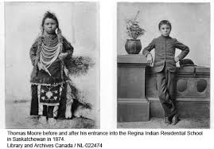
Internalized Oppression
Internalized oppression occurs when colonized individuals internalize positive messages about the dominant group and negative messages about themselves and their cultural group. This integration of negative stereotypes results in feelings of inferiority, shame, and self-hate which then underlie the development of patterns of self-destructive behaviors.

Slide 13
Objectification
The process of relating to persons in a way that depersonalizes them. When people are objectified, they cease to be thought of as living, thinking and experiencing individuals and instead are seen as things that can be studied, measured, manipulated and acted upon. When things such as culture are objectified, they are treated as static and universal phenomena which can be reduced to a list of items to be measured and manipulated.

Slide 14
TRC Calls to Action
“It is time to commit to a process of reconciliation. By establishing a new and respectful relationship, we restore what must be restored, repair what must be repaired, and return what must be returned.” (page 6)

Slide 15
TRC Calls to Action
Nuhsimis
“In order for that to happen, there has to be awareness of the past, acknowledgement of the harm that has been inflicted, atonement for the causes, and action to change behavior.” (page 6 and 7)

Slide 16
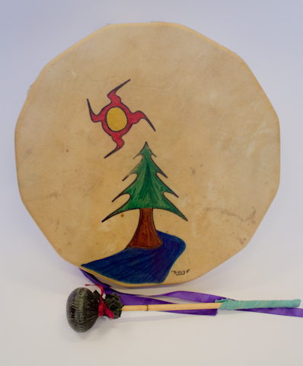
Kci Lakutimok
“We are all Treaty people. History plays an important role in reconciliation; to build for the future, Canadians must look to, and learn from, the past.” (page 8)

Slide 17
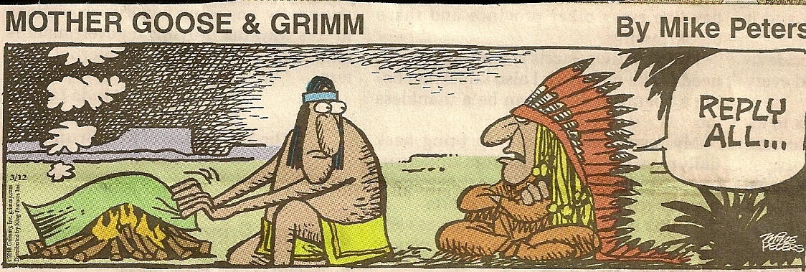
Woliwon/Welalin/Merci/Thank you
Dr. Imelda Perley C.M.
Opolahsomuwehs
C: (506) 461-0602
Email: iperley@unb.ca
Twitter: askomiw150

