Slide 1

Anglophone West School District (ASD-W)
Multi-year infrastructure planning
Oromocto Schools (K to 8)
New Brunswick Department of Education
and Early Childhood Development (EECD)
12 April 2018

Slide 2
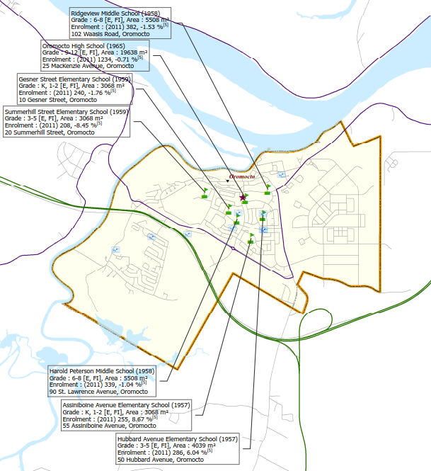
Scope – ASD-W has initiated a review of 6 Oromocto schools to examine potential scenarios for long-term infrastructure planning
  Oromocto Schools
  Subject schools – year built
  Assiniboine Avenue Elementary School (K to 2 – 1957)
  Gesner Street Elementary School (K to 2 – 1959)
  Hubbard Avenue Elementary School (3 to 5 – 1957)
  Summerhill Street Elementary School (3 to 5 – 1959)
  Harold Peterson Middle School (6 to 8 – 1958)
  Ridgeview Middle School (6 to 8 – 1958)
  Other schools possibly affected:
  Burton Elementary School (K to 2 – 1961)
  Gagetown School (K to 8 – 1960)
  Lincoln Elementary Community School (K to 5 – 2013)
  Geary Elementary Community School (K to 5 – 2014)
  Sunbury West School (K to 8 – 1991)
  Average age of the subject infrastructure:
  60 years
Source: EECD sub-district map 12, and 13 for ASD-W.

Slide 3
Scope – Consultations between the District and EY narrowed the scope to 5 potential scenarios for the infrastructure review to be summarized
The following scenarios were included within the scope of the Oromocto schools infrastructure planning review. Each scenario was based on space requirements identified in the EECD Planning Guidelines for Educational Facilities, with enrolment projections for the schools developed by mapping 2016 Census (Statistics Canada) to the school boundaries in order to determine future space requirements:
Scenario 1: Close all six schools within scope and replace them with a new 6-8 middle school (currently 663 combined students) and two K-5 elementary schools (currently 565 combined students for Assiniboine Avenue Elementary and Hubbard Avenue Elementary schools; and 524 combined students for Gesner Street Elementary and Summerhill Street Elementary schools). Develop a Class “D” (± 30%) estimate for the construction costs of the 3 new schools. Determine their future space requirements, and whether there is potential benefit from adjusting the school boundaries.
Scenario 2: Close all six schools within scope and replace them with two new K-8 schools (currently 878 combined students for Assiniboine Avenue Elementary, Hubbard Avenue Elementary and Ridgeview Middle schools; and 874 combined students for Gesner Street Elementary, Summerhill Street Elementary and Harold Peterson Middle schools). Develop a Class “D” (± 30%) estimate for the construction costs of the new schools. Determine their future space requirements, and whether there is potential benefit from adjusting the school boundaries.
Source: ASD-W: 2017-18 enrolment statistics.

Slide 4
Scope – Consultations between the District and EY narrowed the scope to 5 potential scenarios for the infrastructure review to be summarized (continued)
Scenario 3: Close all six schools within scope and replace them with three new K-8 schools, while trying to evenly distribute the student population within the school boundaries (currently 584 students per new school based on the total combined enrolment of 1,752 students in 2017-18). Develop a Class “D” (± 30%) estimate for the construction costs of the new schools. Determine their future space requirements, and whether there is potential benefit from adjusting the school boundaries.
Scenario 4: Review the existing two middle schools compared to the EECD Planning Guidelines for Educational Facilities to determine what/if any space is deficient to the guidelines for a possible school addition and/or amalgamation in a mid-life upgrade scenario in conjunction with two new elementary schools.
Scenario 5: Close all six schools within scope and replace them with a new K-2 school (currently 533 combined students for Assiniboine Avenue Elementary and Gesner Street Elementary schools); a new 3-5 school (currently 556 combined students for Hubbard Avenue Elementary and Summerhill Street Elementary schools); and a new 6-8 school (currently 663 combined students for Ridgeview Middle and Harold Peterson Middle schools). Develop a Class “D” (± 30%) estimate for the construction costs of the new schools. Determine their future space requirements, and whether there is potential benefit from adjusting the school boundaries.
Source: ASD-W: 2017-18 enrolment statistics.

Slide 5
Appendix A – Overview of schools that feed into Oromocto middle schools

Slide 6
Overview of schools that feed into Oromocto middle schools – Ridgeview Middle School has the LFI Program, and Harold Peterson Middle School has the EFI Program
Ridgeview Middle School
(grades 6-8)
Harold Peterson Middle School
(grades 6-8)
Early French Immersion (EFI) Students
Late French Immersion (LFI) Students
Hubbard Avenue Elementary School
(grades 3-5)
Summerhill Street Elementary School (grades 3-5)
Summerhill Street students go to Harold Peterson, and LFI students and a small section of English Prime go to Ridgeview
Hubbard Avenue students go to Ridgeview, and EFI students and a small section of English Prime go to Harold Peterson
Lincoln Elementary Community School
(grades K-5)
Gesner Street Elementary
School
(grades K-2)
Lincoln EFI students go to Gesner Street, and English Prime Program students go to Ridgeview
Burton Elementary School* (grades K-2)
Assiniboine Avenue
Elementary School
(grades K-2)
Geary Elementary Community School
(grades K-5)
Gagetown School*
(grades K-8)
EFI Students*
Assiniboine Avenue students go to Hubbard Avenue
Geary EFI students go to Assiniboine Avenue, and English Prime Program students to Harold Peterson
EFI Students
Source: ASD-W: English Prime and French Immersion Program Statistics.

Slide 7
Appendix B – 2016 Census data

Slide 8
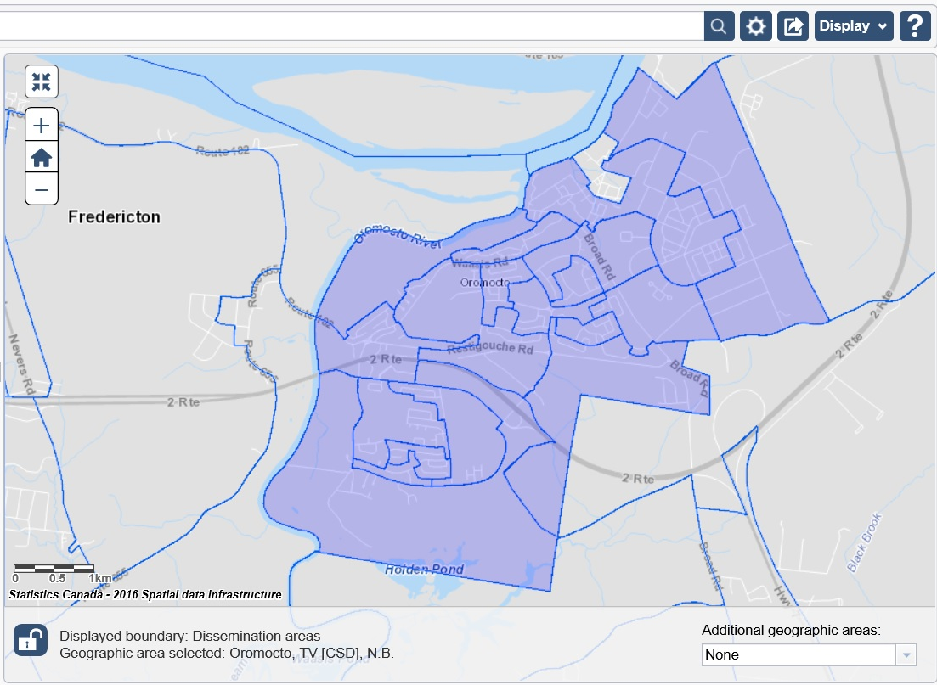
2016 Census data – Oromocto K-8 schools projected to see an increase in enrolment (based on the population age grouping census data), and from EFI program entry at grade 1
Table 1.4 Population By Five-Year Age Groups And Sex, 2016.
Boundary for Oromocto (TV)
  In 2017-18, the entry point for the Early French Immersion (EFI) program was changed from grade 3 to grade 1.
  This will increase the amount of rural students attending the Oromocto schools for Early French Immersion with two additional grades in the program.
*Source: Statistics Canada: http://www12.statcan.gc.ca/census-recensement/2016/as-sa/fogs-spg/desc/Facts-desc_Age.cfm?LANG=Eng&GK=CSD&GC=1301006&TOPIC=2&#fd1_1.

Slide 9
Mapping 2016 Census data – The dissemination areas of the 2016 Census are not an exact match to the school boundaries and assumptions were required in mapping
Main Street
Source: Google Maps, ASD-W school transportation software – Busplanner, and Statistics Canada: http://www12.statcan.gc.ca/census-recensement/2016/as-sa/fogs-spg/desc/Facts-desc_Age.cfm?LANG=Eng&GK=CSD&GC=1301006&TOPIC=2&#fd1_1.
.

Slide 10
Mapping 2016 Census data – ASD-W 2017-18 enrolment projections were compared to the 2016 Census mapping results and the discrepancy between the two was within 1.0%
  Since the dissemination areas of the 2016 Census are not an exact match to the school boundaries, the assumptions in mapping were validated by comparing the ASD-W 2017 K-5 enrolments to the number of students determined with the census statistics.
  The total amount of students (ages 4 to 9) in the 2016 Census for the Oromocto schools before assumptions was more than ASD-W had enrolled for 2017-18.
  The discrepancy between the two can be explained in several ways, including:
    Some students may be in the Francophone school system;
    The census rounds dissemination areas to the nearest interval of 5;
    The census does not fit to the school boundaries perfectly and had to be fit as best as possible;
    Some people do not file their census returns (not a 100% data collection);
    Students with later birth months (i.e. October/November/December) may choose to start school at age 6 instead of age 5;
    The census is a point in time; people move in/move out of the school boundaries; and
    Some children within the selected school boundaries are home schooled.
*Source: Statistics Canada: http://www12.statcan.gc.ca/census-recensement/2016/as-sa/fogs-spg/desc/Facts-desc_Age.cfm?LANG=Eng&GK=CSD&GC=1301006&TOPIC=2&#fd1_1 and ASD-W 2017-18 enrolment.

Slide 11
Appendix C – Scenario 1 (Close the 6 existing schools and replace with 2 new K-5s and a 6-8)

Slide 12
Based on enrolment projection results, one new K-5 school for Oromocto would be sized for 614 students, and the other for 603 students (depending on project start time)
Project start-up would depend on DEC and GNB approval
  New K-5 Oromocto Schools
  Enrolment projections indicate an increase in K-5 student population during the 10-year planning horizon (as was seen in the 2016 Census data and for the entry point change of the EFI program).
  2027-28 was projected with the most students (614 for Assiniboine Avenue/Hubbard Avenue and 603 for Gesner Street/Summerhill Street) after the period of potential construction.
  The schools would be larger than a typically sized K-5 school. The EECD Planning Guidelines note a regular elementary school is typically sized between 200 and 500 students.
  For comparison, based on 2016-17 school statistics, GNB had 86 K-5 schools. 48 of these schools were considered regular sized schools. The average student enrolment for this regular sized school was 355.
  There were 5 K-5 schools whose enrolment exceeded 500 students in 2016-17:
    École Champlain (631)
    Gibson-Neill Memorial Elementary (615)
    École Sainte-Thérèse (601)
    École Anna-Malenfant (578)
    Priestman Street Elementary (534)
Project start-up would depend on DEC and GNB approval
Note: Statistics from the dissemination areas of the 2016 Census were mapped to the school boundaries and the ASD-W 2017-18 enrolment statistics to project the enrolment. It was assumed that both K-5 schools would have an EFI program.
The entry point for the EFI program was changed from grade 3 to grade 1 in 2017-18. The two additional grades of EFI will increase the number of students attending Oromocto schools from the surrounding rural schools.
Source: ASD-W: 2017-18 enrolment statistics, EECD Policy, Planning Summary Statistics, EECD Planning Guidelines for Educational Facilities, and Statistics Canada 2016 Census: http://www12.statcan.gc.ca/census-recensement/2016/as-sa/fogs-spg/desc/Facts-desc_Age.cfm?LANG=Eng&GK=CSD&GC=1301006&TOPIC=2&#fd1_1.
New Schools: 2 K-5s, and a 6-8 (Scenario 1)

Slide 13
Based on enrolment projection results, a new 6-8 middle school for Oromocto would be sized for 759 students (depending on project start time)
Project start-up would depend on DEC and GNB approval
  New 6-8 Oromocto School
  Enrolment projections indicate an increase in 6-8 student population during the 10-year planning horizon (as was seen in the 2016 Census data and for the 2017-18 K-5 enrolment data).
  2026-27 was projected to require the most classroom space for the 3 different programs (English Prime, EFI and LFI), with 759 students (614 for Assiniboine Avenue/Hubbard Avenue and 603 for Gesner Street/Summerhill Street) after the period of potential construction.
  The school would be larger than a typically sized 6-8 middle school. The EECD Planning Guidelines note a regular middle school is typically sized between 300 and 700 students.
  For comparison, based on 2016-17 school statistics, GNB had 29 6-8 schools. 17 of these schools were considered regular sized schools. The average student enrolment for this regular sized school was 470.
  There were 2 6-8 schools whose enrolment exceeded 700 students in 2016-17:
    École Carrefour de l'Acadie (752)
    George Street Middle School (727)
Note: Statistics from the dissemination areas of the 2016 Census were mapped to the school boundaries and the ASD-W 2017-18 enrolment statistics to project the enrolment. It was assumed that the 6-8 school would have both an EFI and an LFI program.
The projected student distribution indicates 32 classrooms (17 English Prime, 10 EFI and 5 LFI) would be required for the 759 students in 2026-27. Although 2024-25 had 5 more students, the projected split in the program required less classrooms (16 English Prime, 10 EFI and 4 LFI). Therefore, the analysis was based on the 759 students in 2026-27.
Source: ASD-W: 2017-18 enrolment statistics, EECD Policy, Planning Summary Statistics, EECD Planning Guidelines for Educational Facilities, and Statistics Canada 2016 Census: http://www12.statcan.gc.ca/census-recensement/2016/as-sa/fogs-spg/desc/Facts-desc_Age.cfm?LANG=Eng&GK=CSD&GC=1301006&TOPIC=2&#fd1_1.
New Schools: 2 K-5s, and a 6-8 (Scenario 1)

Slide 14
Class “D” estimate*: $73.4M to $76.4M would be required for the construction of 2 new K-5 and a 6-8 middle school, with a cost avoidance of $7.3M in deferred maintenance
  2 K-5 and a 6-8 School Scenario
  Class “D” estimate* for the 3 new schools is approximately $73.4M to $76.4M, depending on the cost of land and any topographical challenges.
  EECD Planning Guidelines recommend a site size of 24 acres each for the two K-5 schools and 26 acres for the middle school (Note: in urban areas, site size may be reduced when land is at a premium and/or existing community field/facilities are used offsite).
  The cost avoidance for deferred maintenance at the 3 proposed amalgamated schools would be $7.3M, as identified in the EECD School Physical Plant Status Report.
  Based on the current EECD Planning Guidelines, the total school footprint would see an increase in net square metres of 3,308 m² for scenario 1.
*Note: Class "D" estimate (± 30%) based on the EECD Planning Guidelines for Educational Facilities, as an estimate for this report only. Estimates will be adjusted when EECD Infrastructure and project team establish the actual space allocation. EECD School Asset Data, School Physical Plant Status Report for Deferred Maintenance.
New Schools: 2 K-5s, and a 6-8 (Scenario 1)

Slide 15
The annual operational costs in scenario 1 are estimated to remain approximately the same (excluding staffing), based on historical costs for schools of similar size and efficiency
  Operational Costs
  Scenario 1 closes 6 existing schools and amalgamates them into 3 new schools.
  Based on the current EECD Planning Guidelines and student enrolment projections, the total school footprint would see an increase in net square metres of 3,308 m².
  A review of annual operational costs (excluding staffing) for schools of a similar size/scale indicates that annual operational savings from school closures would be used to offset increased costs of a larger school footprint.
  Busses already commute from the outside communities (Geary Elementary Community School, Burton Elementary School, Gagetown School and Lincoln Elementary) to the Oromocto area for the French Immersion Program. The District anticipates minimum changes in student transportation and associated costs due to the close proximity of the Oromocto schools.
Source: EECD School Asset Data and ASD-W file: Operating Costs for 2016.
New Schools: 2 K-5s, and a 6-8 (Scenario 1)

Slide 16
Appendix D – Scenario 2 (Close the 6 existing schools and replace with 2 new K-8s)

Slide 17
Based on enrolment projection results, one new K-8 school for Oromocto would be sized for 999 students, and the other for 961 students (depending on project start time)
Project start-up would depend on DEC and GNB approval
  2 New K-8 Oromocto Schools
  Enrolment projections indicate an increase in K-8 student population during the 10-year planning horizon (as was seen in the 2016 Census data and for the entry point change of the EFI program).
  Changes to existing school boundaries are required to prevent switching between K-8 schools.
  2026-27 was projected with the most students (999 for Assiniboine Avenue/Hubbard Avenue/Ridgeview Middle and 2025-26 with 961 students for Gesner Street/Summerhill Street/Harold Peterson) after the period of potential construction.
  The schools would be larger than a typically sized K-8 school. The EECD Planning Guidelines note a regular mixed school is typically sized between 300 and 650 students (700 for 6-8 schools).
  For comparison, based on 2016-17 school statistics, GNB had 79 K-8 schools. 24 of these schools were considered regular sized schools. The average student enrolment for this regular sized school was 458.
  There were 3 K-8 schools whose enrolment exceeded 650 students in 2016-17:
    Evergreen Park School (780)
    Northrop Frye School (765)
    Forest Hills School (671)
Note: It was assumed that this school would have an EFI and the LFI program. Adjustments are required to the existing school boundaries to prevent students from switching between schools. EFI students from Geary currently attending Assiniboine Avenue would be moved to the Harold Peterson amalgamated K-8. Hubbard Avenue EFI students attending Harold Peterson would now remain at the Ridgeview amalgamated K-8. Hubbard Avenue English Prime students from the MacKenzie Avenue area attending Harold Peterson, would remain at the Ridgeview amalgamated K-8. Summerhill Street English Prime students from the Dexter Crescent area attending Ridgeview, would remain at Harold Peterson amalgamated K-8.
Project start-up would depend on DEC and GNB approval
Note: Statistics from the dissemination areas of the 2016 Census were mapped to the school boundaries and the ASD-W 2017-18 enrolment statistics to project the enrolment. It was assumed that both K-8 schools would have an EFI program.
The entry point for the EFI program was changed from grade 3 to grade 1 in 2017-18.
Source: ASD-W: 2017-18 enrolment statistics, EECD Policy, Planning Summary Statistics, EECD Planning Guidelines for Educational Facilities, and Statistics Canada 2016 Census: http://www12.statcan.gc.ca/census-recensement/2016/as-sa/fogs-spg/desc/Facts-desc_Age.cfm?LANG=Eng&GK=CSD&GC=1301006&TOPIC=2&#fd1_1.
New Schools: 2 K-8s (Scenario 2)

Slide 18
Class “D” estimate*: $64.5M to $66.5M would be required for the construction of 2 new K-8 schools, with a cost avoidance of $7.3M in deferred maintenance
  2 K-8s School Scenario
  Class “D” estimate* for the 2 new schools is approximately $64.5M to $66.5M, depending on the cost of land and any topographical challenges.
  EECD Planning Guidelines recommend a site size of 28 acres each for the two K-8 schools (Note: in urban areas, site size may be reduced when land is at a premium and/or existing community field/facilities are used offsite).
  The cost avoidance for deferred maintenance at the 2 proposed amalgamated schools would be $7.3M, as identified in the EECD School Physical Plant Status Report.
  Based on the current EECD Planning Guidelines, the total school footprint would see an increase in net square metres of 2,890 m² for scenario 2.
*Note: Class "D" estimate (± 30%) based on the EECD Planning Guidelines for Educational Facilities, as an estimate for this report only. Estimates will be adjusted when EECD Infrastructure and project team establish the actual space allocation. EECD School Asset Data, School Physical Plant Status Report for Deferred Maintenance.
New Schools: 2 K-8s (Scenario 2)

Slide 19
For scenario 2, the annual operational costs would decrease by approximately $21K (excluding staffing) based on historical costs for the two newest K-8 schools in ASD-W
  Operational Costs
  Scenario 2 closes 6 existing schools and amalgamates them into 2 new schools.
  Based on the current EECD Planning Guidelines and student enrolment projections, the total school footprint would see an increase in net square metres of 2,890 m².
  Annual operational costs (excluding staffing) would decrease by approximately $21K for the new schools, based on the historical costs of the two newest K-8 schools in ASD-W. There are no K-8 schools of similar size for comparison.
  Busses already commute from the outside communities (Geary Elementary Community School, Burton Elementary School, Gagetown School and Lincoln Elementary) to the Oromocto area for the French Immersion Program. The District anticipates minimum changes in student transportation and associated costs due to the close proximity of the Oromocto schools.
Source: EECD School Asset Data and ASD-W file: Operating Costs for 2016.
New Schools: 2 K-8s (Scenario 2)

Slide 20
Appendix E – Scenario 3 (Close the 6 existing schools and replace with 3 new K-8s)

Slide 21
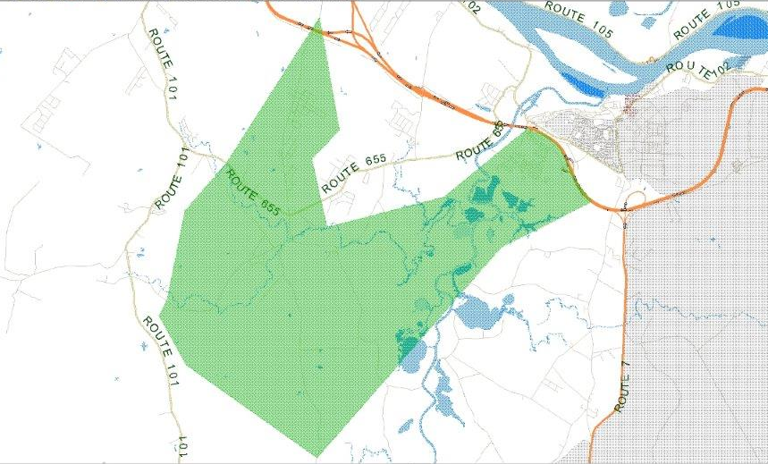
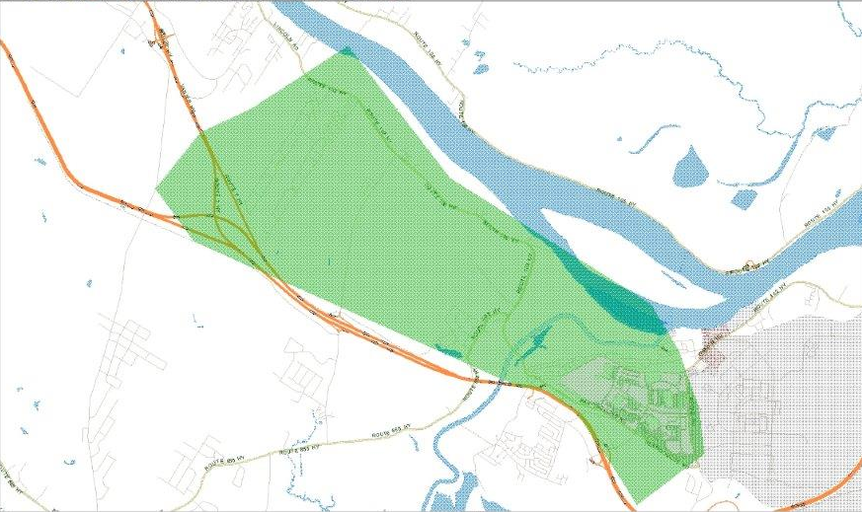
Scenario 3 (3 new K-8s) requires new school boundaries to be established, as the existing boundaries cannot be merged to evenly distribute the students in this scenario
Proposed Oromocto West K-8 School Boundary
  Proposed Oromocto West (K-8)
  The proposed Oromocto West school boundary would include the Wilsey Road (WR) area to the north of Route 655.
  It would include the Rusagonis (RUS) area between Route 101 to Jordan Street (JS), off Route 655.
  Additionally, the K-8 boundary would extend to the Sunbury West school boundary (SWS).
  The school boundary also includes Oromocto West up to the Trans-Canada Highway (TCH).
  Proposed Oromocto Central (K-8)
  The proposed Oromocto Central school boundary would include the grade 6-8 students of the Lincoln Elementary Community School (LECS).
  It would include the Richmond Estates (RE) (Dexter Crescent area) off Route 655.
  Additionally, the K-8 boundary would extend to the Broad Road (BR) in Oromocto (O), and would extend southward to the Trans-Canada Highway (TCH).
  The Saint John River (SJR) would be the northern boundary for this new school.
WR
OW
TCH
JS
RUS
SWS
Proposed Oromocto Central K-8 School Boundary
LECS
SJR
RE
TCH
O
BR
ASD-W school transportation software - Busplanner.
New Schools: 3 New K-8s (Scenario 3)

Slide 22
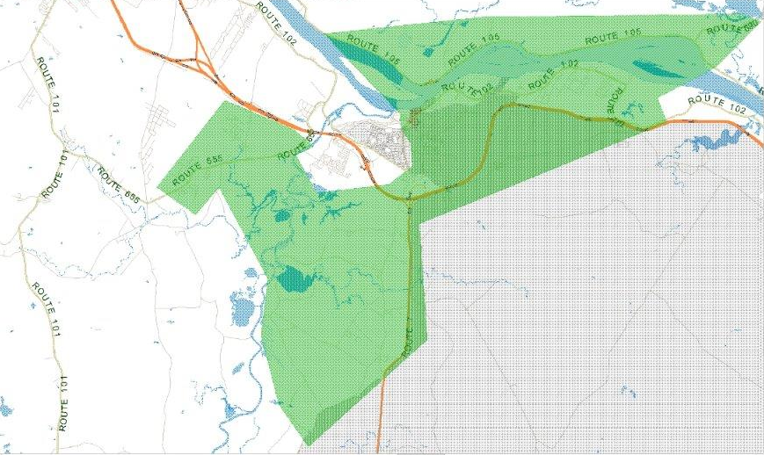
Scenario 3 (3 new K-8s) requires new school boundaries to be established, as the existing boundaries cannot be merged to evenly distribute the students in this scenario (continued)
  Proposed Burton-Geary (K-8)
  The proposed Burton-Geary school boundary would include the grade 6-8 students of the Geary Elementary Community School (GECS) boundary.
  It would include the area between Jordan Street (JS), off Route 655 to the Trans-Canada Highway (TCH).
  Additionally, it includes the 3-8 catchment area of the Burton Elementary School (BES) boundary, and this would extend to the Broad Road (BR) in Oromocto (O).
  The school boundary would include the area across the Saint John River (SJR), along Route 105 in Sheffield (SF).
Proposed Burton-Geary K-8 School Boundary
SF
SJR
BES
O
BR
TCH
JS
GECS
ASD-W school transportation software - Busplanner.
New Schools: 3 New K-8s (Scenario 3)

Slide 23
Class “D” estimate*: $79.8M to $82.8M would be required for the construction of 3 new K-8 schools, with a cost avoidance of $7.3M in deferred maintenance
  3 New K-8s School Scenario
  Class “D” estimate* for the 3 new schools is approximately $79.8M to $82.8M, depending on the cost of land and any topographical challenges.
  EECD Planning Guidelines recommend a site size of 26 acres each for the two larger K-8 schools (Note: in urban areas, site size may be reduced when land is at a premium and/or existing community field/facilities are used offsite).
  The cost avoidance for deferred maintenance at the 3 proposed amalgamated schools would be $7.3M, as identified in the EECD School Physical Plant Status Report.
  Based on the current EECD Planning Guidelines, the total school footprint would see an increase in net square metres of 7,659 m² for scenario 3.
*Note: Class "D" estimate (± 30%) based on the EECD Planning Guidelines for Educational Facilities, as an estimate for this report only. Estimates will be adjusted when EECD Infrastructure and project team establish the actual space allocation. EECD School Asset Data, School Physical Plant Status Report for Deferred Maintenance.
New Schools: 3 New K-8s (Scenario 3)

Slide 24
For scenario 3, the annual operational costs would increase by approximately $80K (excluding staffing), based on historical costs for schools of similar size and efficiency
  Operational Costs
  Scenario 3 closes 6 existing schools and amalgamates them into 3 new schools.
  Based on the current EECD Planning Guidelines and student enrolment projections, the total school footprint would see an increase in net square metres of 7,659 m².
  Annual operational costs (excluding staffing) would increase by approximately $80K for the new schools, based on schools of a similar size and efficiency.
  Busses already commute from the outside communities (Geary Elementary Community School, Burton Elementary School, Gagetown School and Lincoln Elementary) to the Oromocto area for the French Immersion Program. The District anticipates minimum changes in student transportation and associated costs due to the close proximity of the Oromocto schools.
Source: EECD School Asset Data and ASD-W file: Operating Costs for 2016.
New Schools: 3 New K-8s (Scenario 3)

Slide 25
Appendix F – Scenario 4 (School addition/mid-life upgrade of a middle school with 2 new K-5s)

Slide 26
Class “D” estimate*: $16.9M would be required for the mid-life upgrade of an amalgamated 6-8 middle school, which exceeds the 50% cost threshold for a new school
  Mid-Life Upgrade 6-8 with 2 New K-5s
  Class “D” estimate* for an amalgamation/mid-life upgrade of a 6-8 middle school (both are same size and design) is approximately $16.9M, with a risk of newly identified maintenance costs once renovations are implemented. A building assessment would be recommended to confirm renovation costs, if scenario is selected.
  This is approximately 68% of the estimated cost for a new 6-8 school. EECD planning “rule of thumb” in determining the tipping point between building a new school or renovating an existing school/new addition is when the cost of the deferred maintenance and a new addition exceeds 50% of the cost of a new building.
  Based on the current EECD Planning Guidelines, the total school footprint would see an increase in net square metres of 3,593 m² for scenario 4.
*Note: Class "D" estimate (± 30%) based on the EECD Planning Guidelines for Educational Facilities, as an estimate for this report only. Estimates will be adjusted when EECD Infrastructure and project team establish the actual space allocation. EECD School Asset Data, School Physical Plant Status Report for Deferred Maintenance.
Mid-Life Upgrade 6-8 and 2 new K-5s (Scenario 4)

Slide 27
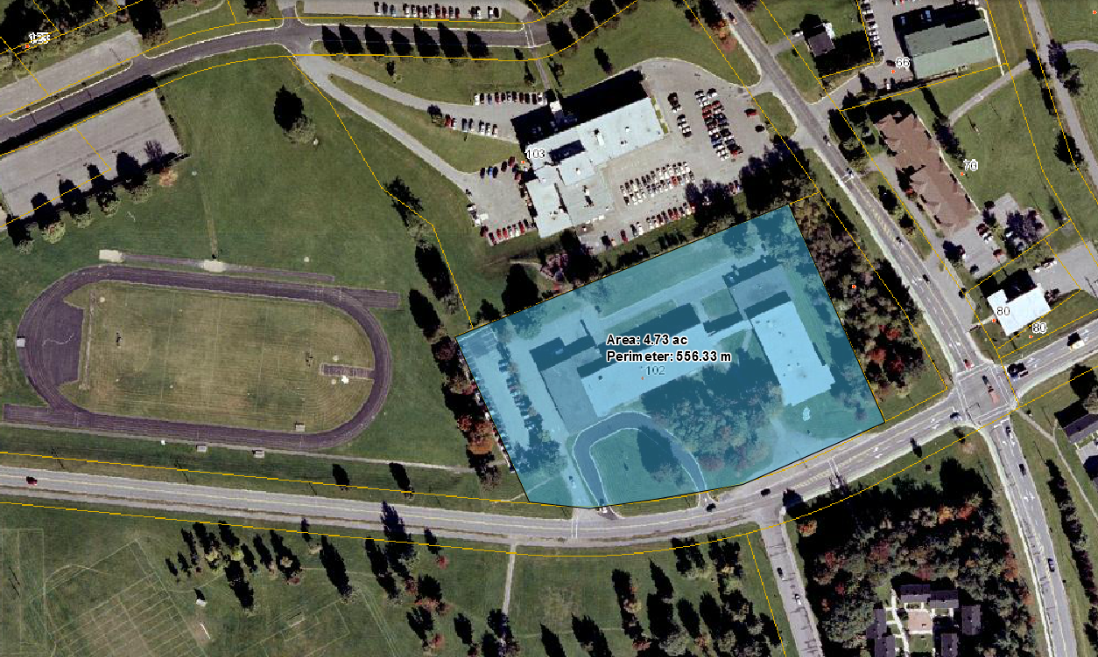
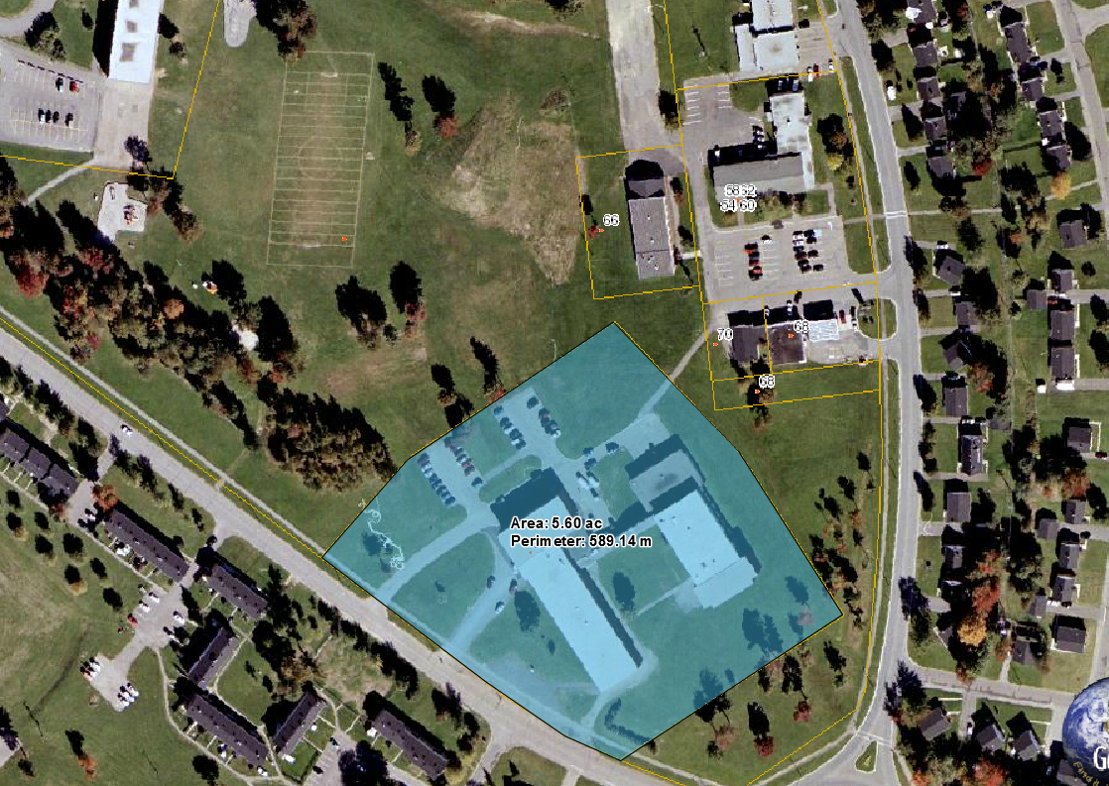
Both of the Oromocto middle school properties have limited to no space available for a school addition in an amalgamated 6-8 mid-life upgrade project
  Mid-Life Upgrade 6-8 with 2 New K-5s
  EECD Planning Guidelines recommend a site size of 26 acres for a 6-8 middle school of 759 students (2026-27). (Note: In urban areas, site size may be reduced when land is at a premium and/or existing community field/facilities are used offsite).
  Ridgeview Middle School property has 4.7 acres of land or 18% of the recommended site size.
  The Ridgeview property is located on the corner of Broad Road and Waasis Road, with Oromocto Public Hospital to the north and Oromocto Turf Field to the west.
  Harold Peterson Middle School property has 5.6 acres of land or 22% of the recommended site size.
  The Harold Peterson property is located on the corner of St. Lawrence Avenue and Miramichi Road, with commercial property and the Oromocto Community Centre to the north and the Gesner Splash Pad and a play field to the west.
  Both of the Oromocto middle school properties have limited to no space available for a school addition of 5,111 m2 (both schools are currently 5,508 m2) in a potential amalgamated 6-8 mid-life upgrade project.
Oromocto Public Hospital
Oromocto Turf Field
Ridgeview Middle School
Broad Road
Waasis Road
Oromocto High School
Gesner Street Elementary School
Play Field
Oromocto Community Centre
Gesner Splash Pad
Commercial Property
Miramichi Road
St. Lawrence Avenue
Harold Peterson Middle School
Rotary
Source: GeoNB Viewer: http://geonb.snb.ca/geonb/, site visit and EECD Planning Guidelines for Educational Facilities.
Mid-Life Upgrade 6-8 and 2 new K-5s (Scenario 4)

Slide 28
For scenario 4, the annual operational costs would increase by approximately $49K (excluding staffing), based on historical costs for schools of similar size and efficiency
  Operational Costs
  Scenario 4 closes 5 existing schools and amalgamates them into 2 new schools and 1 mid-life upgrade.
  Based on the current EECD Planning Guidelines and student enrolment projections, the total school footprint would see an increase in net square metres of 3,593 m².
  Annual operational costs (excluding staffing) would increase by approximately $49K for the new schools, based on schools of a similar size and efficiency.
  Busses already commute from the outside communities (Geary Elementary Community School, Burton Elementary School, Gagetown School and Lincoln Elementary) to the Oromocto area for the French Immersion Program. The District anticipates minimum changes in student transportation and associated costs due to the close proximity of the Oromocto schools.
Source: EECD School Asset Data and ASD-W file: Operating Costs for 2016.
Mid-Life Upgrade 6-8 and 2 new K-5s (Scenario 4)

Slide 29
Appendix G – Scenario 5 (Close the 6 existing schools and replace with a new K-2, 3-5 and 6-8)

Slide 30
Based on enrolment projection results, a new K-2 school for Oromocto would be sized for 590 students, and the 3-5 school sized for 627 students (depending on project start time)
Project start-up would depend on DEC and GNB approval
  New K-2, 3-5 and 6-8 Oromocto Schools
  Enrolment projections indicate an increase in K-5 student population during the 10-year planning horizon (as was seen in the 2016 Census data and for the entry point change of the EFI program).
  2027-28 was projected with the most students (590 for Assiniboine Avenue/Gesner Street and 627 for Hubbard Avenue/Summerhill Street) after the period of potential construction.
  The schools would be larger than a typically sized elementary school. The EECD Planning Guidelines note a regular elementary school is typically sized between 200 and 500 students.
  For comparison, based on 2016-17 school statistics, GNB had 6 K-2 and 4 grade 3-5 schools. 3 of the K-2 and 3 of the grade 3-5 schools were considered regular sized schools. The average student enrolment for these regular sized schools was 239 for K-2 and 264 for grade 3-5 schools.
  There were no K-2 or 3-5 schools whose enrolment exceeded 500 students in 2016-17. The largest of these school types were:
    Assiniboine Avenue Elementary K-2 (251)
    Hubbard Avenue Elementary 3-5 (298)
  As per scenario 1, a new 6-8 middle school would be sized to 759 students.
Project start-up would depend on DEC and GNB approval
Note: Statistics from the dissemination areas of the 2016 Census were mapped to the school boundaries and the ASD-W 2017-18 enrolment statistics to project the enrolment. It was assumed that both schools would have an EFI program.
The entry point for the EFI program was changed from grade 3 to grade 1 in 2017-18. The two additional grades of EFI will increase the number of students attending Oromocto schools from the surrounding rural schools.
Source: ASD-W: 2017-18 enrolment statistics, EECD Policy, Planning Summary Statistics, EECD Planning Guidelines for Educational Facilities, and Statistics Canada 2016 Census: http://www12.statcan.gc.ca/census-recensement/2016/as-sa/fogs-spg/desc/Facts-desc_Age.cfm?LANG=Eng&GK=CSD&GC=1301006&TOPIC=2&#fd1_1.
New Schools: K-2, 3-5 and 6-8 (Scenario 5)

Slide 31
Class “D” estimate*: $69.2M to $72.2M would be required for the construction of a new K-2, 3-5, and a 6-8 middle school, with a cost avoidance of $7.3M in deferred maintenance
  2 K-5 and a 6-8 School Scenario
  Class “D” estimate* for the 3 new schools is approximately $69.2M to $72.2M, depending on the cost of land and any topographical challenges.
  EECD Planning Guidelines recommend a site size of 24 acres each for the two elementary schools and 26 acres for the middle school (Note: in urban areas, site size may be reduced when land is at a premium and/or existing community field/facilities are used offsite).
  The cost avoidance for deferred maintenance at the 3 proposed amalgamated schools would be $7.3M, as identified in the EECD School Physical Plant Status Report.
  Based on the current EECD Planning Guidelines, the total school footprint would see an increase in net square metres of 1,726 m² for scenario 5.
*Note: Class "D" estimate (± 30%) based on the EECD Planning Guidelines for Educational Facilities, as an estimate for this report only. Estimates will be adjusted when EECD Infrastructure and project team establish the actual space allocation. EECD School Asset Data, School Physical Plant Status Report for Deferred Maintenance.
New Schools: K-2, 3-5 and 6-8 (Scenario 5)

Slide 32
For scenario 5, the annual operational costs would decrease by approximately $34K (excluding staffing), based on historical costs for schools of similar size and efficiency
  Operational Costs
  Scenario 5 closes 6 existing schools and amalgamates them into 3 new schools.
  Based on the current EECD Planning Guidelines and student enrolment projections, the total school footprint would see an increase in net square metres of 1,726 m².
  Annual operational costs (excluding staffing) would decrease by approximately $34K for the new schools, based on schools of a similar size and efficiency. There are no K-2 and 3-5 schools to this scale, therefore a K-5 elementary school was used for comparison.
  Busses already commute from the outside communities (Geary Elementary Community School, Burton Elementary School, Gagetown School and Lincoln Elementary) to the Oromocto area for the French Immersion Program. The District anticipates minimum changes in student transportation and associated costs due to the close proximity of the Oromocto schools.
Source: EECD School Asset Data and ASD-W file: Operating Costs for 2016.
New Schools: K-2, 3-5 and 6-8 (Scenario 5)

Slide 34
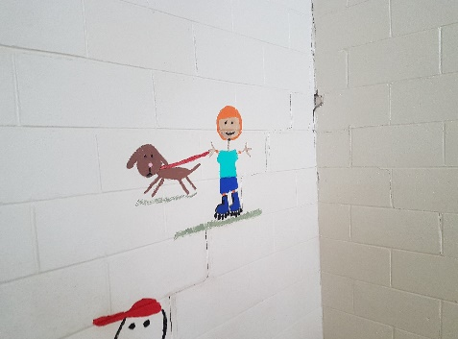
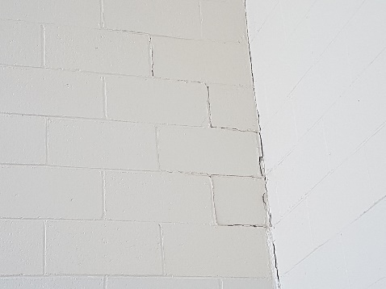
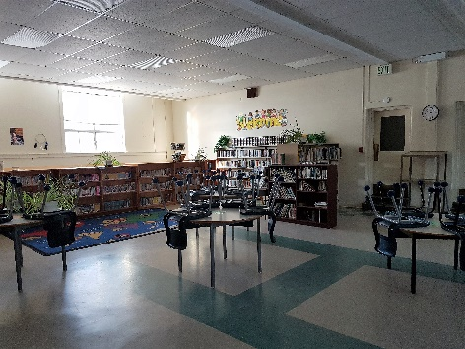
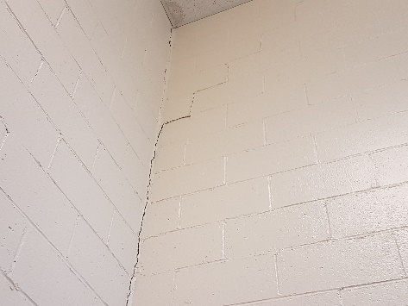
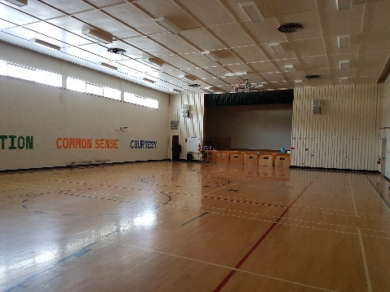
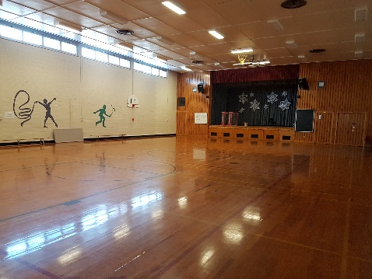
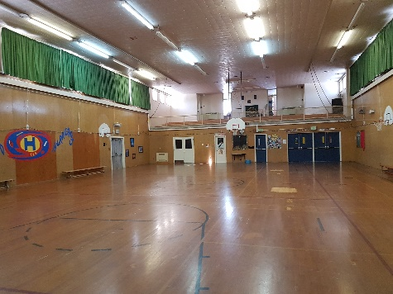
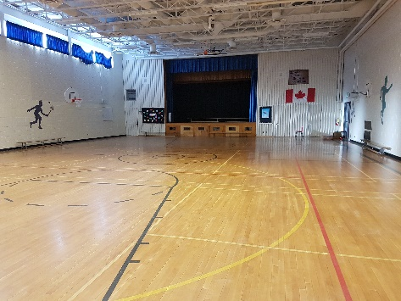
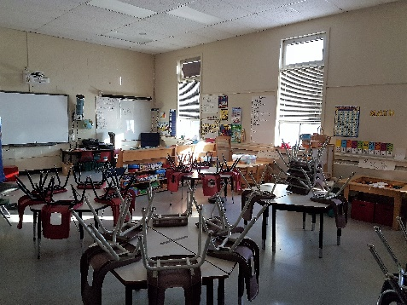
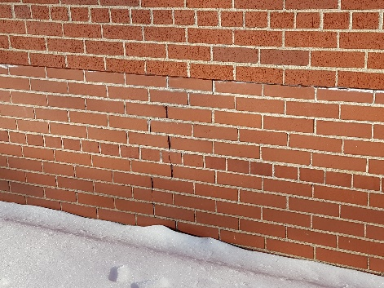
Context – Visual comparison of space types in the schools illustrates some of the pedagogical space compared to the EECD Planning Guidelines, and cracking in masonry (1 of 2)
Assiniboine Avenue Elementary
(K-2), built in 1957
Gesner Street Elementary
(K-2), built in 1959
Hubbard Avenue Elementary
(3-5), built in 1957
Summerhill Street Elementary
(3-5), built in 1959
Cracking In Stairwell Masonry
Cracking In Stairwell Masonry
Library
Guidelines: 139 m² (based on enrolment) / Actual 161 m²
Cracking In Stairwell
Masonry
Single Gymnasium (Elementary)
Guidelines: 380 m² / Actual 343 m²
Single Gymnasium (Elementary)
Guidelines: 380 m² / Actual 343 m²
Single Gymnasium (Elementary)
Guidelines: 380 m² / Actual 398 m²
Single Gymnasium (Elementary)
Guidelines: 380 m² / Actual 343 m²
  All of the schools had signs of potential differential settlement with cracking in the stairwell masonry. Masonry cracking was identified in previous building assessments, with report recommendations being tracked in a data base by ASD-W.
  The average sized classroom is smaller than EECD Planning Guidelines specify for kindergarten and regular sized for grades 1-5.
  The single gyms are undersized compared to the EECD Planning Guidelines by approximately 40 m².
  Accessibility has not been identified as an issue on the deferred maintenance list for these schools.
General Classroom
Guidelines: 90 m² for K / 70 m² for G1-5
Actual Average 69 m²
Cracking in Brick Exterior Wall
Source: ASD-W school site visits, EECD school drawings, EECD Planning Guidelines for Educational Facilities and ASD-W District Projects List.

Slide 35
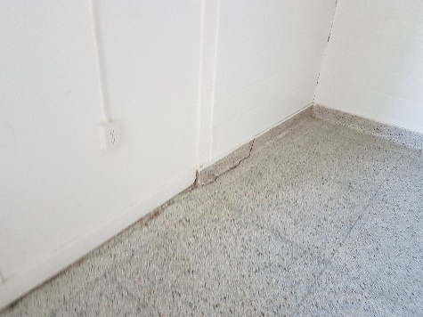
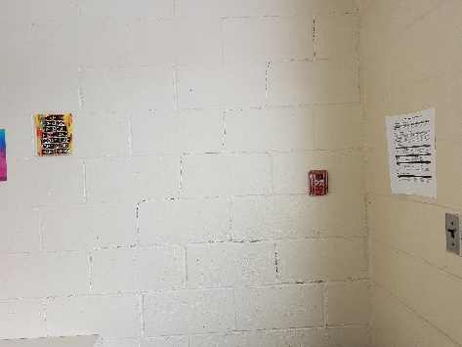
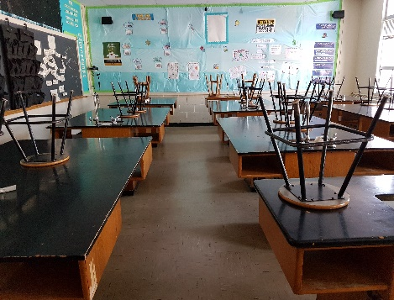
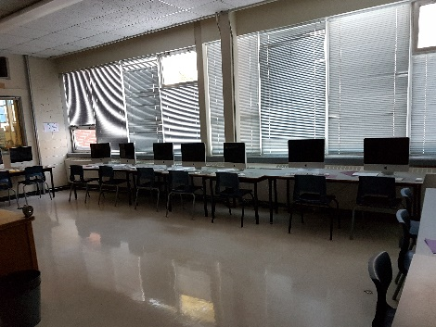
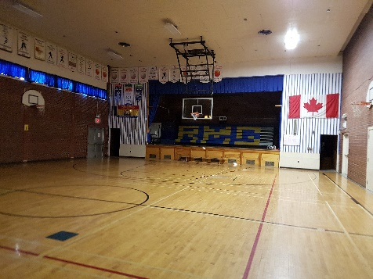
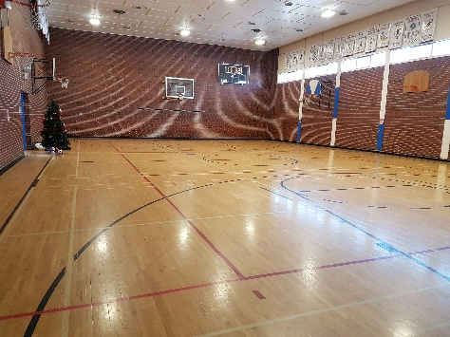
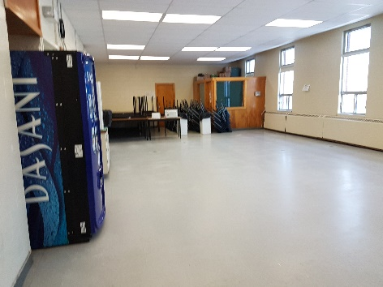
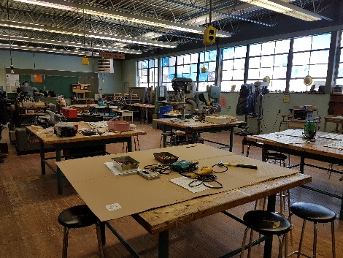
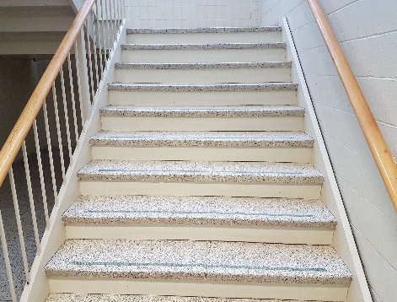
Context – Visual comparison of space types in the schools illustrates some of the pedagogical space compared to the EECD Planning Guidelines, and cracking in masonry (2 of 2)
Ridgeview Middle School
(6-8), built in 1958
Harold Peterson Middle School
(6-8), built in 1958
Harold Peterson (continued)
(6-8), built in 1958
Ridgeview (continued)
(6-8), built in 1958
Cracking In Stairwell Masonry
and Floor
Cracking In Stairwell
Masonry
General Science Lab
Guidelines: 130 m² / Actual 70 m²
Middle School Technology Education
Guidelines: 250 m² / Actual 146 m² #1
Single Gymnasium (Middle School)
Guidelines: 591 m² / Actual 380 m²
Single Gymnasium (Middle School)
Guidelines: 591 m² / Actual 380 m²
Cafeteria (Based on Enrolment)
Guidelines: 257 m² / Actual 191 m²
Middle School Technology Education
Guidelines: 250 m² / Actual 181 m² #2
Classroom Picture (Not Ridgeview Middle – Used for Illustrative Purposes)
Cracking in Stair Tredway
  Both of the schools had signs of potential differential settlement with cracking in the stairwell masonry. Masonry cracking was identified in previous building assessments, with report recommendations being tracked in a data base by ASD-W.
  The average sized classroom, gymnasium, science lab and cafeteria are smaller than the EECD Planning Guidelines specify for middle schools (closer to elementary school specifications).
  The Middle School Technology Education (including wood shops) has more space than the current Guidelines.
  Accessibility has not been identified as an issue on the deferred maintenance list for either school.
General Classroom
Guidelines: 81 m² / Average 67 m²
Source: ASD-W school site visits, EECD school drawings, EECD Planning Guidelines for Educational Facilities and ASD-W District Projects List.

Slide 36
Scenario 1 – Capital costs are estimated between $73.4 M* and $76.4 M* (for 2 new K-5s and 1 new 6-8 school); all schools are projected to exceed EECD recommended sizing
Main Street
The new 6-8 exceeds the middle school sizing specification of 300–700 students, and both K-5 schools significantly exceed the recommended elementary sizing of 200–500 students.
There are some comparable K-5 schools that have more than 500 students enrolled including: École Champlain (631), Gibson-Neill Memorial Elementary (615), École Sainte-Thérèse (601), École Anna-Malenfant (578), and Priestman Street Elementary (534).
There are some comparable 6-8 schools that have more than 700 students enrolled including: École Carrefour de l'Acadie (752), and George Street Middle School (727).
The District’s annual operational costs in scenario 1 are estimated to remain approximately the same (excluding staffing), based on the historical costs for schools of similar size and efficiency. Due to the close proximity of the Oromocto schools, minimum changes in student transportation and associated costs are anticipated.
*Note: Class "D" estimate (± 30%) based on the EECD Planning Guidelines for Educational Facilities, as an estimate for this report only. Estimates will be adjusted when EECD Infrastructure and the project team establish the actual space allocation.

Slide 37
Scenario 2 – Capital costs are estimated between $64.5 M* and $66.5 M* (for 2 new K-8 schools); both schools are projected to exceed EECD recommended sizing
Main Street
The new K-8 schools significantly exceed the recommended mixed school sizing specification of 300–650 students.
There are no comparable K-8 schools that have more than 900 students enrolled. The largest K-8 schools include: Evergreen Park (780), Northrop Frye School (765), and Forest Hills School (671). The first two schools are planned to reduce their enrolment once a new middle school has been built in Moncton.
The District’s annual operational costs in scenario 2 are estimated to decrease by approximately $21 k (excluding staffing), based on the historical costs for the two newest K-8 schools in ASD-W. Due to the close proximity of the Oromocto schools, minimum changes in student transportation and associated costs are anticipated.
For this scenario, adjustments are required to the existing school boundaries to limit the amount of students having to switch between schools. (e.g. EFI students from Geary School attend Assiniboine Avenue, and cross over to attend Harold Peterson Middle School).
*Note: Class "D" estimate (± 30%) based on the EECD Planning Guidelines for Educational Facilities, as an estimate for this report only. Estimates will be adjusted when EECD Infrastructure and the project team establish the actual space allocation.

Slide 38
Scenario 3a – Capital costs are estimated between $79.8 M* and $82.8 M* (for 3 new K-8 schools); two schools are projected to exceed EECD recommended sizing
Main Street
Two of new K-8 schools exceed the recommended mixed school sizing specification of 300–650 students.
There are some comparable K-8 schools that have more than 650 students enrolled. The largest K-8 schools include: Evergreen Park (780), Northrop Frye School (765), and Forest Hills School (671). The first two schools are planned to reduce their enrolment once a new middle school has been built in Moncton.
The District’s annual operational costs in scenario 3 are estimated to increase by approximately $80 k (excluding staffing), based on the historical costs for the two newest K-8 schools in ASD-W. Due to the close proximity of the Oromocto schools, minimum changes in student transportation and associated costs are anticipated.
Scenario 3 requires new school boundaries to be established, as the existing boundaries cannot be merged to evenly distribute the students. There is potential that another school boundary iteration could be performed to try to redistribute the students further.
*Note: Class "D" estimate (± 30%) based on the EECD Planning Guidelines for Educational Facilities, as an estimate for this report only. Estimates will be adjusted when EECD Infrastructure and the project team establish the actual space allocation.

Slide 39
Scenario 3b – Burton Elementary School could be included in scenario 3a for an additional $0.8 M; 60% of these capital costs would be offset by cost avoidance for deferred capital
Main Street
Although Burton Elementary School (K-2) was not included within the original scope, this school could be amalgamated into Scenario 3’s new K-8 school for Burton – Geary. The proposed new school includes the same grade configurations as Burton Elementary, and the Burton Elementary catchment area is included within this new school boundary.
The amalgamation would require 2 more additional classrooms, and it would increase the cost of the new school by 3% ($0.8 M).
The annual operational cost increase (excluding staffing) would be approximately $13 k less than it would be if Burton Elementary School were excluded from the scenario.
There would be an additional $0.5 M in cost avoidance for the deferred maintenance at Burton Elementary School, which would offset approximately 60% of the increased capital costs to include this school in the scenario.
In this proposed scenario, all Burton catchment area students would only have to attend one school between K-8.
*Note: Class "D" estimate (± 30%) based on the EECD Planning Guidelines for Educational Facilities, as an estimate for this report only. Estimates will be adjusted when EECD Infrastructure and the project team establish the actual space allocation.

Slide 40
Scenario 4 – Capital costs are estimated between $65.3 M* and $67.3 M* (2 new K-5 schools and an addition); it exceeds recommended sizing, and the cost threshold for additions
Main Street
The amalgamated 6-8 school exceeds the middle school sizing specification of 300–700 students, and both K-5 schools significantly exceed the recommended elementary sizing of 200–500 students.
There are some comparable K-5 schools that have more than 500 students enrolled including: École Champlain (631), Gibson-Neill Memorial Elementary (615), École Sainte-Thérèse (601), École Anna-Malenfant (578), and Priestman Street Elementary (534).
There are some comparable 6-8 schools that have more than 700 students enrolled including: École Carrefour de l'Acadie (752), and George Street Middle School (727).
An addition for an amalgamated 6-8 middle school is projected to exceed the cost threshold of 50% of a new 6-8 building based on EECD Planning Guidelines. Additionally, there is limited to no space available for a school addition at the Oromocto Middle Schools. Both schools are of the same vintage, design and size (5,508 m²) and the result would be similar at either school.
*Note: Class "D" estimate (± 30%) based on the EECD Planning Guidelines for Educational Facilities, as an estimate for this report only. Estimates will be adjusted when EECD Infrastructure and the project team establish the actual space allocation.

Slide 41
Scenario 5 – Capital costs are estimated between $69.2 M* and $72.2 M* (a new K-2, new 3-5 and new 6-8 school); all three schools are projected to exceed recommended sizing
The new 6-8 exceeds the middle school sizing specification of 300–700 students, and both elementary schools significantly exceed the recommended elementary sizing of 200–500 students. There are some comparable 6-8 schools that have more than 700 students enrolled including: École Carrefour de l'Acadie (752), and George Street Middle School (727).
There are no comparable K-2/3-5 schools that have more than 500 students enrolled. There are 6 K-2 schools with Assiniboine Avenue Elementary being the largest, and 4 grade 3-5 schools with Hubbard Avenue being the largest.
K-2/3-5 schools compact the students into highly utilized schools because all of the classrooms in a K-2 have a maximum class size limit of 21 students. In order to lower the utilization, additional classrooms would be required in the design of these schools.
The District’s annual operational costs are estimated to decrease by approximately $34 k (excluding staffing), based on schools of similar size and efficiency. Due to the close proximity of the Oromocto schools, minimum changes in transportation costs are anticipated.
*Note: Class "D" estimate (± 30%) based on the EECD Planning Guidelines for Educational Facilities, as an estimate for this report only. Estimates will be adjusted when EECD Infrastructure and the project team establish the actual space allocation.

Slide 42
Some existing District space will need to be relocated in all of the scenarios, and the District/District Education Council will need to consider the best implementation approach
Additional considerations for all the scenarios:
The following groups would potentially need to find space in all the new school scenarios, as they would not be included in the EECD Planning Guidelines. This would include space for the District Maintenance Shop at Ridgeview Middle School, the District Information Technology Shop at Harold Peterson Middle School, and some of the district office space in the existing schools.
Additional planning discussions would be required for implementation (all done together or a phased approach). For example, most of the scenarios amalgamate schools into a consolidated school. This provides the option of doing a staggered implementation of the plan over several years. On the other hand, Scenario 3 requires the school boundaries to be redrawn which affects all six existing schools. Yet doing a phased implementation plan could still be considered. However, this could make the school operations temporarily less efficient as a portion of the students might have to be moved to other schools while awaiting for the completion of the phased school construction.

Slide 43
EY | Assurance | Tax | Transactions | Advisory
About EY
EY is a global leader in assurance, tax, transaction and advisory services. The insights and quality services we deliver help build trust and confidence in the capital markets and in economies the world over. We develop outstanding leaders who team to deliver on our promises to all of our stakeholders. In so doing, we play a critical role in building a better working world for our people, for our clients and for our communities.
EY refers to the global organization, and may refer to one or more, of the member firms of Ernst & Young Global Limited, each of which is a separate legal entity. Ernst & Young Global Limited, a UK company limited by guarantee, does not provide services to clients.
For more information about our organization, please visit ey.com.
© 2018 Ernst & Young LLP. All Rights Reserved.
A member firm of Ernst & Young Global Limited.
This publication contains information in summary form, current as of the date of publication, and is intended for general guidance only. It should not be regarded as comprehensive or a substitute for professional advice. Before taking any particular course of action, contact Ernst & Young or another professional advisor to discuss these matters in the context of your particular circumstances. We accept no responsibility for any loss or damage occasioned by your reliance on information contained in this publication.
ey.com/ca/private

