Slide 1
ASD-W’S NEW Mission, Vision and Values
August 2023
Notes:
Welcome everyone!

Slide 2
Time for change
Notes:
ASD-W engaged in a consultative process to update our mission, vision and values in the Spring of 2023. They were lasted updated in 2015.

Slide 3
Why now?
It was time to re-evaluate our organizational positioning to reflect better our evolving educational values, operational strategies, and district goals and ensure that we are poised to respond successfully to our current challenges and opportunities and those of the future.
Notes:
With the national and provincial educational landscapes undergoing so many changes over the past few years, most notably due to the impact of Covid, the leadership team saw an opportunity to re-evaluate our organizational positioning to reflect better our evolving educational values, operational strategies, and district goals and ensure that we were poised to respond successfully to current challenges and opportunities and those of the future.

Slide 4
Benefits
Ensure the aspirations for the district are defined, agreed, and documented.
Provide a shared purpose and common goals – a checklist for school leaders and educators against which decisions, initiatives and future actions are measured.
Help us reflect on our core educational values, improvement plans, operational objectives, public purpose, and hoped-for results for students.
Unite our school community and create long-term connections and trust.
Notes:
Some may challenge whether mission, vision and value statements are worth the effort or if they will affect positive change in the school system. However, if done well, there are several benefits that can mobilize us and drive us forward toward the pursuit of more positive goals and outcomes.
Mission Vision and Value Statements:
Ensure the aspirations for the district are defined, agreed, and documented.
Provide a shared purpose and common goals – a checklist for school leaders and educators against which decisions, initiatives and future actions are measured.
Help us reflect on our core educational values, improvement plans, operational objectives, public purpose, and hoped-for results for students.
Unite our school community and create long-term connections and trust.

Slide 5
Process
Notes:
In order to define our new mission, vision and values, we needed to understand how ASD-W is currently perceived by those who interact with it and within it daily and their long-term hopes for the future.

Slide 6
Process
Committee FORMED
Survey SHARED
Data COLLECTED
Analysis
Statements DEVELOPED
Review
Launch
Notes:
A committee was formed, comprised of a small group of senior leaders appointed by the Superintendent and two District Education Council Members. Information-gathering began with a survey shared electronically (by website, email and social media). The committee collected and reviewed the data and narrowed it down to identify common themes. The work then began to draft the new mission, vision and values statements that represented the collective input gathered. The statements were then reviewed and refined, and we are now able to share them with you and our other stakeholder groups.

Slide 7
Survey
Notes:
Information gathering was the first major step toward our new positioning statements and in began with a survey shared electronically (by website, email and social media).

Slide 8
Survey Details
Open for 2 weeks
54,067 contacted
Notes:
The survey launched on May 11 and remained open for two weeks. It was directly sent to 54,067 stakeholders and shared through social media, our website and word of mouth.

Slide 9
Key Stakeholder Groups
Staff (Union and non-union)
District Education Council (DEC)
Parent School Support Committees (PSSCs)
First Nations Education Directors
Parents
Students (Utilizing the Council of Student Leaders)
Notes:
Our key stakeholder groups included:
Staff (Union and non-union)
District Education Council (DEC)
Parent School Support Committees (PSSCs)
First Nations Education Directors
Parents
Students (Utilizing the Council of Student Leaders)

Slide 10
Survey Stats
3,944 Respondents
73.07% WERE PARENTS/GUARDIANS
61.99% HAD CHILDREN IN K-5
17.06% WERE EMPLOYEES
86.49% EMPLOYEES WERE SCHOOL-BASED TEACHING STAFF
Notes:
When the survey closed on May 26, we had collected 3,944 responses.
Of the total respondents, 73.07% were parents or guardians and of the group 61.99% had children in elementary school.
17.06% of the respondents were employees, of which 86.49% were school-based teaching staff from the NBTF and CUPE 2745, comprising of school administrators, EAs, library workers, school administrative assistants, etc.
Student respondents numbered 4.99%, and Community members numbered less than 2%
Based on Survey Monkey’s formula for respondents needed, we received 58.3% more respondents than required for an appropriate sample size.

Slide 11
Results
Notes:
The results were clear and showed us that there were several themes across the data.

Slide 12
Top 5 Attributes
Friendly
Professional
INCLUSIVE
COMMUNITY-BASED
LEARNING-FOCUSED
Notes:
The first question in the survey, regarding attributes, asked respondents to select the words they would use to describe ASD-W.
Out of 27 word choices and an “Other” box to submit additional words, here are the top 5 attributes used to describe ASD-W:
Friendly
Professional
Inclusive
Community-based
Learning-focused
In a comparison between the Parents/Guardians group and Employee group, Friendly and Professional were both selected in the top 5 attributes.

Slide 13
COMPARISON OF TOP 5 THINGS ASD-W DOES:
VERY WELL | SOMEWHAT WELL | NOT WELL
Safety | High-quality curriculum | Future Readiness
Communication | Communication | Recruitment
Transportation | Technology | Maintenance
Equity / Diversity /Inclusion | Experiential Learning | Regional programming
Health and well-being | Health and well-being | Health and well-being
Notes:
The next survey question asked respondents to rank how well ASD-W did on 19 various responsibilities from selecting either very well, somewhat well, not well, or I don't know. The following is the top 5 from each category.
Refer to slide.
In the comparison between the Parent/Guardian group and the Employee group we learned the following:
What ASD-W does very well: both groups had the same 4 out of 5 areas identified in their top 5 – Safety, Communication, Inclusivity, and Transportation.
What ASD-W does somewhat well: both groups had the same 2 out of 5 areas identified in the top 5 – Curriculum and Technology.
What ASD-W does not do well: both groups had the same 3 out of 5 areas identified in the top 5 – Future readiness, Well-maintained Schools, and Recruitment.

Slide 14
Top 10 Future Focus Areas
High-quality curriculum
Physical health and mental well-being
Future readiness
Physical safety
Experiential or "hands-on" learning
A friendly, positive environment
Well-maintained school and district buildings
Ongoing communication
Inclusive environments
Technology to enhance working and learning
Notes:
The third question in the survey asked respondents to select, from a list of choices, what they believed to be the most important focus areas regarding the future of ASD-W. There were 19 options to choose from with an “Other” section to submit additional thoughts.
There were 196 comments in the "Other" section, including suggestions regarding Black history, STEM, HEPA filters, more training, better food choices, and more discipline. The theme of LGBTQ2S+ inclusivity and Policy 713 dominated.
The top 10 future focus areas are as follows: Refer to slide.
In a comparison between Parents/Guardians and the Employee group, both groups had the same 4 out of 5 areas identified in their top five – Curriculum, Well-being, Future Readiness and Safety.

Slide 15
ASD-W’s most important purpose
“Education, Learning” 81%
“Prepare, Future” 61.72%
“Safety” 38.59%
“Health” 13.4%
“Inclusion” 10.51%
* Based on key word themes
Notes:
The final question in the survey asked respondents to identify ASD-W's most important purpose in one sentence.
2,581 respondents replied.
Keywords were identified within the responses and then themed.
This is a list of the 5 themes that emerged: Refer to slide.
Parents/Guardians and Employees were not too dissimilar in their responses.

Slide 16
Development
Notes:
Taking into the consideration the themes in the data, the committee set to drafting the words that would make up our new mission, vision, and values in a way that carefully reflected the collective input gathered.
Knowing that the input gathered was based on the experiences, opinions, and perceptions of our current environment and culture, the committee’s objective when drafting the mission, vision, and values was to bridge the gap between our stakeholders' perceptions and the reality of our organization's current and future capabilities.

Slide 17
Mission Statement Defined
A Mission Statement:
Is an organization's public declaration of what they do and why.
It is action-oriented and illustrated by the present state and current capabilities.
Notes:
When drafting our statements, we used the following definitions: Refer to slide

Slide 18
Vision Statement Defined
A Vision Statement:
Is an organization's public declaration of what they strive to achieve.
It is illustrated by long-term aspirations and desired future outcomes.
Notes:
Refer to slide

Slide 19
Values Defined
Values:
Are an organization's public declaration of the core principles guiding its work.
Are fundamental to shaping organizational culture and fulfilling mission and vision statements.
Notes:
Refer to slide

Slide 20
New Mission
Notes:
And after a series of writing and refining we established the following statements to represent our districts new mission, vision, and values.

Slide 21
Notes:
Our new mission is:
To nurture learning in a healthy, safe, inclusive environment so students thrive and become confident, contributing community members.

Slide 22
Why these words?
This statement:
Is tightly focused.
Is directly aligned with the top five most important purposes of ASD-W: Education, Future Readiness, Safety, Heath, and Inclusivity.
Supports our mission statement definition by clearly outlining what we do and why.
States the actions we believe are needed to achieve our vision.
Notes:
Refer to slide

Slide 23
New Vision
Notes:
Our new vision statement is…

Slide 24
Notes:
Each student is a successful learner who makes positive contributions to our world.

Slide 25
Why these words?
This statement:
Is optimistic – encouraging one to consider the possibilities that academic achievement and good citizenship can bring to our world.
Is directly aligned with our mission statement and therefore can be achieved if we successfully fulfill our mission.
Supports our definition of a vision statement by clearly stating our hoped-for future reality.
Is clear and easy to understand.
Notes:
Refer to slide

Slide 26
New Values
Notes:
And our new values are as follows…

Slide 27
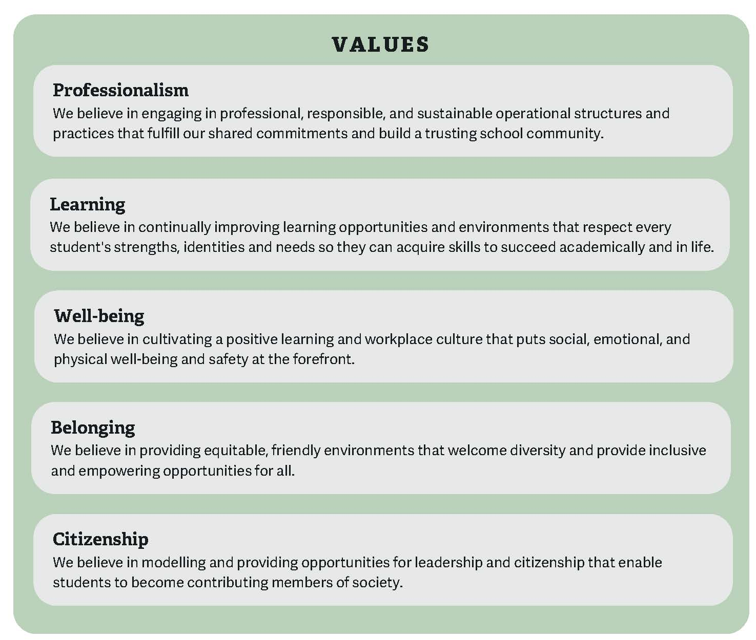
Notes:
Refer to slide.

Slide 28
Why these values?
The values identified are what we are required to have if we are going to respond to the needs of our key stakeholders.
For example: If there is a need for system competency, effective communication, well-maintained buildings, efficient transportation, career growth, sustainability, etc., we need to value Professionalism.
Notes:
Refer to slide

Slide 29
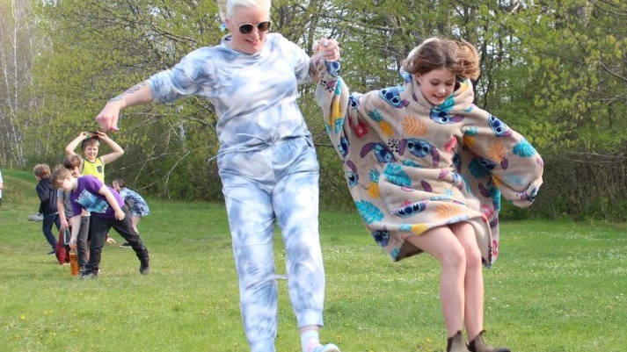
Next Steps
Notes:
The draft mission, vision and values were shared with the ASD-W administrators in late August at our annual meeting. Today we are sharing them publicly. In the coming days, communications will be sent our school community and the new statements will be posted on our website.
Follow-up sessions with individual schools, departments and groups can be planned throughout the fall to facilitate deeper integration of the new positioning and ensure we are aligned district-wide. These sessions would aim to take teams through ways to incorporate the new mission, vision and values into their daily work and encourage connection, mobilization and alignment.
Thank you!

