Slide 1
District Education Council: Science Presentation
Presented by:
Jon Hoyt-Hallett – Subject Coordinator
Peter Trusiak – Science Lead K-12
Jeremy Smith – Science Lead K-12

Slide 2
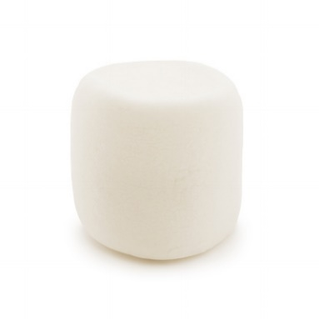
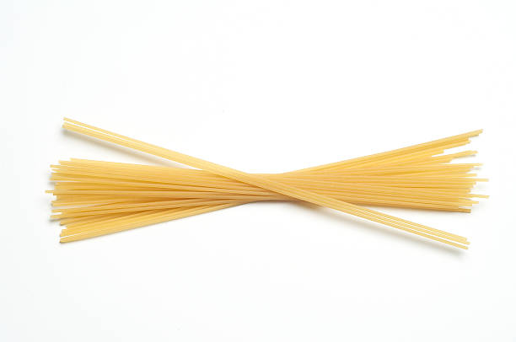
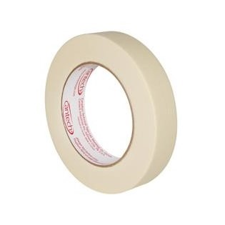
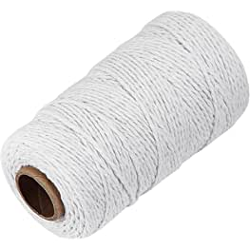
Your Task:
Build the highest free-standing spaghetti tower that holds one marshmallow!
You will be given:
20 sticks of spaghetti
1 metre of tape
1 metre of string
1 jumbo marshmallow

Slide 3
New Science Curriculum Gr 3-10 and the Modernized Curriculum Framework
Overall summary - a focus on skills-based learning outcomes and big ideas in science

Slide 4
High School Renewal - Science
Updated curriculum in Human Physiology 11, Biology 11/12 and Physics 11/12
Science 10 is no longer a mandatory graduation course
Additional courses in the Sciences
Agriculture 110
Forestry 110
New courses being created

Slide 5
NB Science WEEk
Over 25 community partners
Presenting over 70 sessions
NB Teachers have registered for over 3500 sessions
ASDW teachers - ~1200

Slide 6
Canada-Wide Science Fair

