Slide 1
Wabanaki People:
Historical and Contemporary Contributions
by
David Perley

Slide 2
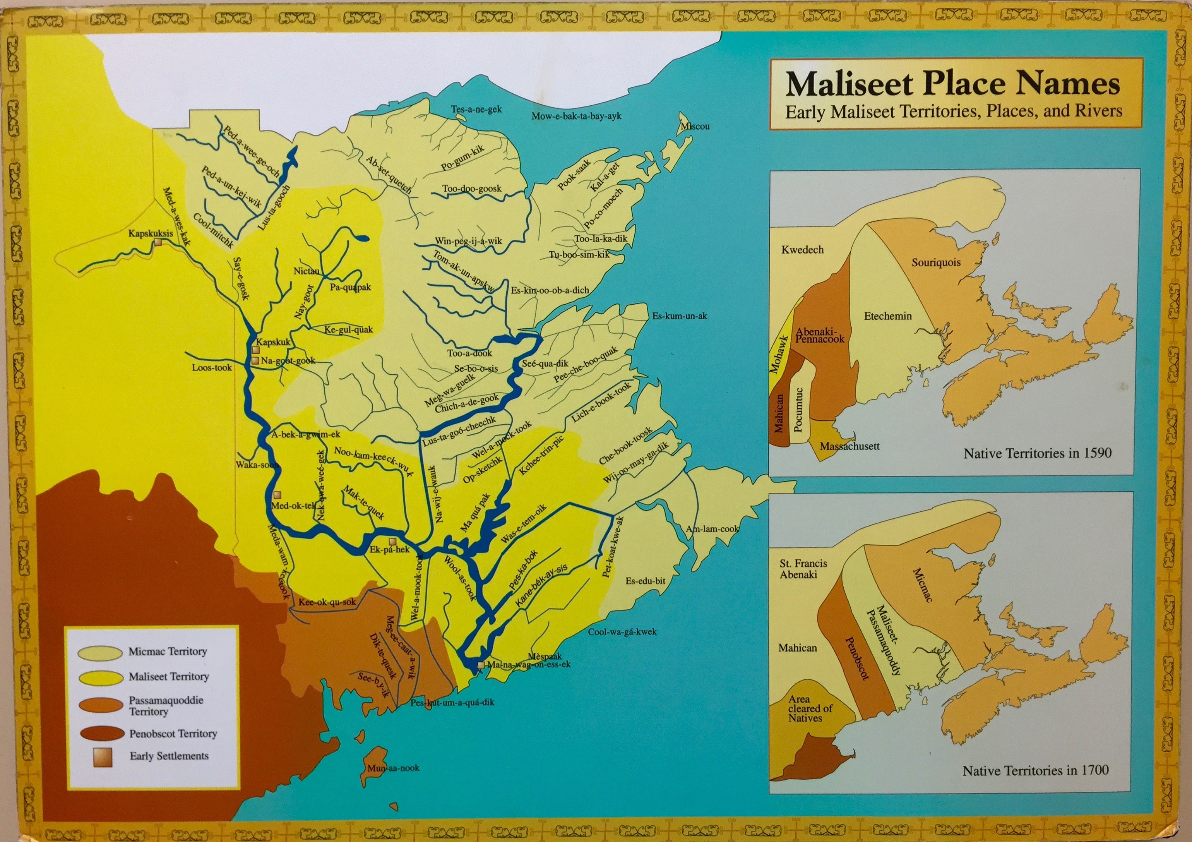
Historical Contributions
Sustained and enhanced the fur trade established within Wabanaki homeland
Early explorers adopted Wabanaki mode of transportation which allowed European settlers to continue exploration of Wabanaki territory

Slide 3
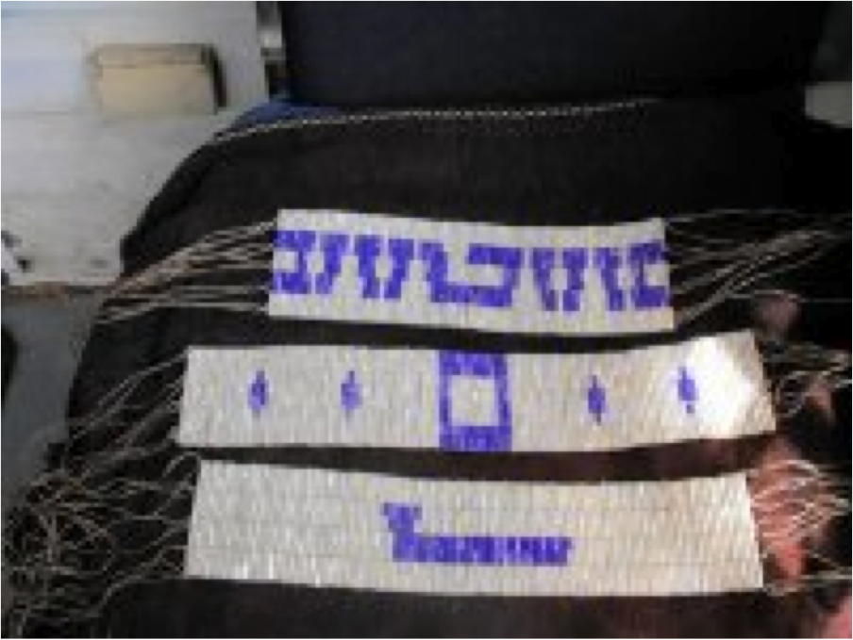
Historical Contributions
Knowledge of land and skills required for survival within Wabanaki country
Knowledge of medicines was shared with early settlers
Wabanaki land for French/English settlements

Slide 4
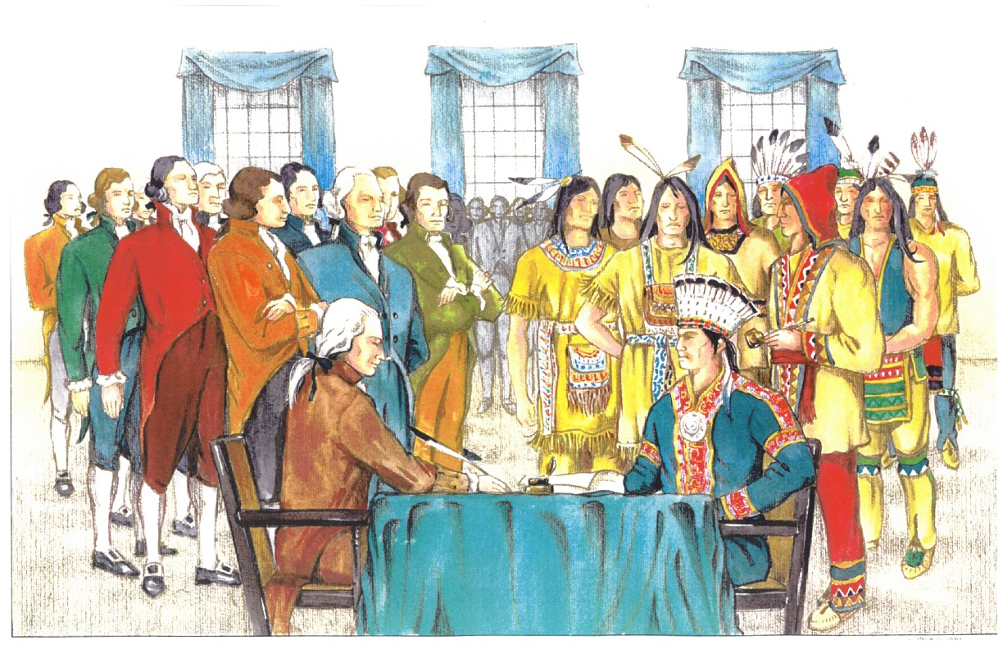
Historical Contributions
Wabanaki Confederacy provided a model of democratic government
Provided labor for different economic activities of early settlers

Slide 5
Contemporary Contributions
All federal funds flowing into Wabanaki communities are expended in non-Native communities. Wabanaki citizens make major contributions to local and provincial economies which also depend on Wabanaki consumers for economic growth
1.6 Billion Dollars Strong: this is the amount Wabanaki people contribute towards the Atlantic economy (as of 2017)

Slide 6
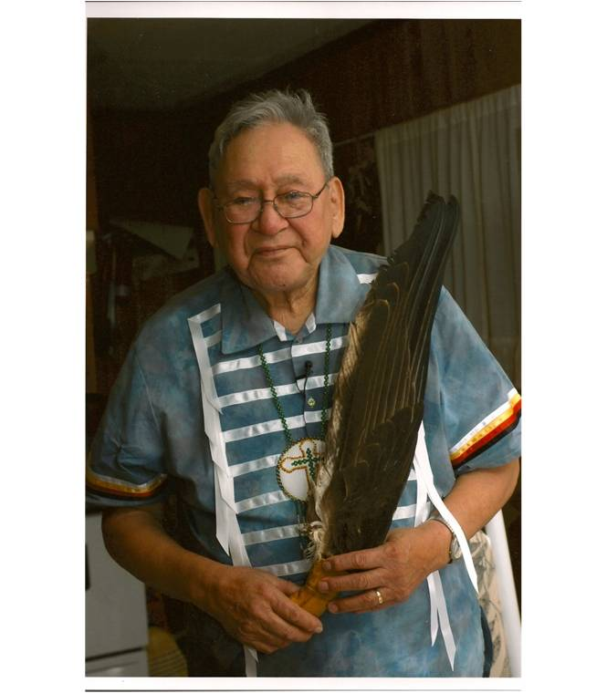
Contemporary Contributions
First Nation veterans
“It is estimated that as many as 12,000 First Nation, Metis and Inuit people served in the great wars of the 20th century” (Veteran Affairs Canada). We honour their dedication and sacrifice as well as their record of wartime accomplishments.

Slide 7
Wabanaki Contributions
Understanding Canada’s Indigenous historical and contemporary contributions leads learners toward a mutually respectful relationship with Indigenous people. The sharing and teachings of Indigenous contributions in Canada is essential to the reconciliation process.
(Taken from empoweringthespirit.ca)

