Slide 1
Treaty-Making Period Protecting Our Rights
By
David Perley

Slide 2
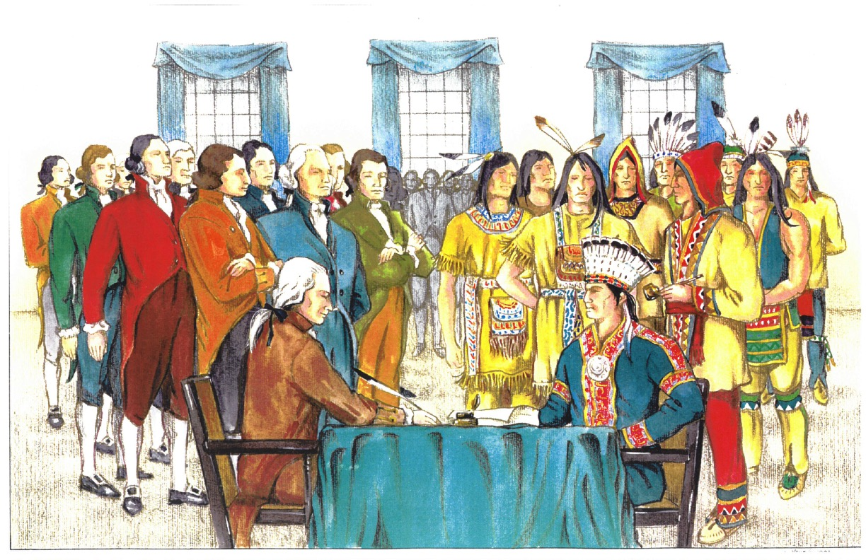
Treaty-Making Period (1674 – 1794)

Slide 3
Treaty-Making Period (1675 – 1794)
Aboriginal Rights: Rights of Aboriginal people arising from their use and occupation of a territory
Aboriginal Title: An Aboriginal people’s right to ownership of their territory
Inherent Rights: Rights specific to you because of your ancestry; rights that are not given to you by an external government
Treaty Rights: Rights explicitly affirmed in a treaty such as the Peace and Friendship Treaties

Slide 4
Treaty-Making Period (1675 – 1794)
Peace and Friendship Treaties were entered into by Wabanaki Nations and the British Crown
These treaties did not transfer ownership of lands to the British Crown
Intent of treaties: Coexistence, peace, harmony, friendship, mutual respect and recognizing the institutions of each

Slide 5
Treaty-Making Period (1675 – 1794)
Wolastoqi and Mi’kmaq ancestors viewed these treaties as sacred and lasted “as long as the sun and moon endure”
Covenant Chain of Treaties
Wolastoqi and Mi’kmaq ancestors believed that each treaty represents an addition to the Wabanaki family

Slide 6
Treaty-Making Period (1675 – 1794)
“We are directed by the government to tell you that the English have no design to take your country or any of your lands from you: or to deprive you of any of your just Rights or Privileges”
(November, 1720, English Treaty Commissioners). p. 26

Slide 7
Treaty-Making Period (1675 – 1794)
Rights recognized by Peace and Friendship Treaties:
Land rights
Hunting, fishing, and fowling
Harvesting rights
Self-government
Economic development
Religious freedom
Social support
Treaties were protecting a way of life

Slide 8
Treaty Relationship in NB
We Are All Treaty People!

